Slide 1
Click Alt & Enter to view this notebook on full screen.

Slide 2
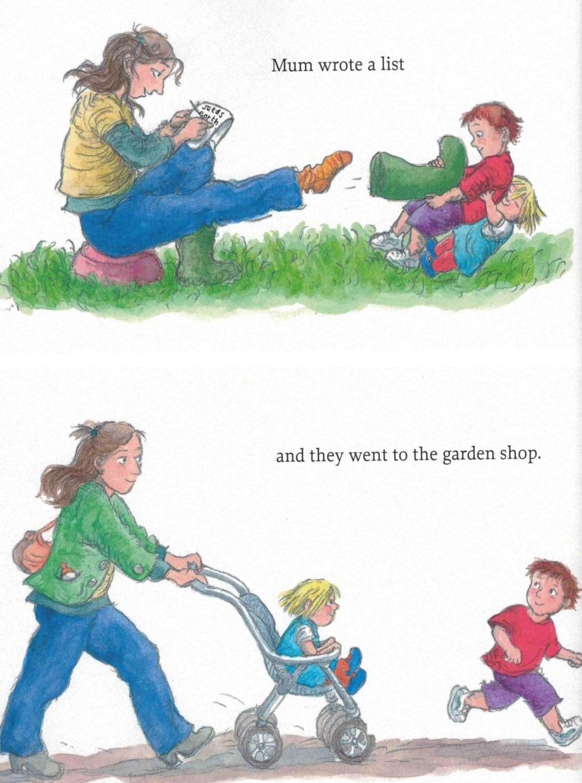
Click Alt & Enter to view this notebook on full screen.

Slide 3
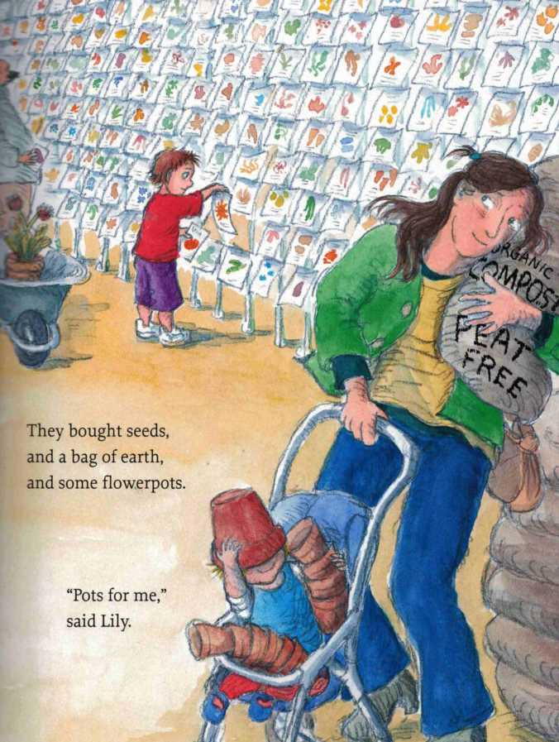
Click Alt & Enter to view this notebook on full screen.

Slide 4
Click Alt & Enter to view this notebook on full screen.

Slide 5
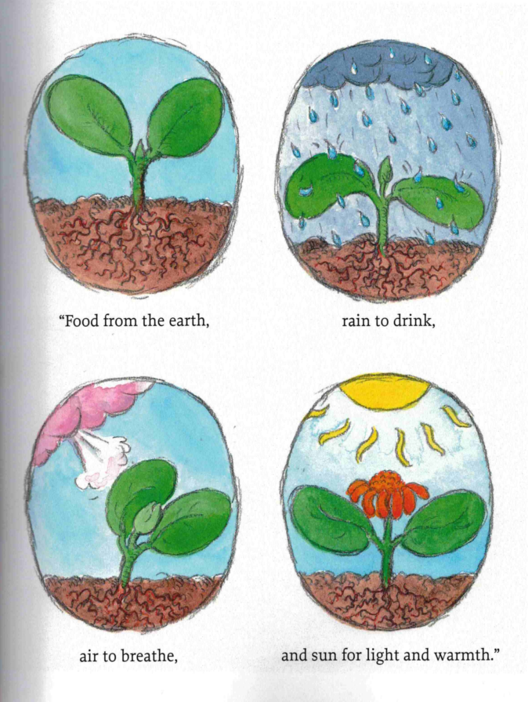
Click Alt & Enter to view this notebook on full screen.

Slide 6
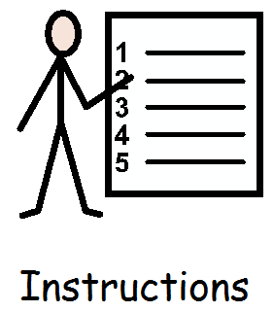
Wednesday 21st April
LI: To know the features of instructions.
Click Alt & Enter to view this notebook on full screen.

Slide 7
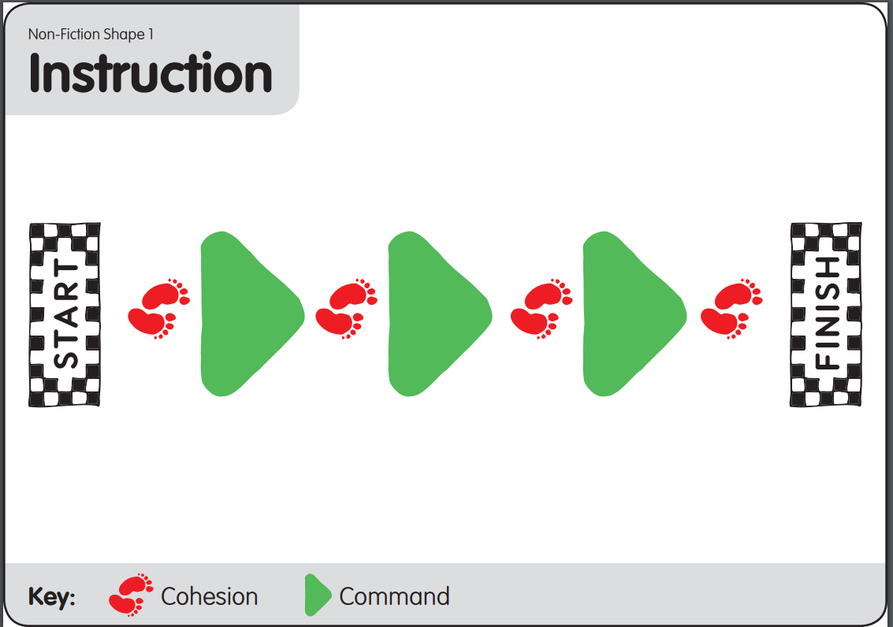
Wednesday 21st April
LI: To know the features of instructions.
Click Alt & Enter to view this notebook on full screen.
Here is the shape for writing instructions.
What do you notice?

Slide 8
Wednesday 21st April
LI: To know the features of instructions.
Click Alt & Enter to view this notebook on full screen.
Here is the shape for writing instructions.
Let's begin at the start.
We need a title.
We will use a 'How to' title, like Eddie.
Can you think of a better word for 'Things'?
Go to write your title neatly and clearly in your book.

Slide 9
Wednesday 21st April
LI: To know the features of instructions.
Click Alt & Enter to view this notebook on full screen.
Here is the shape for writing instructions.
Now we're going to introduce our instructions. This is called an introduction.
Initiate
We are going to hook our reader in by asking a question.
Would you like to...?
Do you know how to..?
Have you ever wanted to...?
Let's think of good questions.
Enable
Go to write your your question neatly and clearly in your book.

Slide 10
Wednesday 21st April
LI: To know the features of instructions.
Click Alt & Enter to view this notebook on full screen.
Here is the shape for writing instructions.
Now we're going to tell our reader what they will need. We will use a 'You will need list...'
Initiate
What do you think we will need?
Jot your ideas on a white board, sounding out words carefully.
Enable
Look at the next page to see how to set out a list

Slide 11
Click Alt & Enter to view this notebook on full screen.
Wednesday 21st April
LI: To know the features of instructions.
Time to write your You will need list.
You will need:
Model
Year 2 extension
Can you write a list as an interesting sentence. e.g. "Make sure you have a pot, soil and seeds ready. You will also need water and sunshine.

