Slide 1
Lesson 1: Buttons
Save a copy
Key Stage 1 – Moving a robot
Notes:
Last updated: 01-07-20
This resource is available online at ncce.io/pg1a-1-s. Resources are updated regularly — please check that you are using the latest version.
This resource is licensed under the Open Government Licence, version 3. For more information on this licence, see ncce.io/ogl.

Slide 2
Lesson 1: Buttons
Objectives
To explain what a given command will do
I can predict the outcome of a command on a device
I can match a command to an outcome
I can run a command on a device
Making Links
Remember, we are learning about writing instructions in English.
This term, we are going to be learning how to code computer instructions (algorithms) to tell robots what to do.

Slide 3
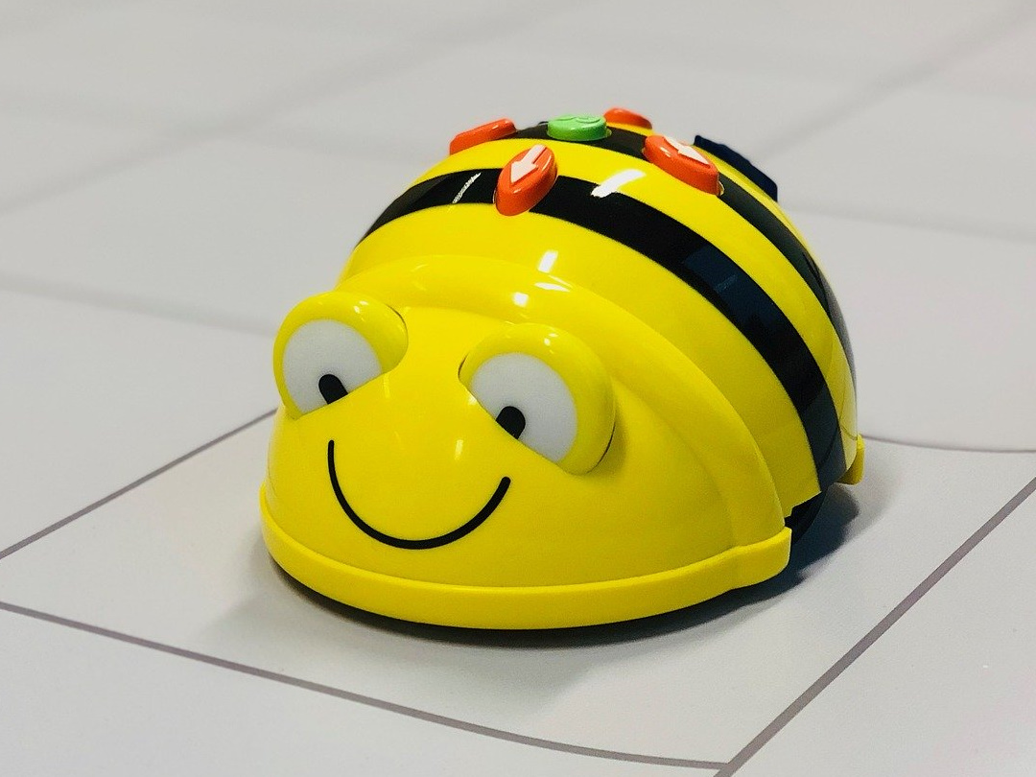
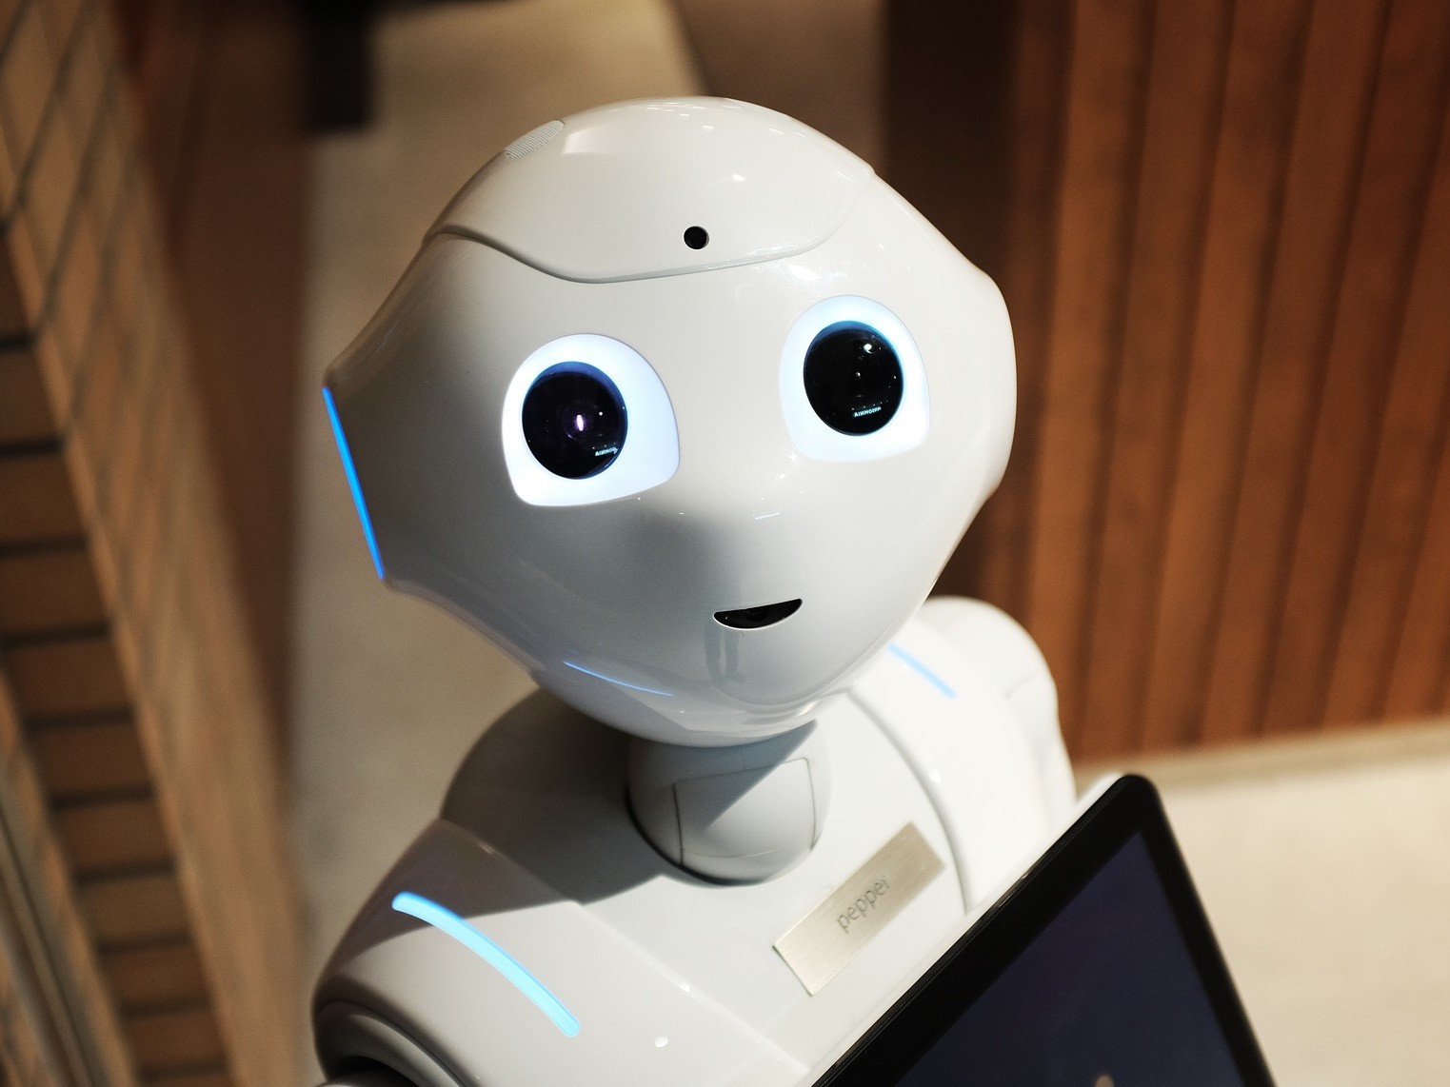
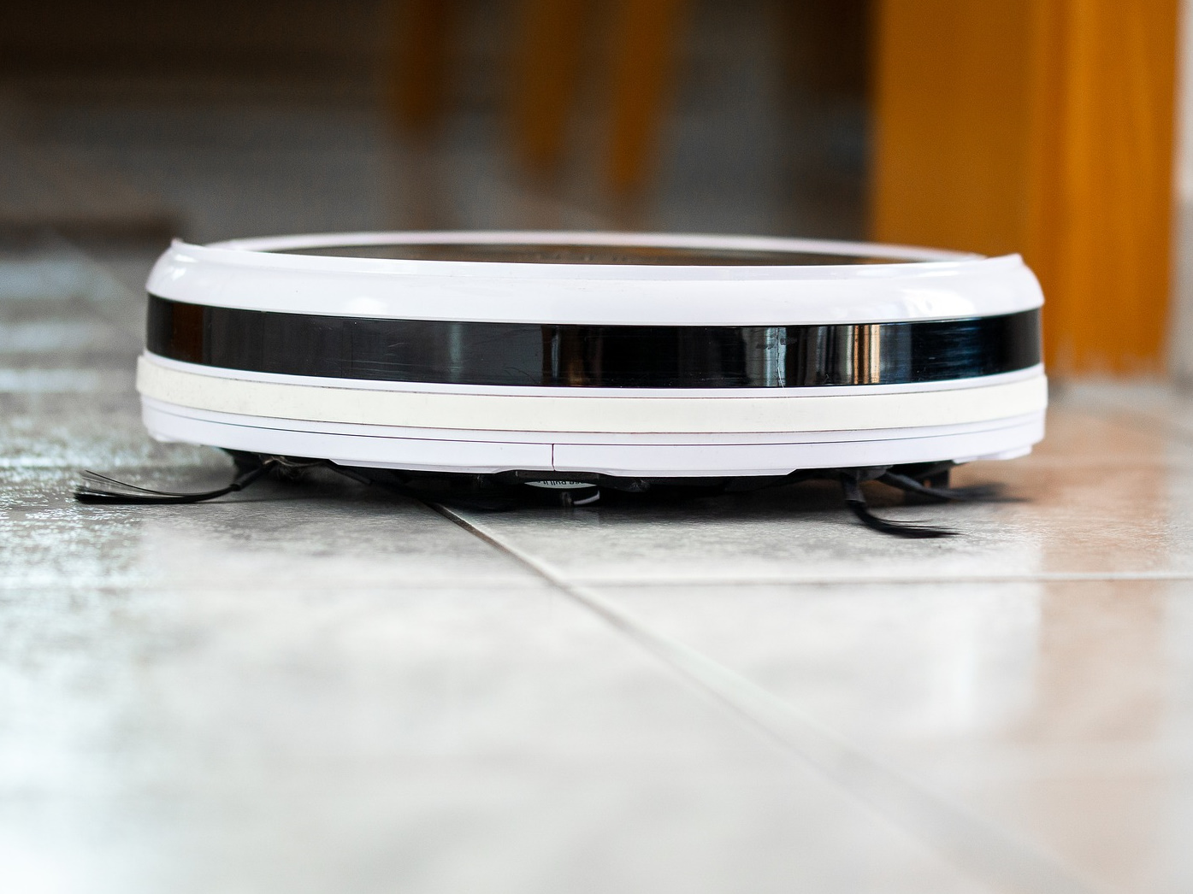
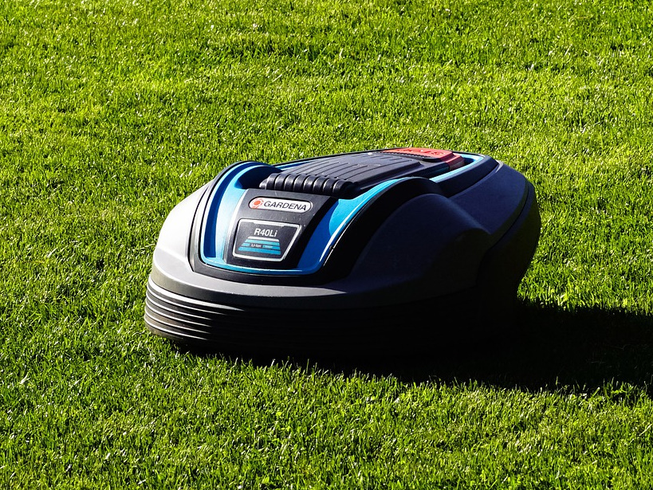
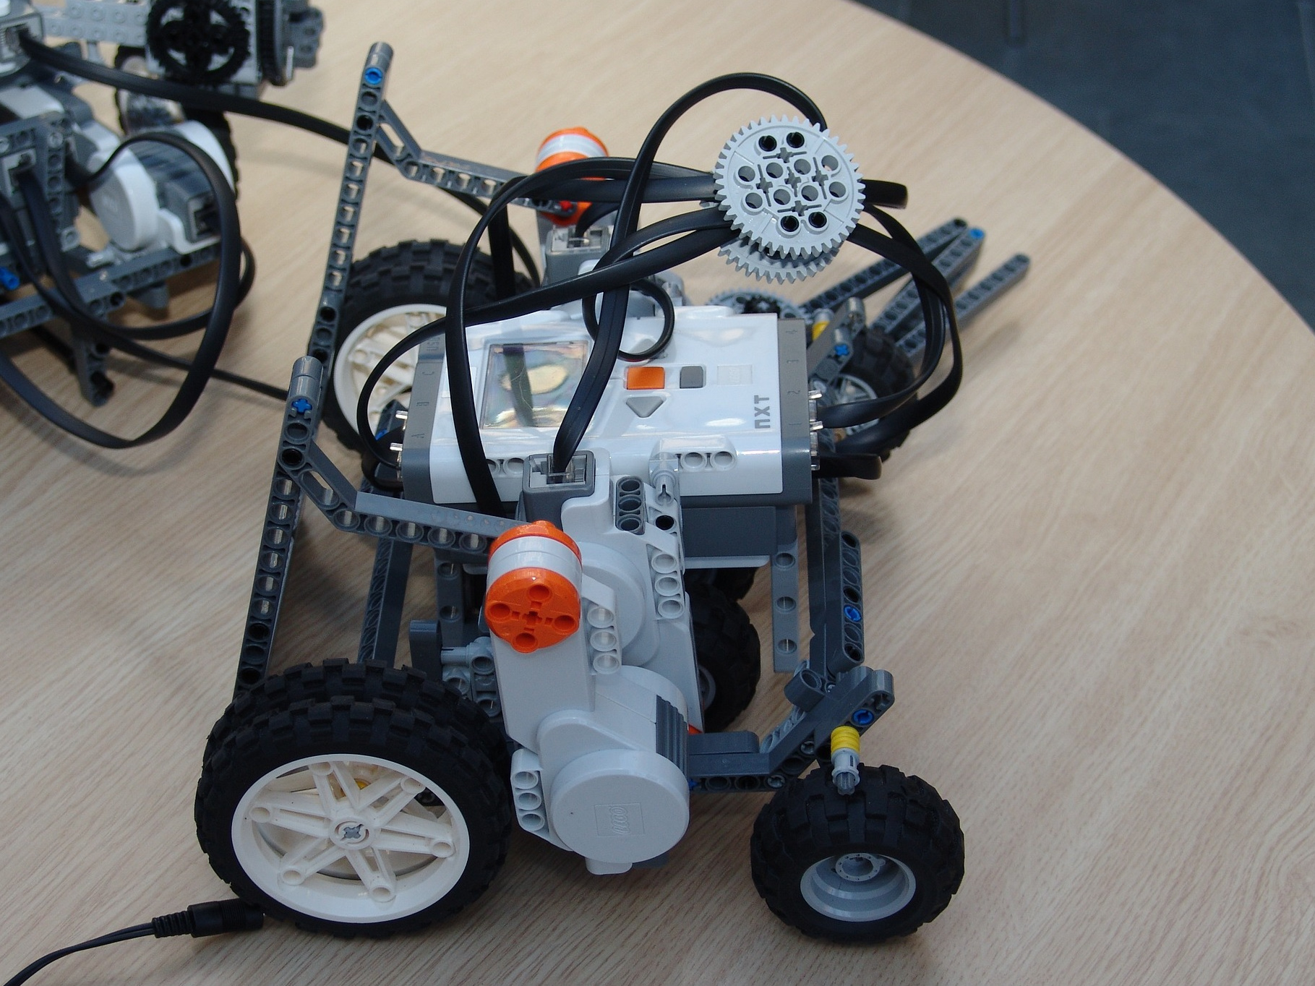
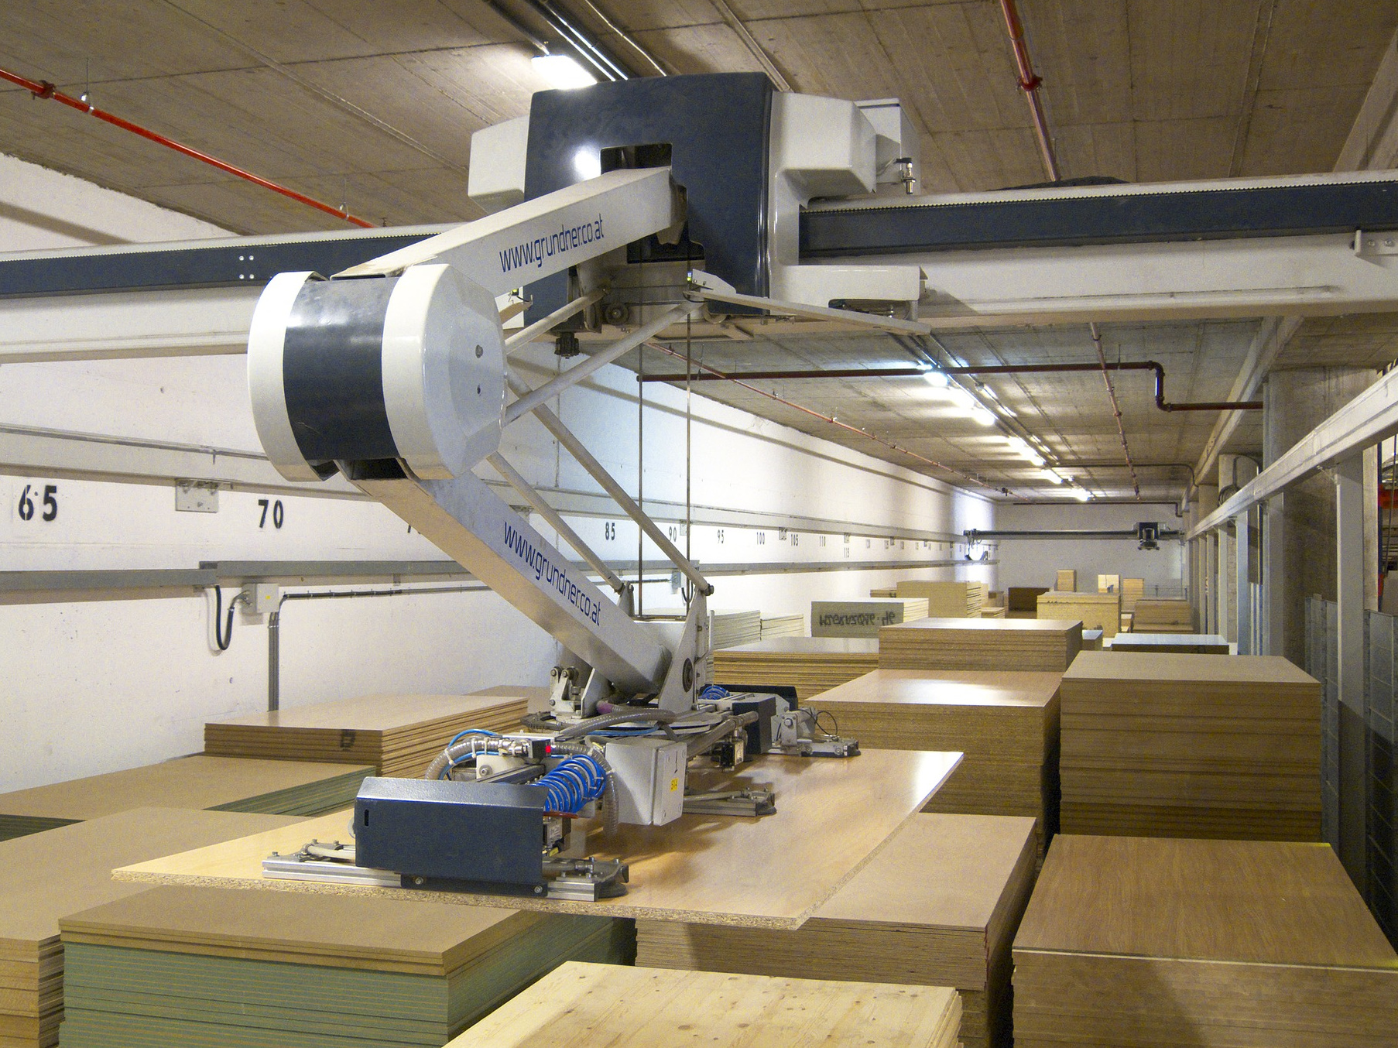
These are all robots
Introduction
What do we use robots for? Why do robots do what they do?
Notes:
Brief think, pair, share. We use robots to help us eg clean, mow. We use robots to help in factories. We use robots to help us learn.
We tell / program them to job a task.
Images L to R. Row 1 - Bee-Bot®️ (Educational floor robot), Pepper (Social robot), Robot vacuum cleaner. Row 2 - Robot lawn mower, Lego NXT robot, Warehouse robot moving sheets of wood
https://pixabay.com/photos/lawn-mower-battery-mower-4502093/
https://pixabay.com/photos/mars-rover-robot-exhibit-space-2095270/
https://pixabay.com/photos/beebot-bee-robot-technology-4096410/
https://pixabay.com/photos/robot-warehouse-wood-2363400/
https://pixabay.com/photos/robot-technology-programming-675902/
https://pixabay.com/photos/vacuum-cleaner-robot-budget-4827253/

Slide 4
Let’s get organised
Introduction
Half the class are going to be working on the computers, half will work on the BeeBots.
Then we will swap over groups.
If anyone doesn’t get the chance to use the BeeBot today, they will get the chance next week.

Slide 5
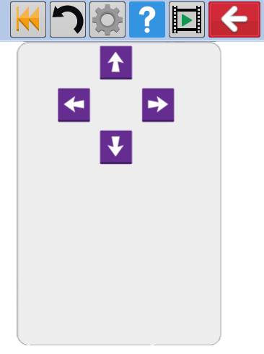
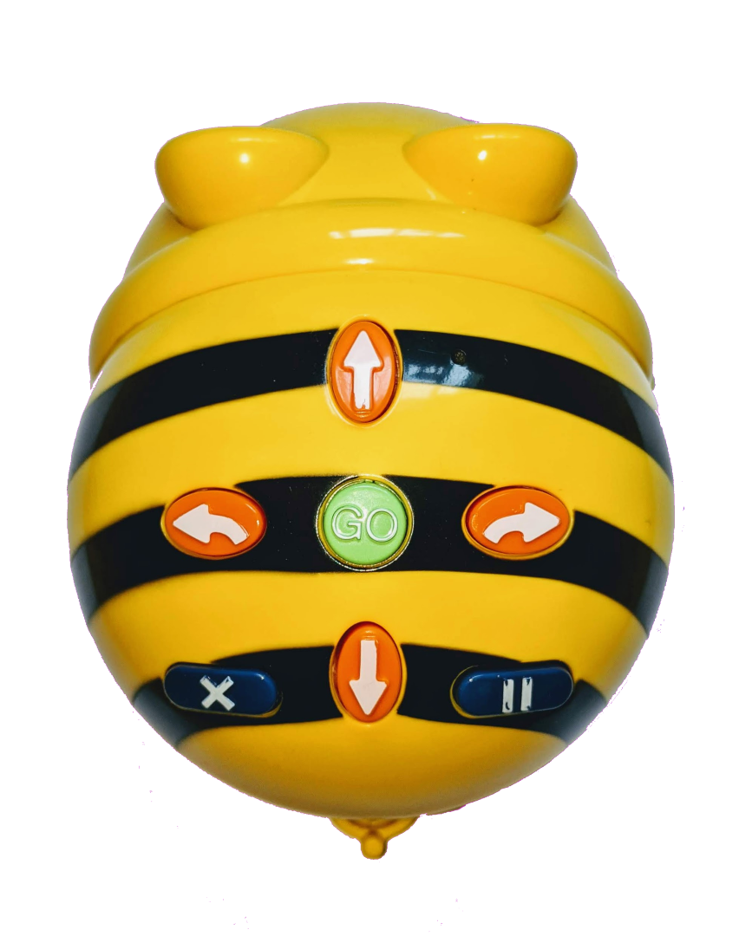
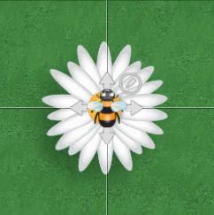
Your robots – Beebot and Purple Mash
Activity 1
Your robots have buttons on the top.
What do you think they do?
Notes:
https://pixabay.com/illustrations/search-to-find-internet-1013911/

Slide 6
Your robots
Activity 1
Before you press any buttons, talk to your partner about what you think they do.
Purple Mash Partners:
Speak to the partner at the workstation next to your’s.
Notes:
https://pixabay.com/illustrations/search-to-find-internet-1013911/

Slide 7
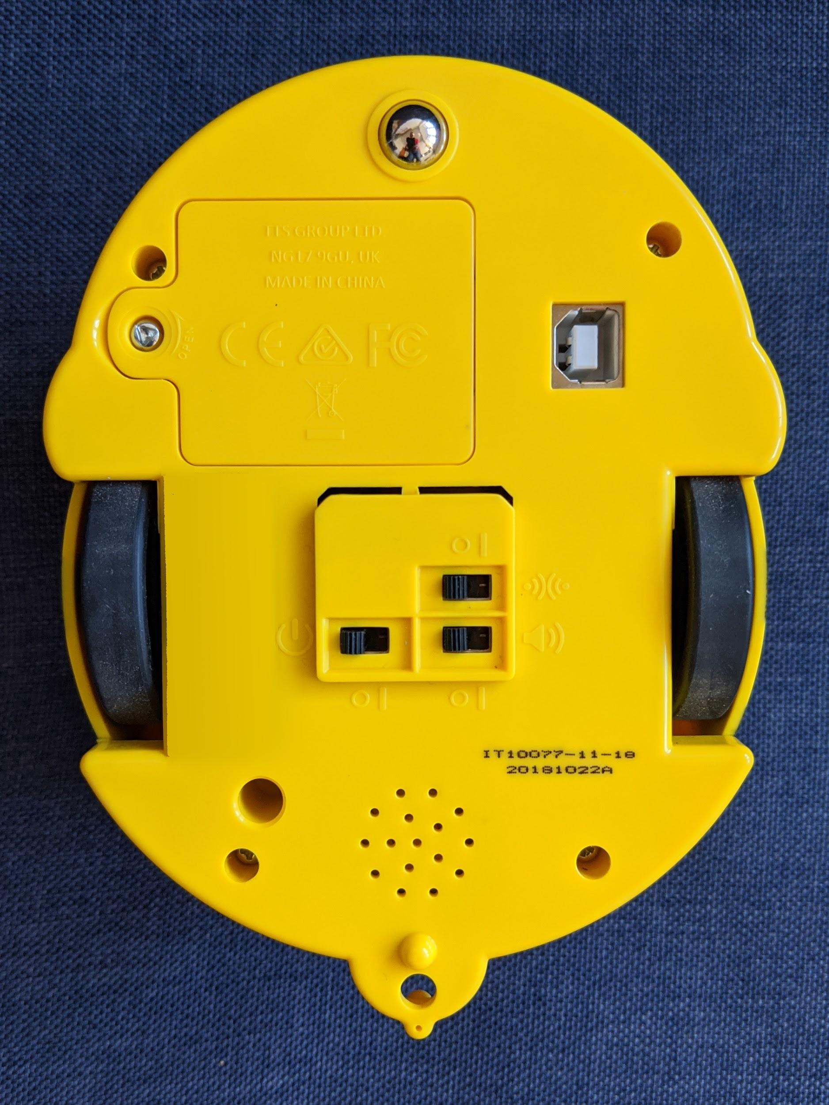
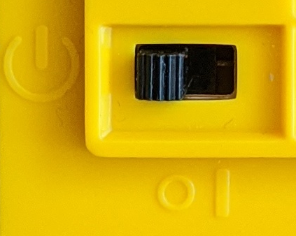
Try it out (part 1)
Activity 1
BeeBots
You will need to switch the robot on. The switch is underneath.
Something lights up when you switch the robot on. Can you work out what it is?
Notes:
Eyes

Slide 8
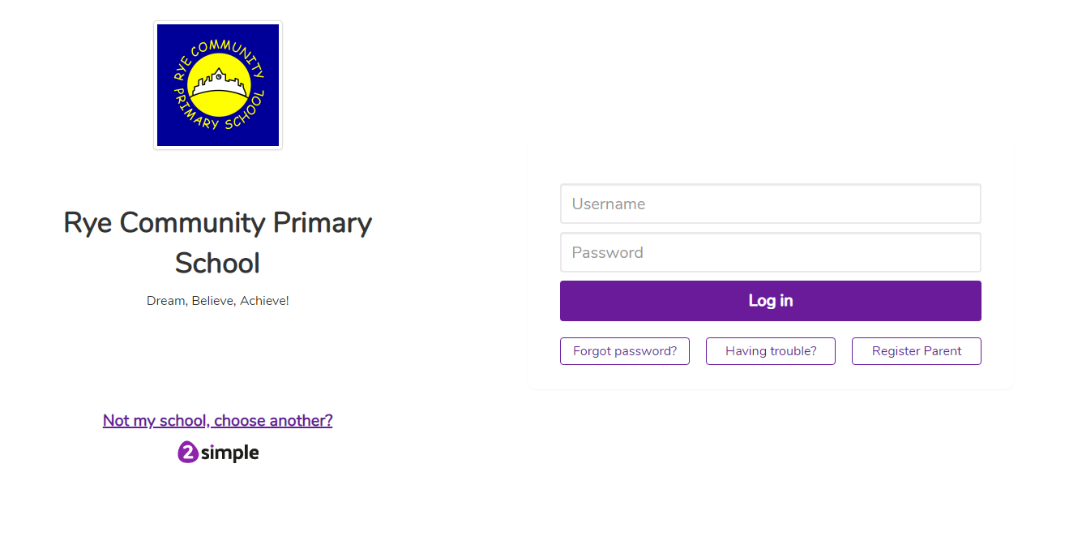
Try it out (part 2)
Activity 1
Purple Mash
First, login using your card.
Notes:
Eyes

Slide 9
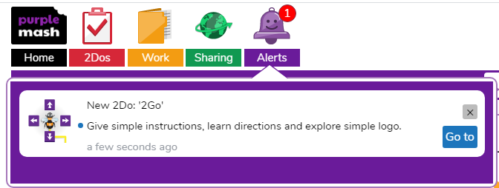
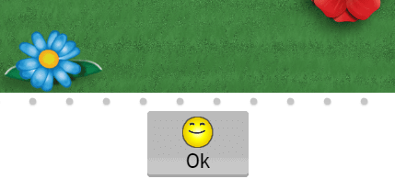
Try it out (part 2)
Activity 1
Purple Mash
Then, either click on the alert or on your 2Dos.
Next, click on the smiley face to begin.
Notes:
Eyes

Slide 10
Try it out
Activity 1
What did it do?
Did the buttons do what you expected them to?

Slide 11
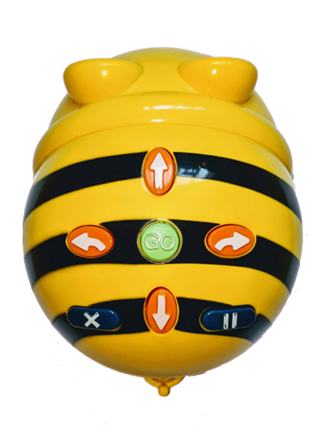
Let’s get ready for the next activity
Activity 2
If you are at a workstation, log-out safely and shut down.
If you are using a BeeBot, turn it off and return it to the docking station for a wipe-over.
We will sit in a circle for the next slide.
GO

Slide 12
Match them up
Activity 2
Your teacher is going to secretly press one button and then press go.
After you see Bee-Bot move, place your finger on the button you think was used.
GO

Slide 13
Why are these two buttons very important?
Plenary
GO

Slide 14
Assessment
How confident are you? (1–3)
I can predict the outcome of a command on a device
I can match a command to an outcome
I can run a command on a device
3 – Very confident
2 – Unsure
1 – Not confident
Notes:
Image source: https://pixabay.com/vectors/thumb-up-hand-like-confirm-go-top-307176

Slide 15
Next lesson
Summary
In this lesson, you…
Talked about robots and how we control them
Thought about which commands had been used to program the robot and how programs are run and cleared
Next lesson, you will…
Pretend to be robots and give each other instructions.
Solve some-more problems on 2Go
Have your turn using the BeeBot if you haven’t already.

