Slide 1
Can I name the noun?
A noun is a word in a sentence which indicates a person, a place or a thing.

Slide 3
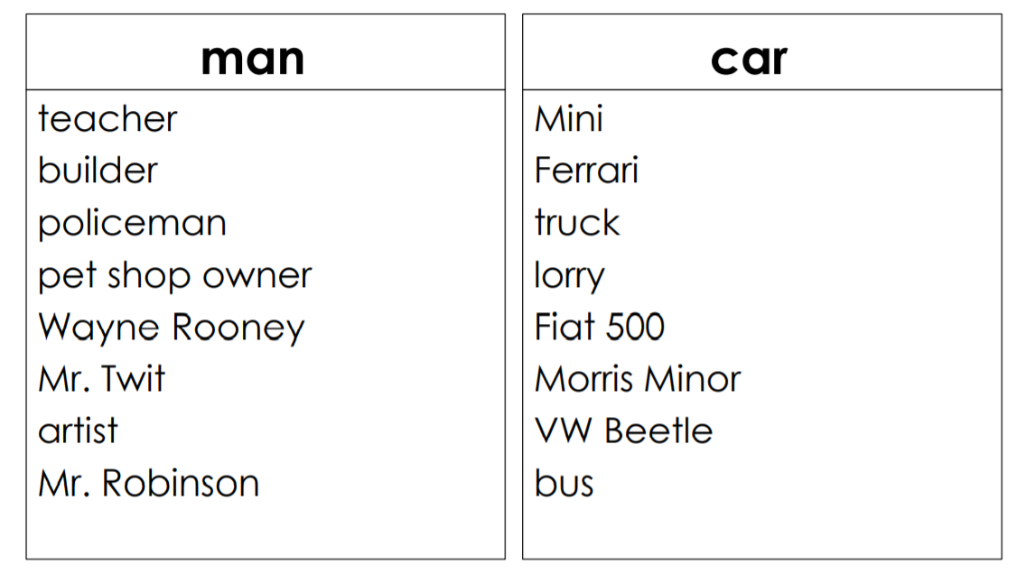
Write your own sentences using these nouns.

