Slide 1
Can I order numbers?

Slide 2
Thursday 24.9.20

Slide 3
Focus task
Year 3: which number in this row is the greatest and which number is the smallest?
Year 4: which number in this row is the greatest and which number is the smallest?

Slide 4
Fluency – do and talk
Make the smallest and largest number using the digits in each block.
3
4
0
6
1
5
7
9
2
0
3
4
1
5
6
2
7
9
4
3
0
6
5
1
9
7
2

Slide 5
Fluency – do and talk
What strategy did you use to find the smallest and largest number?
How did you know you were correct?

Slide 6
Fluency – ordering language
What is meant by ascending and descending?
Put these numbers in ascending order
Year 3: Year 4:

Slide 7
Independent task
Year 3 – sheet
Year 4 - sheet

Slide 8
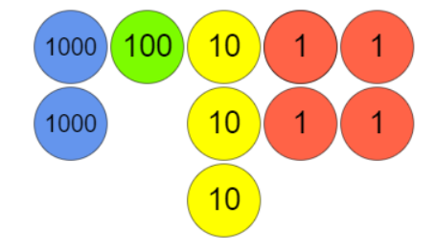
Fluency - variation
Year 3
Year 4

Slide 9
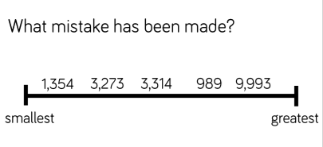
Reasoning
Find the mistakes and correct it.
Explain what went wrong.
Year 3
Year 4

Slide 10
Lightbulb challenge
Year 3
Year 4

