Slide 1
Can I check my work against the steps to success?
I can find and highlight my lens sentences
I can explain which paragraph I think I wrote well
I can write up my chosen paragraph neatly.
Challenge: write an author’s note. Why are you proud of this paragraph?

Slide 2
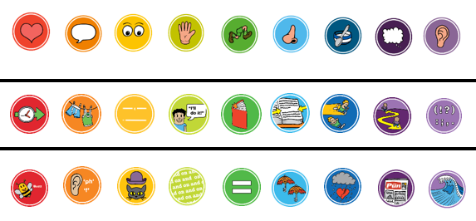
Your steps to success
You chose 4-6 lenses for the steps to success for your story. Find and underline the lens sentences in your story.

Slide 3
Your steps to success
Look at the 4-6 sentences you highlighted. Which one shows you using the lens particularly well?
You are going to read this sentence to the class and show off your amazing writing skills.

Slide 4
Publish
You are going to copy the paragraph (plotpoint) that contains the sentence you have read out on a separate piece of paper.
This may be used for a display.
I need to see good handwriting.
Challenge: write an author’s note. Why are you proud of this paragraph?
I am proud of this paragraph because ____

