Slide 1
Can I revise my work?
I can find missing/wrong capital letters and correct them.
I can find missing/wrong punctuation and correct them.
I can check and correct spellings.
Challenge: rewrite – uplevel sections of your writing

Slide 3
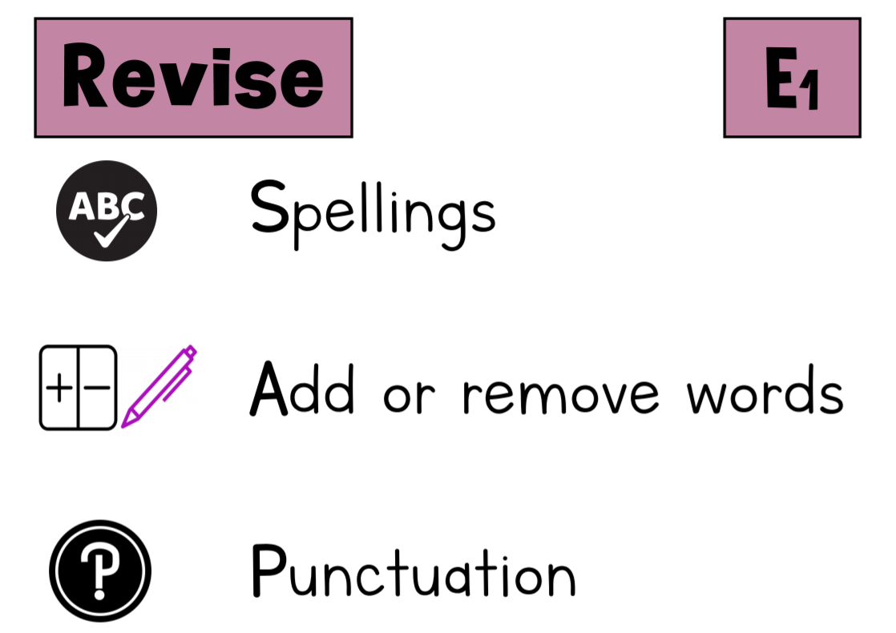

Slide 4
Spelling
sword use your keyword mats
heard
castle
said

Slide 5
Punctuation

Slide 6
Challenge

