Slide 1
The Bayeux Tapestry
LI: Can I analyse a historical source?

Slide 2
Today we are going to analyse two sections of the Bayeux Tapestry
What does it mean to analyse a historical source?
Analyse means to examine (look at) something in detail, to think about what we notice, and to try to explain and make predictions about it.

Slide 3
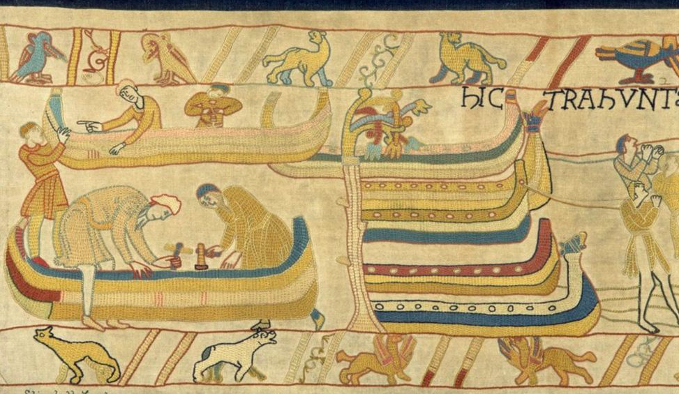
Sheet 1:
What do you notice?
Discuss with your partner and make a spider diagram.
What do you think is happening in this picture?
Write a prediction in 1-3 sentences.

Slide 4
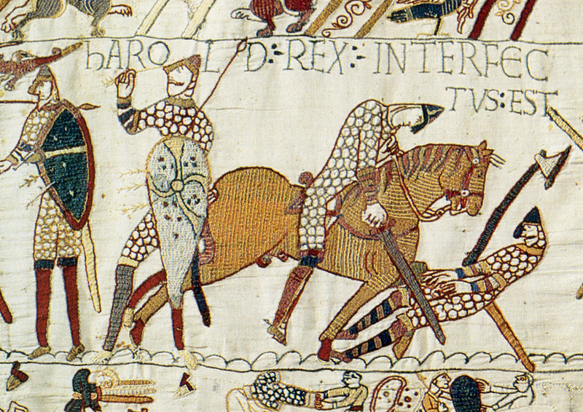
Sheet 2:
What do you notice?
Discuss with your partner and make a spider diagram.
What do you think is happening in this picture?
Write a prediction in 1-3 sentences.

