Slide 1
Biography
Thursday 8th October 2020
Sentence Stacking

Slide 2
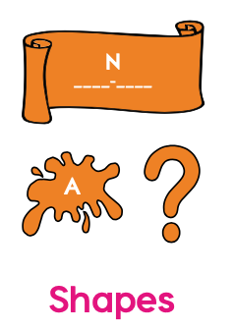
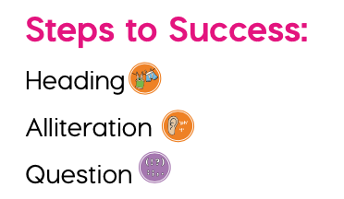
Today we will be looking at headings, alliterative subheadings and questions.

Slide 3
Headings
Ocean Creatures
Popstars
Ariana Grande
Christmas
Minibeasts
Castles
William the Conqueror
Rye Primary School

Slide 4
Sentence stacking lesson 1
Headings.
Learning Chunk 1 (Heading)
Model
Florence Joyner (1958-1988).
Your turn
Write the heading for Florence include information with no spelling mistakes and accurate numbers.
Deepen the moment:

Slide 5
Alliteration
Peter Piper picked a peck of pickled peppers.
Dunkin’ Donuts.
Coca-Cola.
Better Botter bought butter.
Manky, mouldy moat.
Terrific Tommy.
Fantastic fairy.

Slide 6
Sentence stacking lesson 1
Alliterative subheadings.
Average
Captivating
Radical
Sassy
Awesome
Reliable
Sincere
Radiant
Clever
Courageous
Magnificent
Amazing
Motivated
Marvelous
Creative
Strong
Compassionate
Sweet
Resilient
Ambitious
Stylish
Sophisticated
Accomplished
Ruthless
Restless
Active
Adamant
Majestic
Angelic
Modest
Astonishing
Advantageous
Learning Chunk 2 (Alliteration)
Initiate
Match the words to the correct sound at the beginning of the word.
1 – Competitor
2 – Sprinter
3 – Runner
4 – Medal winner
5 - Athlete

Slide 7
Alliterative sub-heading
Learning Chunk 2 (Alliteration)
Model
Ambitious, adept athlete.
Choose three different alliterative verbs before your noun.
Deepen the moment:
Your turn

Slide 8
Question
Learning Chunk 3 (Question)
Model
Can you imagine running 100 metres in under 11 seconds?
Ask the reader a ‘Can you imagine…?’ question to challenge their thinking.
Deepen the moment:
Your turn

Slide 9
Question
Learning Chunk 3 (Question)
Initiate
Four facts:
1984 Los Angeles Summer Olympics, Joyner won a silver medal in the 200m run.
1988 Olympics in South Korea, she took home 2 golds and a silver medal.
She still holds the world records in the 100m. She ran at 10.49 seconds.
Ran at 21.31 in the 200m event which is also a world record.
‘Can you imagine…’ (key fact).

Slide 10
Biographies
Friday 9th October 2020

Slide 11
Conjunctions
Sort, gather and use
Sort the sentence starts and sentence finishers into two groups.
Remember… the word ‘because’ can join two ideas together.

Slide 12
Save for another day
Learning Chunk 1 (Heading)
Initiate
Florence Joyner was an American track and field athlete. She was born in 1959. She died in 1998.
Mandy Rushalot wrote:
Florence joyner wos a athlete. she born in 1959 she die in 1998.
How can we improve this writing?

