Slide 1
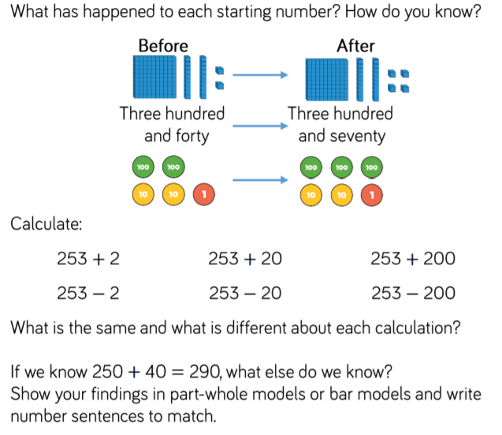
Year 3 fluency
Year 3 fluency
Year 3 reasoning
Year 3 reasoning

