Slide 1
Can I regroup? (concrete and pictorial lesson).

Slide 2
6.10.20

Slide 3
In focus task Convert these numbers into tens and ones in your book: e.g. 11 = 1 ten and 1 one. 12 = ___ ten and ___ ones. 13 = ___ ten and ___ ones. 14 = ___ ten and ___ ones. 15 = ___ ten and ___ ones. 16 = ___ ten and ___ ones. 17 = ___ ten and ___ ones. 18 = ___ ten and ___ ones. 19 = ___ ten and ___ ones.

Slide 4
Regrouping Whole class https://www.khanacademy.org/math/cc-2nd-grade-math/cc-2nd-add-subtract-100/cc-2nd-add-100/v/addition-with-regrouping https://www.harcourtschool.com/activity/elab2004/gr3/3.html We will regroup different numbers and see what we notice. Then, we will complete the activity sheet.

Slide 5
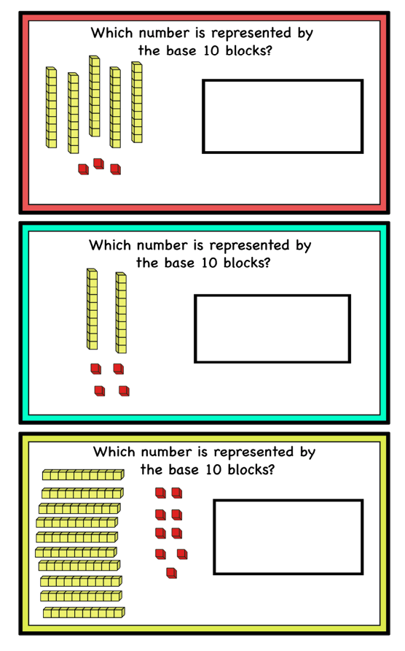
Independent/talk partners Now, complete the flashcards activity. Find each number that is being represented by the base 10.

Slide 6
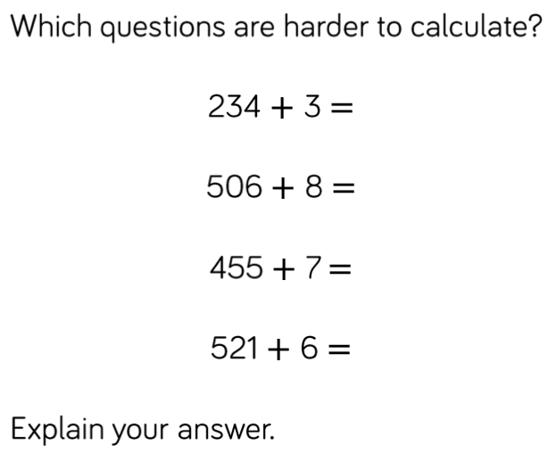
Light bulb challenge
Year 3
Year 4
Is Mo correct? Explain why.

Slide 7
Can I regroup in columns?

Slide 8
Year 3: Can I add 3-digit and 1-digit numbers? Year 4: Can I add 3-digit and 2-digit numbers?

Slide 9
Year 3: Can I add 3-digit and 2-digit numbers? Year 4: Can I add two 3-digit numbers?
Notes:
One exchange, can be a mix of ones or tens

Slide 10
In Focus complete these in your books
Year 3
900
600 300
Can you write all the fact families for the bar model?
Year 4
Can you write all the fact families for the bar model?
1400
300
1100

