Slide 1
Can I use column addition with regrouping?

Slide 2
In focus task
Year 3
1 + ___ = 10
10 + ___ = 100
2 + ___ = 10
20 + ___ = 100
3 + ___ = 10
30 + ___ = 100
4 + ___ = 10
40 + ___ = 100
5 + ___ = 10
50 + ___ = 100
Year 4
10 + ___ = 100
100 + ___ = 1000
20 + ___ = 100
200 + ___ = 1000
30 + ___ = 100
300 + ___ = 1000
40 + ___ = 100
400 + ___ = 1000
50 + ___ = 100
500 + ___ = 1000

Slide 3
https://www.harcourtschool.com/activity/elab2004/gr3/3.html First, we will complete 3-digit add 1-digit with regrouping ones. 126 + 7 = 214 + 9 = 388 + 5 = Year 3s can then move on to complete their independent activity. Then, Year 4s will remain on the carpet where we will practice regrouping only tens, before moving on to their independent activity. 1169 + 50 = 2984 + 11 = 6271 + 54 =

Slide 4
Independent activity
Year 3
165 + 7 =
256 + 6 =
395 + 9 =
477 + 6 =
546 + 7 =
659 + 5 =
764 + 8 =
819 + 3 =
952 + 9 =
919 + 9 =
Year 4
1165 + 1071 =
2256 + 1363 =
3355 + 2192 =
4477 + 2261 =
5546 + 1372 =
6659 + 2150 =
6764 + 3083 =
6819 + 2090 =
7952 + 1061 =
7699 + 1170 =

Slide 5
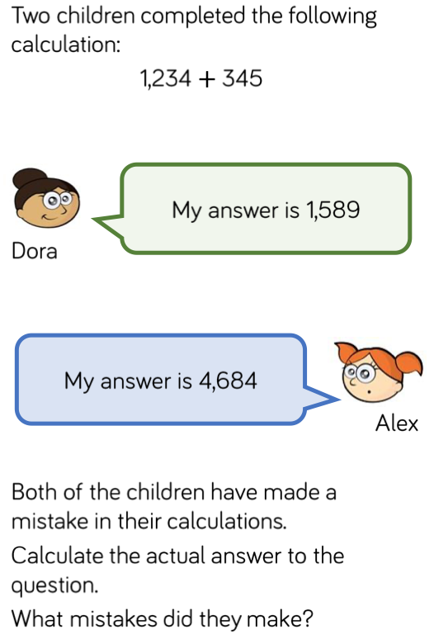
Light bulb challenge
Year 3
When 6 + 5 are added together, the digit in the ones column of the answer will always be 1.
What other digits will always give a 1 in the ones column? Prove it.
Year 4
Is Mo correct? Explain why.

