Slide 1
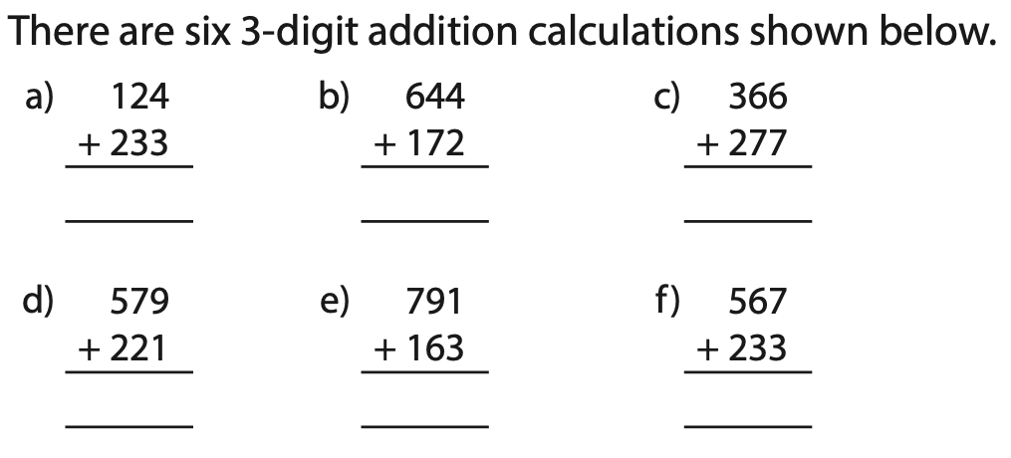
Maths meeting (Fluency)
Check that you are looking at the numbers involved rather than working out the answers.
Which calculations have no exchange?
Which calculations have one exchange?
Which calculations have two exchanges?
Which calculation has the greatest answer?
Which calculation has the smallest answer?

Slide 2
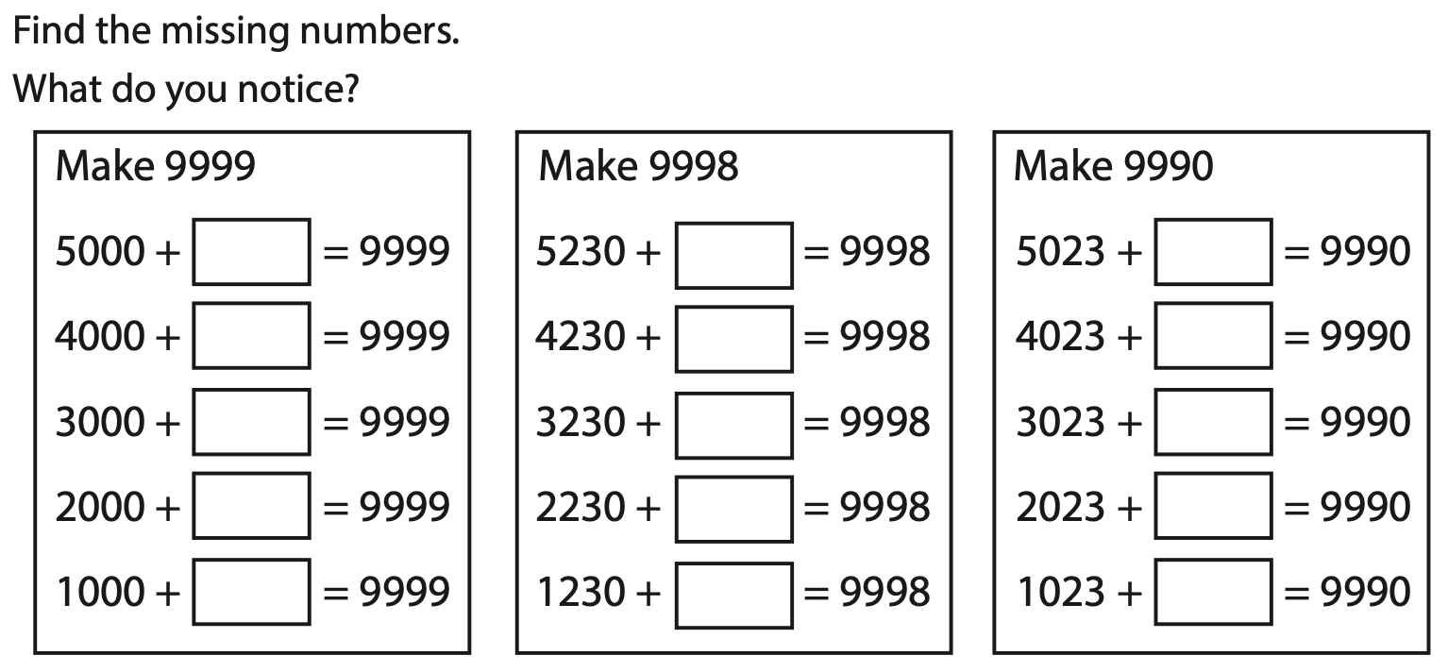
Maths meeting (Reasoning)

Slide 3
Maths meeting (pre teach)
What is estimating?
What can you tell your partner about estimating?
When would it be important to estimate numbers?

