Slide 1
Demonstration Read
As we are reading, we are going to focus on the Impact lens.

Slide 2
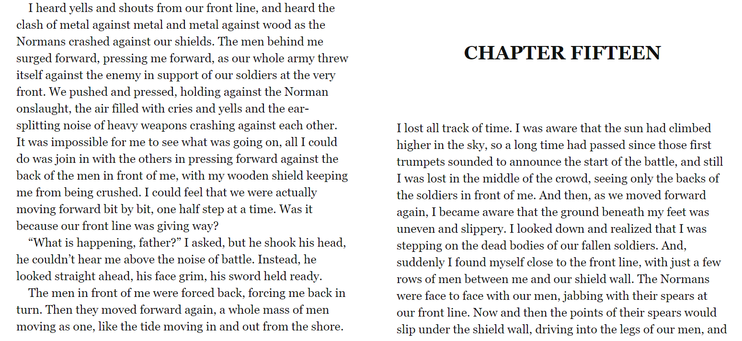

Slide 4
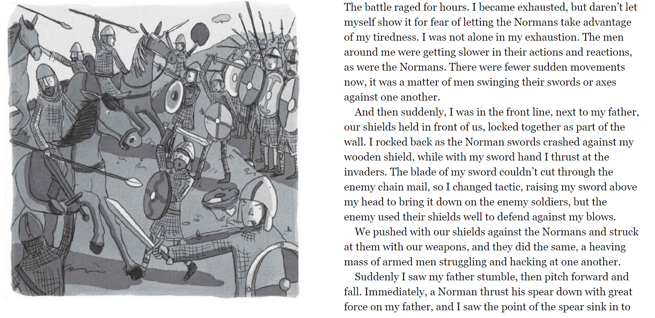

Slide 5
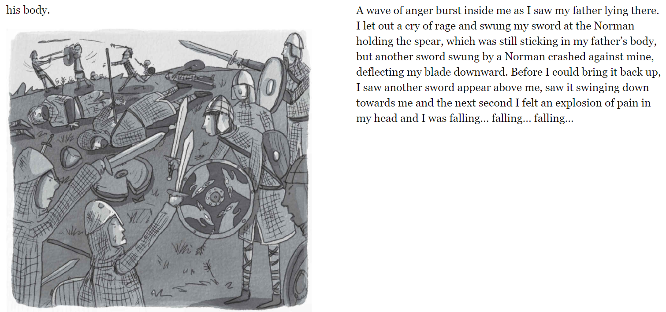

Slide 6
Lesson 1 and 2 - Book Talk
We are going to read Chapter 16 together and focus on 3 lenses.
Noticing
Setting
Accessing phonics and grammar

Slide 10
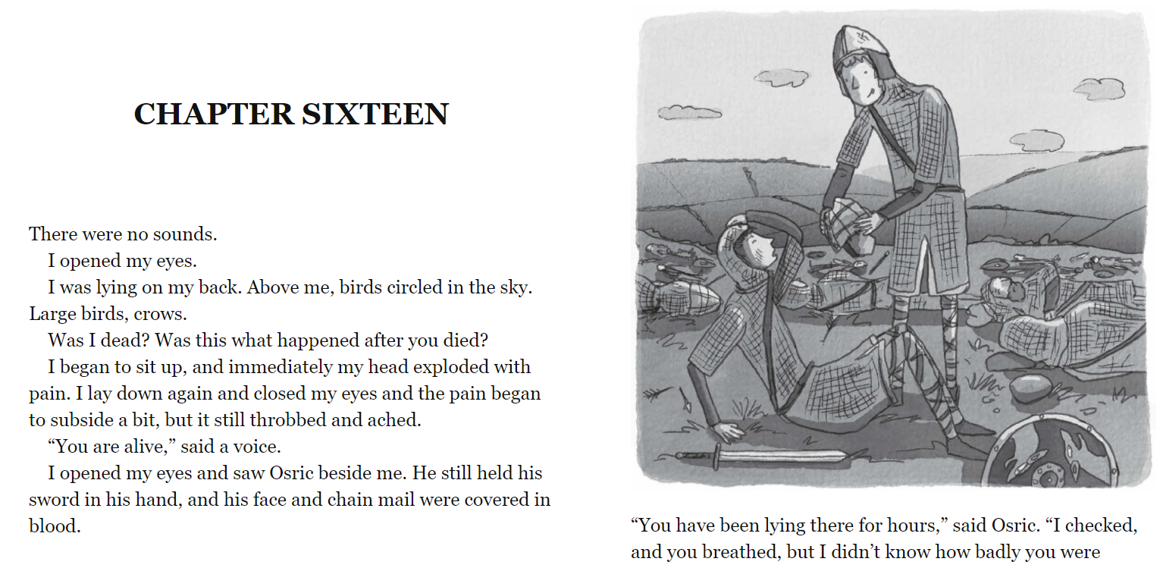

Slide 11
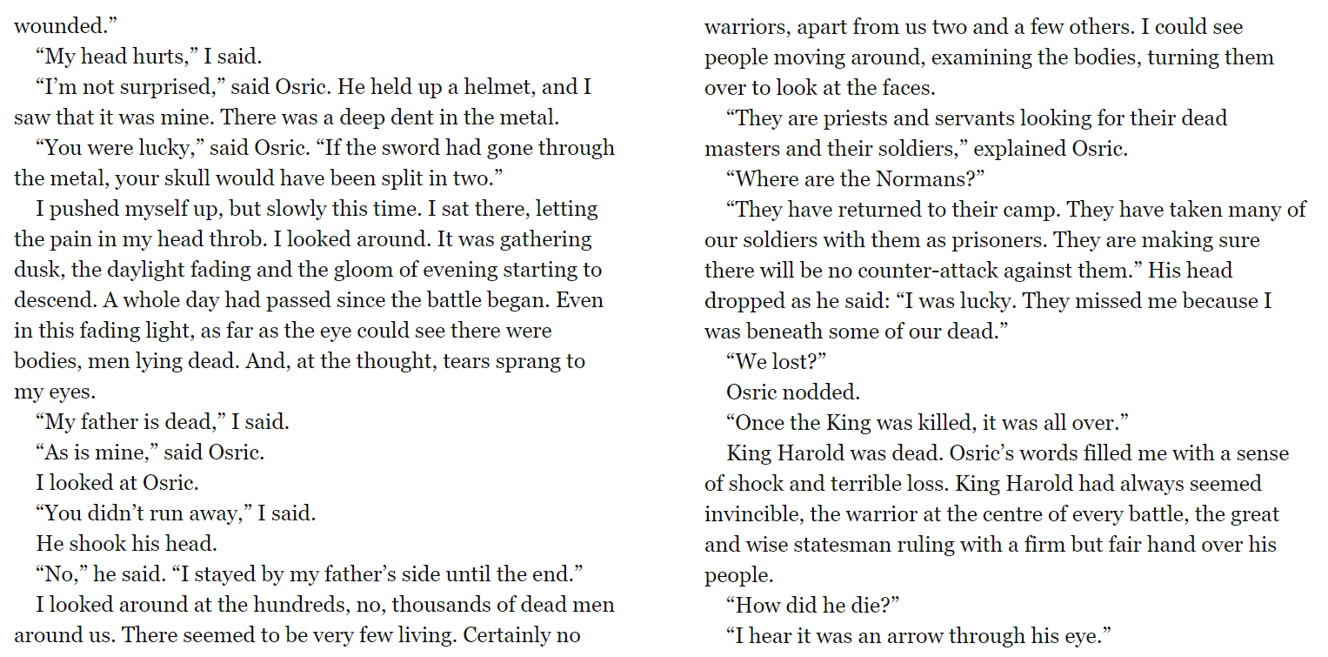

Slide 12
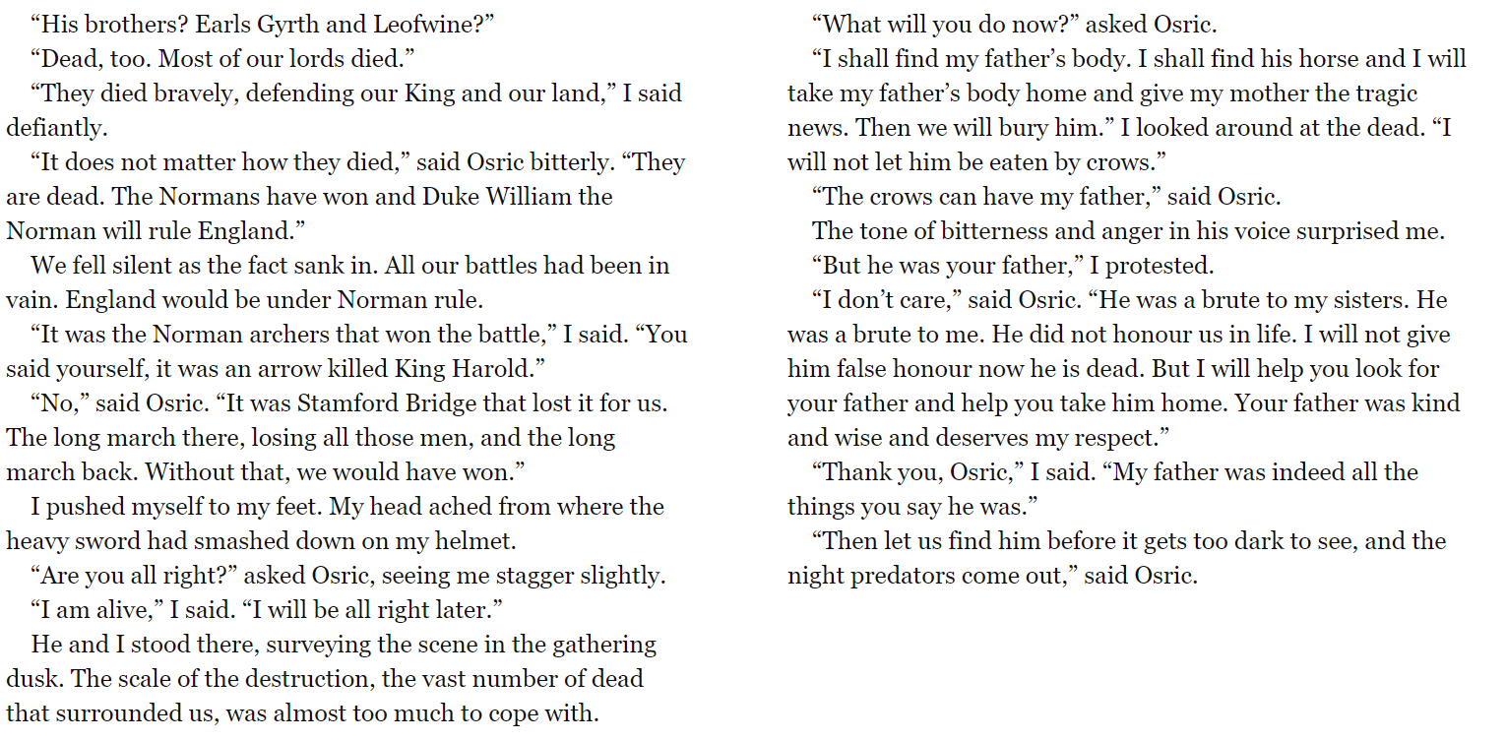

Slide 13
Noticing lens
Describe what Osric and the main character see in the final chapter as they survey the scene.
On flipchart paper, make a list of what the battlefield looks like.

Slide 14
Setting lens
How does the author create a devastating setting?
How does the setting make you feel as a reader?

Slide 15
Accessing phonics and grammar lens
Can you find a sentence that you think is powerful and explain why?
Why are there lots of short sentences used here? How does it make you feel?

Slide 16
Session 2 - Model
We are going to create some sentences together today using the same 3 lenses
Noticing
Setting
Accessing phonics and grammar

Slide 17
Noticing lens
An image of the bloody and vicious battlefield is created in the reader’s mind when the author writes…
(we are going to find 2 examples of a powerful setting)

Slide 18
Setting lens
The author creates a believable setting by…
(we are going to find 3 examples from the text that show how the setting has been written for effect).

Slide 19
Accessing phonics and grammar lens
A sentence that caught my eye was…
This is because…
Bonus question!
Find 2 interesting adjectives used by the author and say why they are effective.

Slide 20
Session 3 - Enable
You are going to answer 4 questions today on your own.
There will be a question from each lens and a bonus question.
Noticing
Setting
Accessing phonics and grammar

Slide 21
Session 3 – Enable (Independent comprehension)
Year 3
1) What does the main character see? Give 3 examples.
2) Where is the setting for Chapter 16? Explain how you know.
3)‘Invincible’ What does this word mean?
Bonus question
4 ) What was your favourite sentence and why?
Year 4
1) Describe the battlefield? Find 3 examples from the text. What image does this create in your mind?
2) Why does the setting make the main character feel so sad? Give 2 reasons.
3) Which sentence ‘caught your eye?’ Explain why.
Bonus question
4) Why does the author use so many short sentences?

