Slide 1
Can I use and improve my mental maths?

Slide 2
Counting along a numberline
Can I count forward and back in 2s from any number?
What number am I pointing to if I start from….?
If I can count in 2s, can I count in 20s? Let’s go!
What number am I pointing to if I start from…?

Slide 3
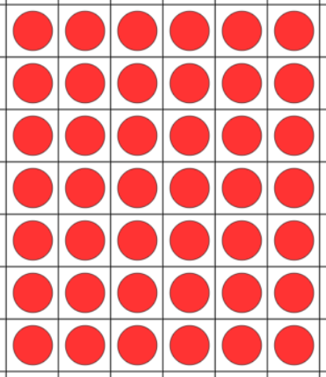
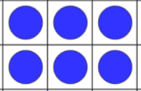
Learn it!
How many in a minute?
Write the following fact as many times as you can on your whiteboard.
Year 3 Year 4
2 x 3 = 6
7 x 6 = 42

Slide 4
It’s nothing new - doubling
Double 1 =
Double 2 =
Double 3 =
Double 4 =
Double 5 =
Double 6 =
Double 7 =
Double 8 =
Double 9 =
Use this knowledge to double
23
41
122

Slide 5
Calculations
Get your pen and whiteboards ready

Slide 6
The sum of 15 and 10 is __
The total of 14 and 6 is ___
33 plus 7 is __
20 minus 8 is __
sum
total
plus
minus

Slide 7
15 is 5 less than __
22 is 3 more than __
12 take away 6 is __
6 taken from 12 is __
less than
more than
take away
taken from

Slide 8
The difference between 13 and 15 is __
If 54 is subtracted from 65 then you are left with ___
If you increase 33 by 8 then you get an answer of ___
difference
subtracted from
increase

