Slide 1
Diary
Monday 9th November 2020

Slide 2
Can I draft and write by building a varied and rich vocabulary?
Today we will use:
Actions
Rhetorical question
Feelings

Slide 3
Actions
My tooth still wouldn’t come out. Mr Erstwhile then asked all the people in the waiting room to come in and help.
Chotting
Think of some actions the people could do to help pull the tooth out.

Slide 4
Actions
My tooth still wouldn’t come out. Mr Erstwhile then asked all the people in the waiting room to come in and help.
Modelling
They lined up and pulled, heaved, yanked, shouted encouragingly and gritted their teeth.
Deepen the moment: use adverbs

Slide 5
Rhetorical question
After all this effort to extract the tooth what do you think Alfie may be thinking. What questions could he be asking himself?
A rhetorical question doesn’t need to have an answer.

Slide 6
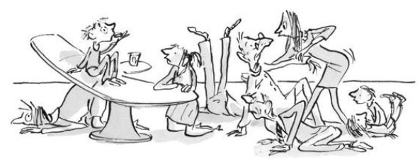
Feelings
Finally, after what seemed like days, weeks, even months of yanking my tooth came out with a loud crunch.
Think about how Alfie is feeling. What could he be hoping or wishing for?

Slide 7
Feelings
Finally, after what seemed like days, weeks, even months of yanking my tooth came out with a loud crunch.
Deepen the moment: add more feelings
Model
I wish I had never gone to the dentist. He took out the wrong tooth.

