Slide 1
Y3 LI: Can I make equal groups when grouping? Y4 LI: Can I multiply numbers by 100?

Slide 2
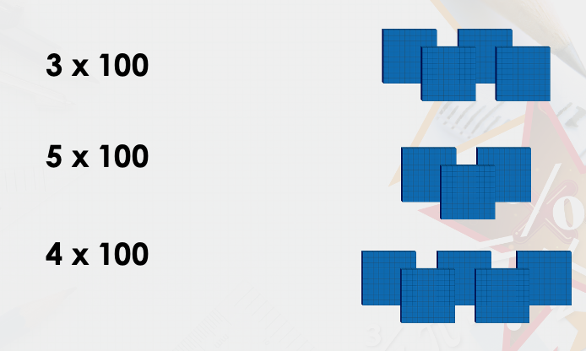
Focus task
Year 3
(In school)
Divide the Year 3s into 2 equal groups. Is this possible?
(At home)
Divide teaspoons (or another object) into 2 equal groups. Is this possible?
Year 4
Match the calculation to the visual representation.

Slide 3
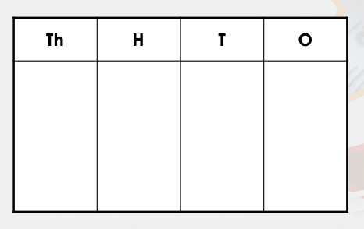
Year 3 on a whiteboard
Year 4 on a whiteboard
Sort 27 cubes into equal groups of 3.
How many groups are there?
Complete the counters to complete the calculation 100 x 27

Slide 4
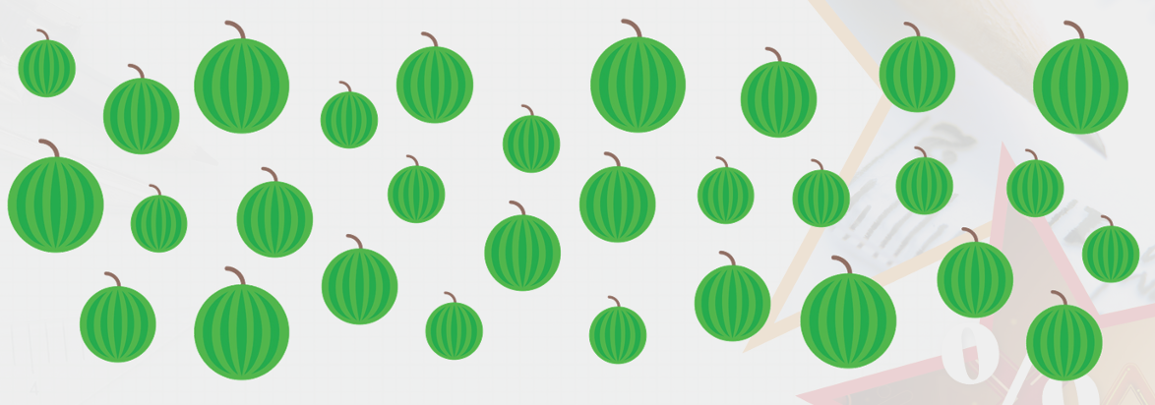
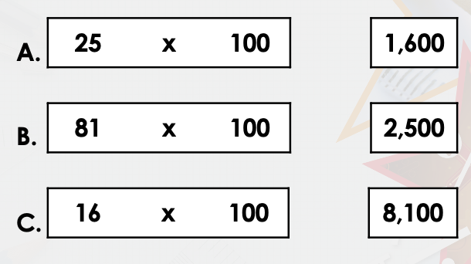
Year 3 on a whiteboard
Year 4 on a whiteboard
Put the melons into equal groups of 6.
Use the groups to complete this calculation:
30 divided by _____ = 6
Match the question with the correct answer.

Slide 5
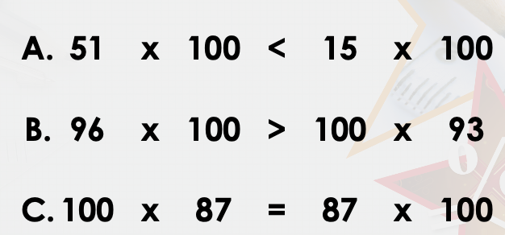
Year 3 on a whiteboard
Year 4 on a whiteboard
Use the bead string to help fill in the calculation.
___ divided by ___ = ____
Which statements are correct?

Slide 6
Year 3 on a whiteboard
Miss Turton buys 28 peppers. Each group needs 7 peppers.
How many groups can have peppers?

Slide 7
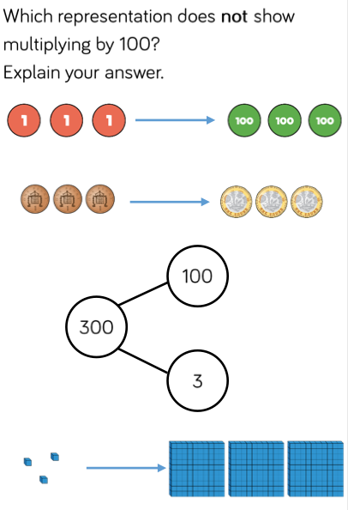
Lightbulb challenge
Year 3
Year 4

