Slide 1
Y3: LI: Can I multiply by 4? - Count in groups of 4. - Understand that multiplication is commutative. - Relate the 4 times table to the 2 times table. Challenge: Reasoning and problem-solving. Y4: LI: Can I multiply and divide by 6? - Count in groups of 6. - Know that multiplication is the opposite of division. - Relate the 6 times table to the 3 times table. Challenge: Reasoning and problem-solving.

Slide 2
Focus task
Year 3: Count in 2s in your book to 24.
Then, count in 4s in your book to 48.
Year 4: Count in 3s in your book to 36.
Then, count in 6s in your book to 72.

Slide 3
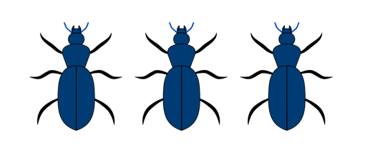
In your book
Year 3
How many wheels?
Count in groups of 4.
What are the number sentences?
Year 4
How many legs are there?
What are the number sentences?

Slide 4
In your book
Year 3
What happens to the number of wheels as the number of cars goes up?
Can you draw and fill in the table in your book?
Year 4
What happens to the number of dots as the number of dice goes up?
Can you draw and fill in the table in your book?

Slide 5
In your book
Year 3
Can you write out your 4 times table in two different ways?
Can you think of any more ways you could show the 4 times table?
Year 4
Can you write out your 6 times table in two different ways?
Can you think of any more ways you could show the 6 times table?

Slide 6
In your book
Year 3
Can you compare the number line going up in 1s to the number line going up in 4s.
What do you notice?
Draw the number lines in your book and explain.
Year 4
Can you compare the number line going up in 1s to the number line going up in 6s.
What do you notice?
Draw the number lines in your book and explain.

Slide 7
In your book
Year 3
What number sentences are being shown here?
Can you relate this to the two times table?
Year 4
What number sentences are being shown here?
Can you relate this to the three times table?

Slide 8
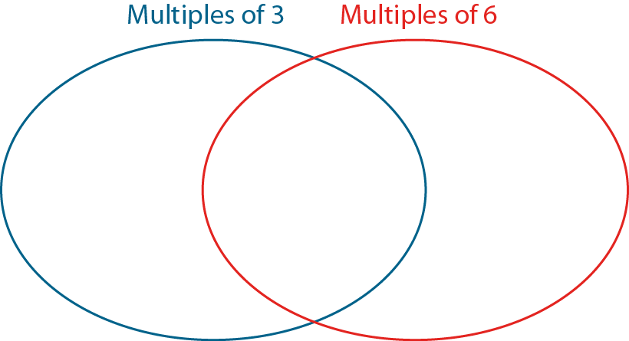
In your book
Year 3
Dougie wrote this.
Draw a picture like this to show that 4 x 6 = 24.
Year 4
Which of the these numbers are multiples of 3, multiples of 6, both, or neither?
0, 3, 6, 31, 15, 61, 30, 36, 60

Slide 9
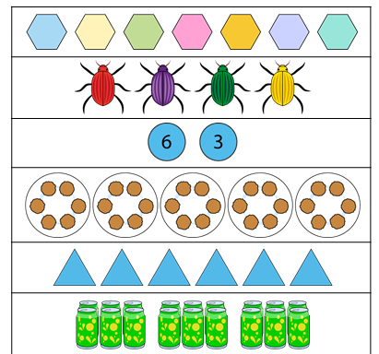
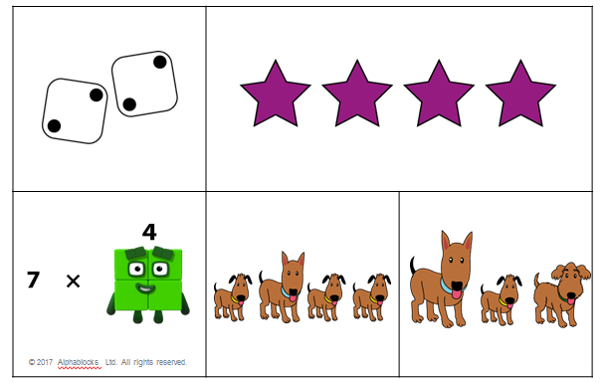
In your book
Year 3
Which one represents groups of 4? Don’t get mixed up with 4 groups!
Year 4
Which one represents groups of 6? Don’t get mixed up with 6 groups!

Slide 10
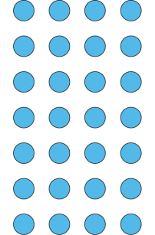
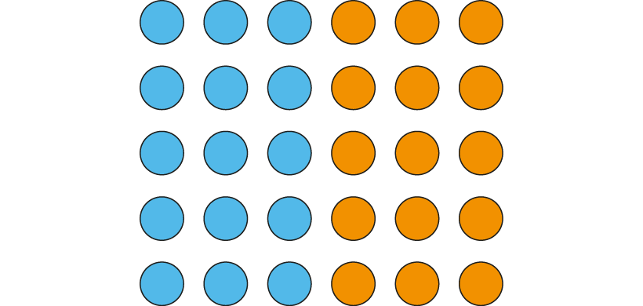
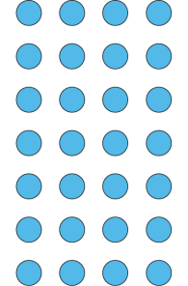
In your book
Year 3
Draw the array in your book and circle the groups of 4.
Draw the array in your book and circle the 4 equal groups.
How does this relate to the two times table?
Year 4
Draw the array in your book and circle the groups of 6.
Draw the array in your book and circle the 6 equal groups.
How does this relate to the 3 times table?

Slide 11
In your book
Year 3
Write down the multiples of 4.
How do you know they are multiples of 4?
Year 4
Write down the multiples of 6.
How do you know they are multiples of 6?

Slide 12
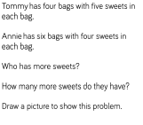
Light bulb challenge Year 3 Year 4

