Slide 1
Let’s make it CLIC
Tuesday, 1st December 2020

Slide 2
CLIC - Counting
Reading and writing numbers
What numbers are written here?
Year 3
Year 4
Seventy-eight
Twenty-nine
Seven hundred
Three hundred and fifty
Nine hundred and two
Three hundred and fifty
Nine hundred and two
Seven thousand four hundred and twelve
Two thousand and ninety
Five thousand one hundred and eighy-four

Slide 3
CLIC - Learn Its
5 x 3 = 15
Year 3, your learn it this week is:
Year 4, your learn it this week is:
I’ll put the timer on. How many times in a minute can you write your learn it on your whiteboard?
9 x 7 = 63

Slide 4
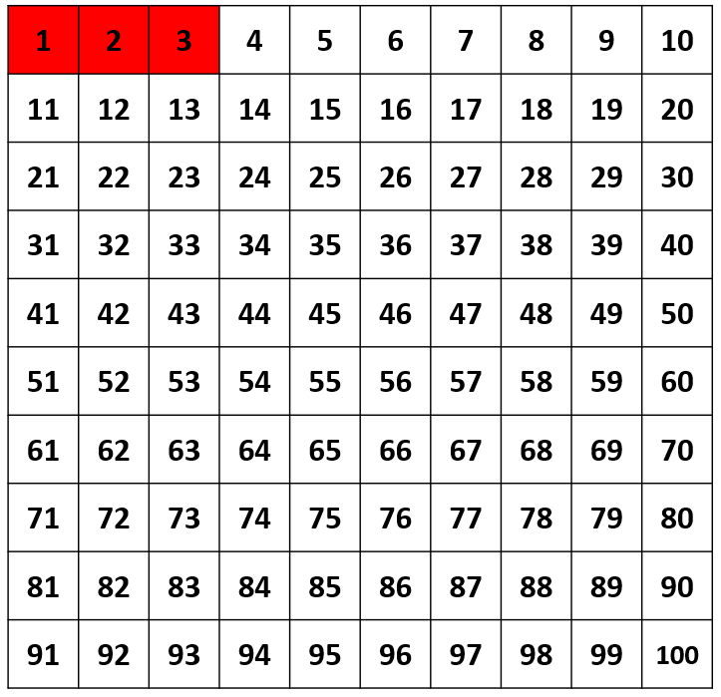
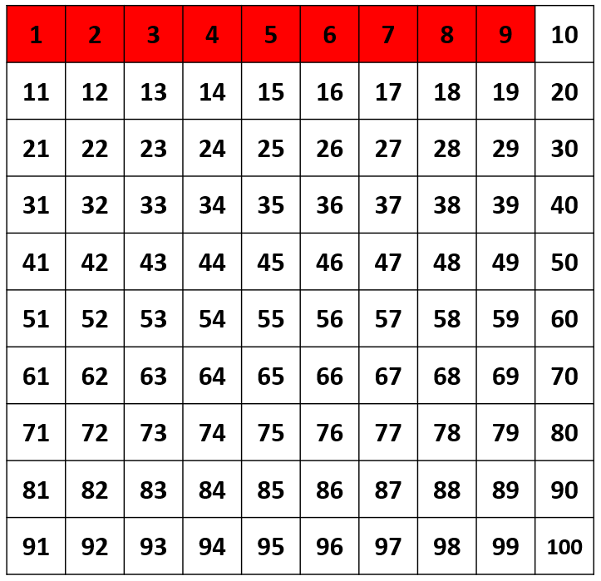
CLIC – It’s nothing new
I can find multiples of 3 (Y3) / 9 (Y4)

Slide 5
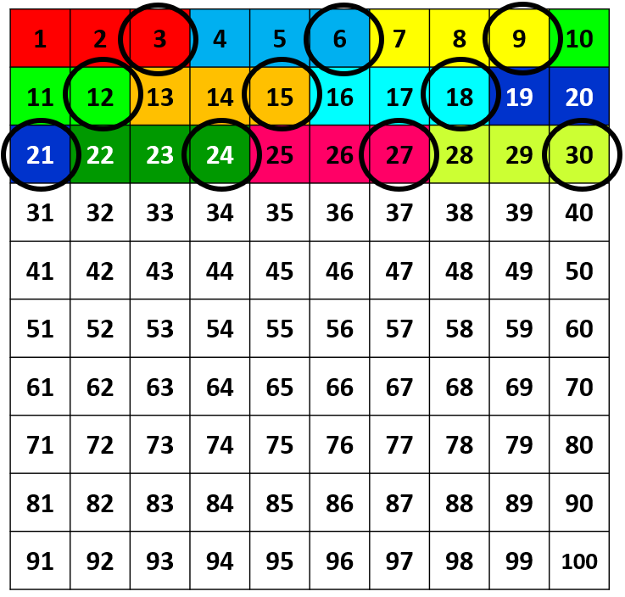
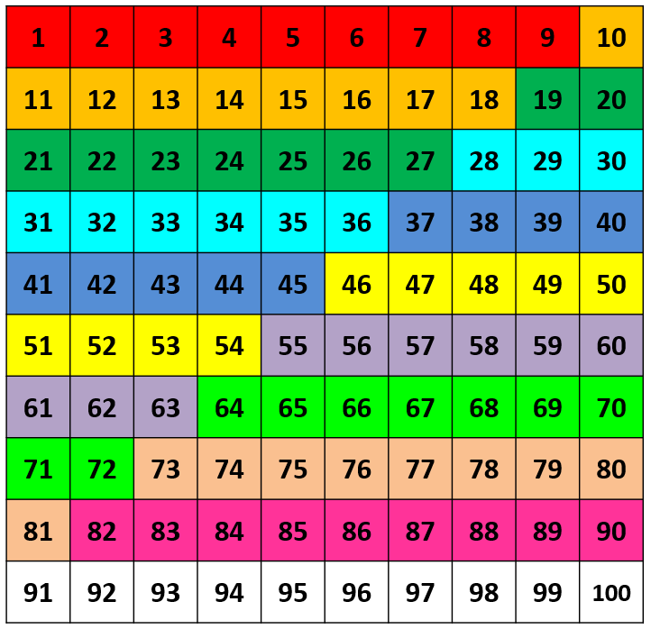
CLIC – It’s nothing new
I can find multiples of 3 (Y3) / 9 (Y4)

Slide 6
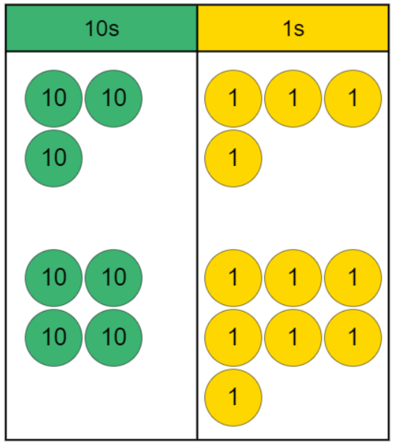
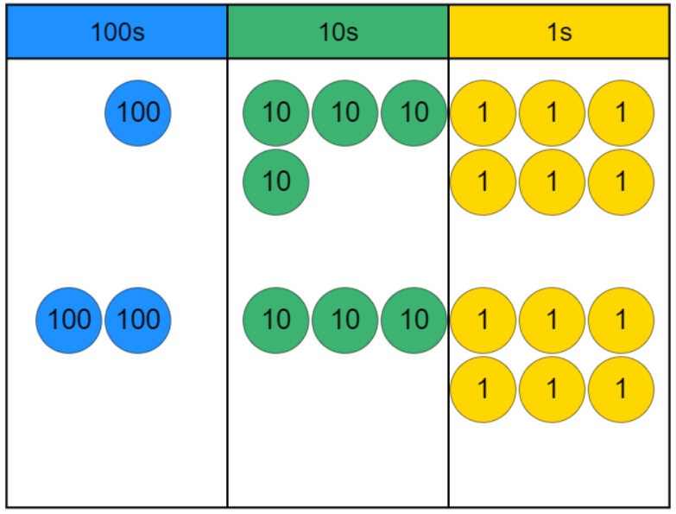
CLIC – Calculations
Year 3: I can add two 2-digit numbers with regrouping
Year 4: I can add two 3-digit numbers with regrouping
+
+

Slide 7
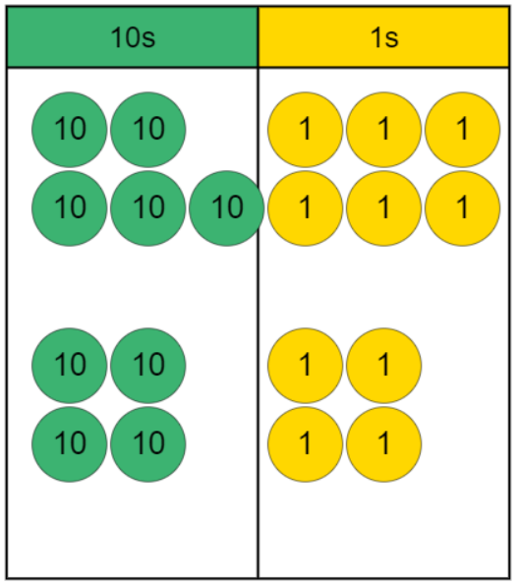
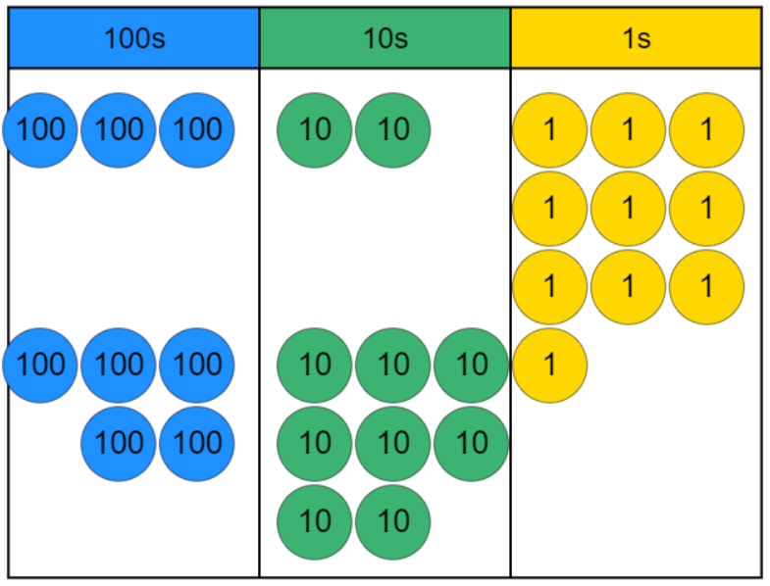
CLIC – Calculations
Year 3: I can add two 2-digit numbers with regrouping
Year 4: I can add two 3-digit numbers with regrouping
+
+

Slide 8
Let’s make it CLIC
Wednesday, 2nd December 2020

Slide 9
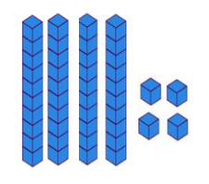
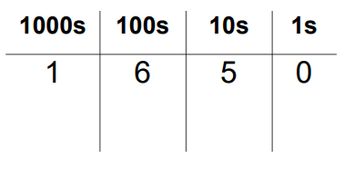
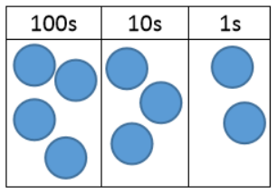
CLIC - Counting
Write these representations in numerals and words
A.
B.
C.

Slide 10
CLIC - Learn Its
5 x 3 = 15
Year 3, your learn it this week is:
Year 4, your learn it this week is:
Hide and seek
Remember to repeat the learn it softly, when far away and louder when getting near.
9 x 7 = 63

Slide 11
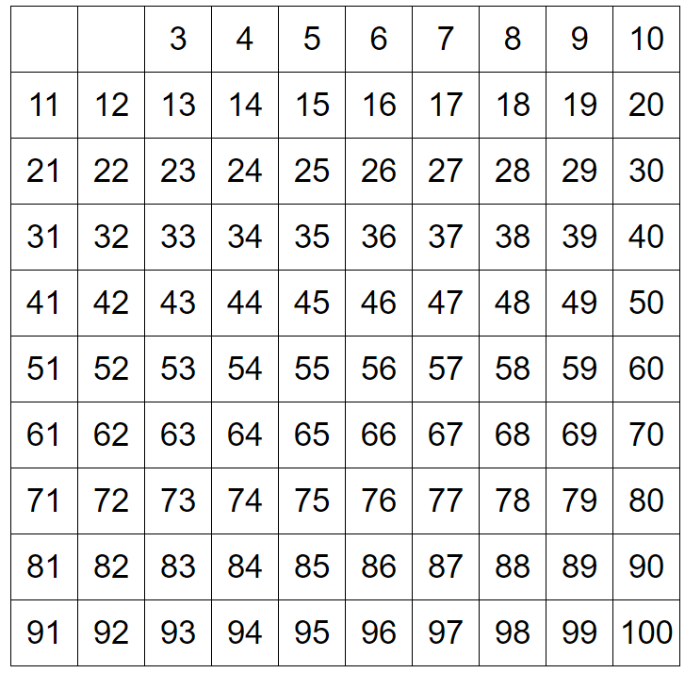
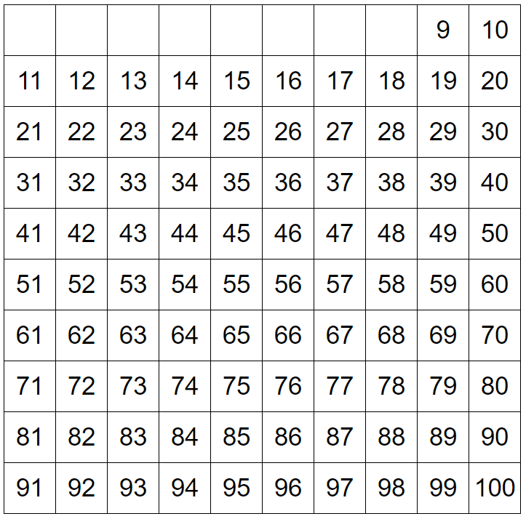
CLIC – It’s nothing new
I can find multiples of 3 (Y3) / 9 (Y4)

Slide 12
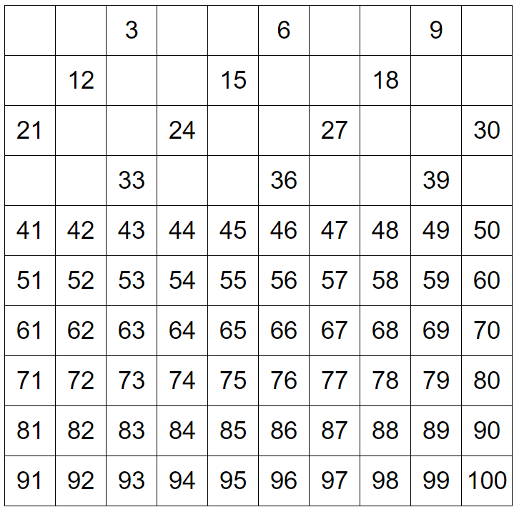
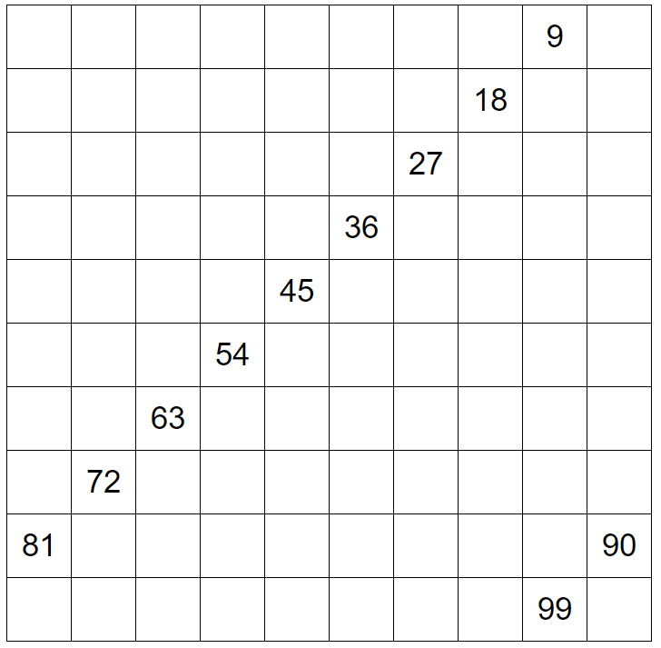
CLIC – It’s nothing new
I can find multiples of 3 (Y3) / 9 (Y4)

Slide 13
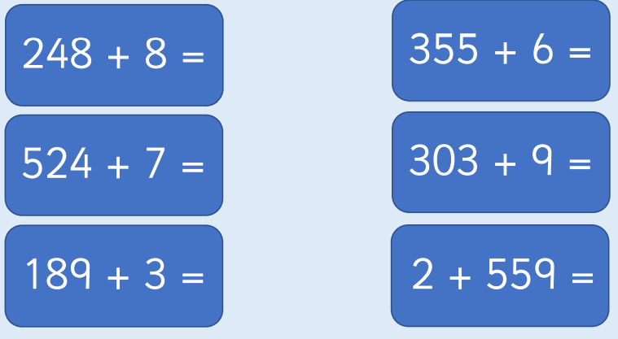
CLIC – Calculations
I can add number, with regrouping

Slide 14
Let’s make it CLIC
Thursday, 3rd December 2020

Slide 15
CLIC - Counting
True or false. Explain using your ACE explanation.
Doug has written the number two hundred twelve as 212.
Noah has written the number four hundred and two as 420.
Sophie has written the number five hundred seventy-two as 752.

Slide 16
CLIC - Learn Its
5 x 3 = 15
Year 3, your learn it this week is:
Year 4, your learn it this week is:
Fact families
Write the fact family for your learn it.
9 x 7 = 63

Slide 17
CLIC – It’s nothing new
Year 3
Find the largest multiple of 3, that is smaller than 44.
Year 4
Find the largest multiple of 9 that is smaller than 121.

Slide 18
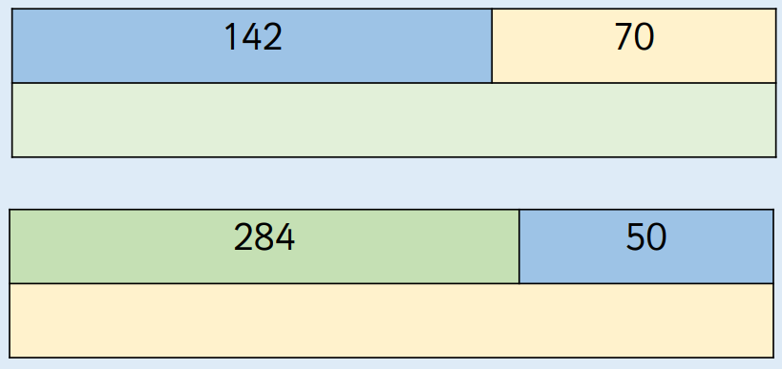
CLIC – Calculations
I can add two numbers with regrouping
Use columns of you cannot do it mentally!

Slide 19
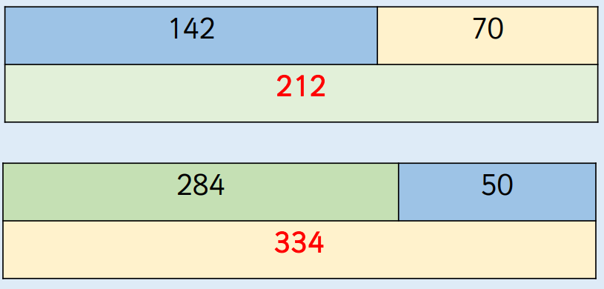
CLIC – Calculations
I can add two numbers with regrouping
Use columns of you cannot do it mentally!

