Slide 1
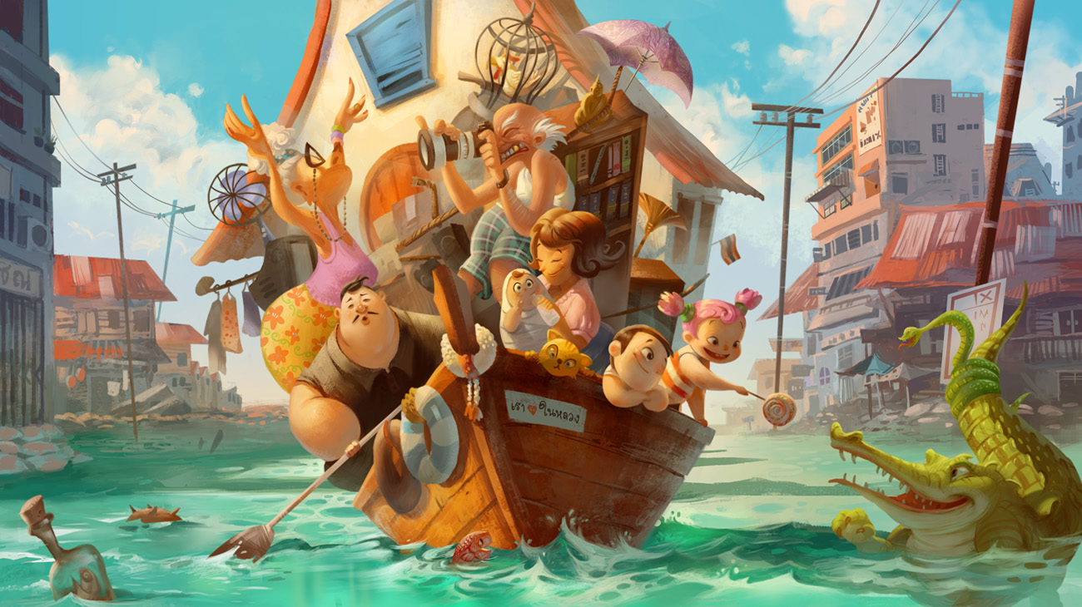
Look at the picture and answer the questions
Evacuation
Why are all of these people on the boat?
What has happened?
How do they feel about it?
How did they manage to get so much onto the boat (including a house!)?
Where do you think this is? Why?
Write a short story about this picture.

