Slide 1
Year 3
L.I - Can I order fractions?
Steps to success
I can identify the numerator and denominator.
I can compare the fractions.
I can identify the order of the fractions.
Challenge: True or false?
Year 4
L.I - Can I subtract fractions from whole amounts?
Steps to success
I can identify the numerator and denominator.
I can subtract the fractions by looking at the numerators.
I can use different representations.
Challenge: True or false?

Slide 2
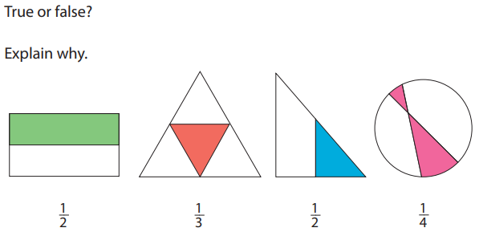
In Focus Task

Slide 3
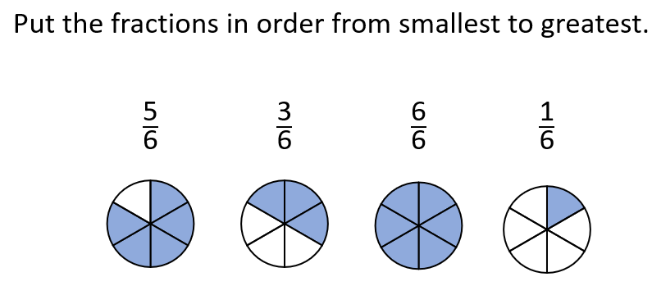
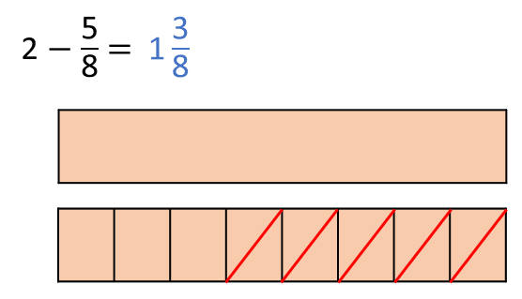
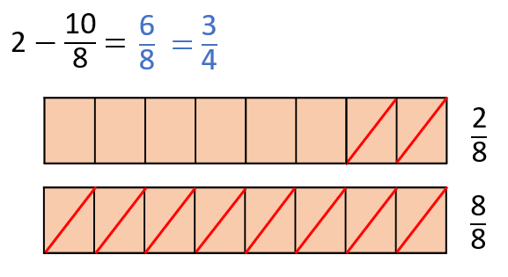
New Learning
Year 3
Year 4

Slide 4
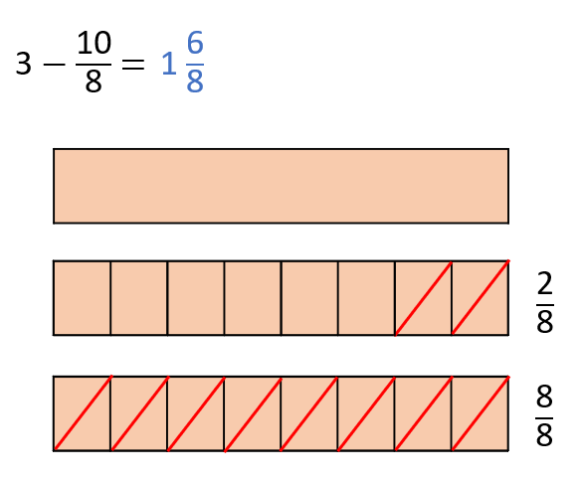
New Learning
Year 3
Year 4

Slide 5
New Learning
Stem sentences:
Y3:
When the denominators are the same, the greater the numerator, the greater the fraction.
When the denominators are the same, the smaller the numerator, the smaller the fraction.
Y4: When subtracting fractions that have the same denominator, you only change the numerator.

Slide 6
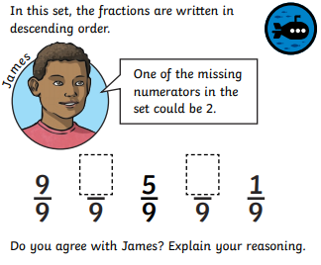
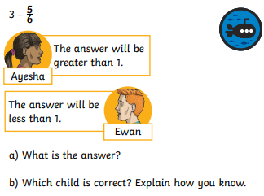
Talk Task
Year 3
Year 4

Slide 7
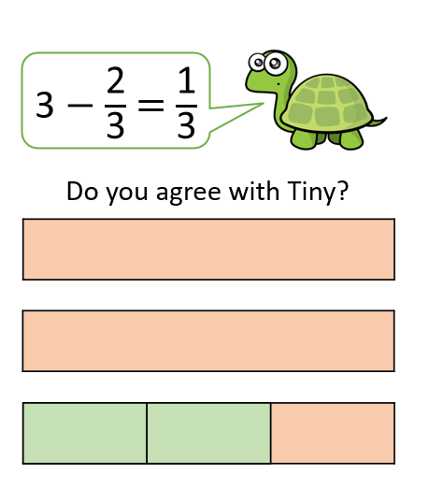
Develop Learning
Year 3
Year 4

Slide 8
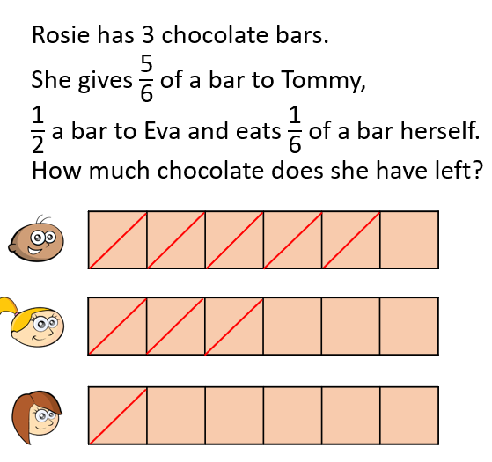
Develop Learning
Year 3
Year 4

Slide 9
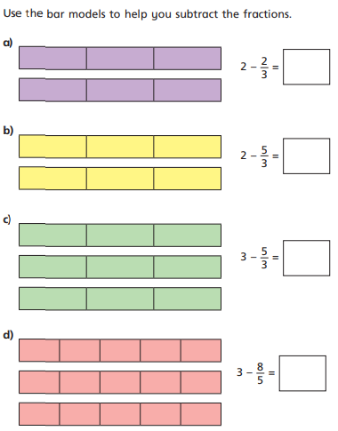
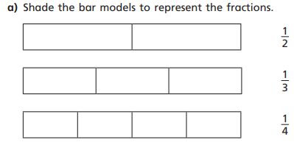
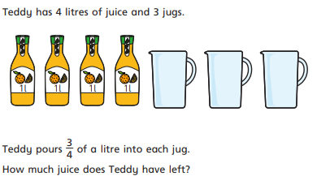
Independent Task
Year 3
Year 4

Slide 10
Plenary
Year 3
Year 4

