Slide 1
Year 3 – Summer Block 2 – Time
Step 2: Hours in a Day
© Classroom Secrets Limited 2019

Slide 2
Introduction
Sort the months.
There are ______ days in a year.
There are _____ days in a leap year.
There are _____ months in a year.
30 days | 31 days | 28 or 29 days
January
February
March
April
May
July
June
August
September
October
November
December
© Classroom Secrets Limited 2019

Slide 3
Introduction
Sort the months.
There are 365 days in a year.
There are 366 days in a leap year.
There are 12 months in a year.
30 days | 31 days | 28 or 29 days
April June September November | January March May July August October December | February
© Classroom Secrets Limited 2019

Slide 4
Varied Fluency 1
Match the statements to the correct number.
days in April |  | 4
hours in 3 days |  | 30
days in two weekends |  | 72
© Classroom Secrets Limited 2019

Slide 5
Varied Fluency 1
Match the statements to the correct number.
days in April |  | 4
hours in 3 days |  | 30
days in two weekends |  | 72
© Classroom Secrets Limited 2019

Slide 6
Varied Fluency 2
Put these events in the correct order from earliest to latest.
home time |  | morning registration
afternoon playtime |  | noon
© Classroom Secrets Limited 2019

Slide 7
Varied Fluency 2
Put these events in the correct order from earliest to latest.
morning registration
noon
afternoon playtime
home time
home time |  | morning registration
afternoon playtime |  | noon
© Classroom Secrets Limited 2019

Slide 8
Varied Fluency 3
Fill in the blanks:
There are _________ days in five weeks.
There are 12 ___________ in half a day.
© Classroom Secrets Limited 2019

Slide 9
Varied Fluency 3
Fill in the blanks:
There are _________ days in five weeks.
There are 12 ___________ in half a day.
35
hours
© Classroom Secrets Limited 2019

Slide 10
Varied Fluency 4
True or false?
Lunch is served around midday.
© Classroom Secrets Limited 2019

Slide 11
Varied Fluency 4
True or false?
Lunch is served around midday.
True because...
© Classroom Secrets Limited 2019

Slide 12
Varied Fluency 4
True or false?
Lunch is served around midday.
True because lunch is served in the ‘middle’ of the day – usually about 12 o’clock.
© Classroom Secrets Limited 2019

Slide 13
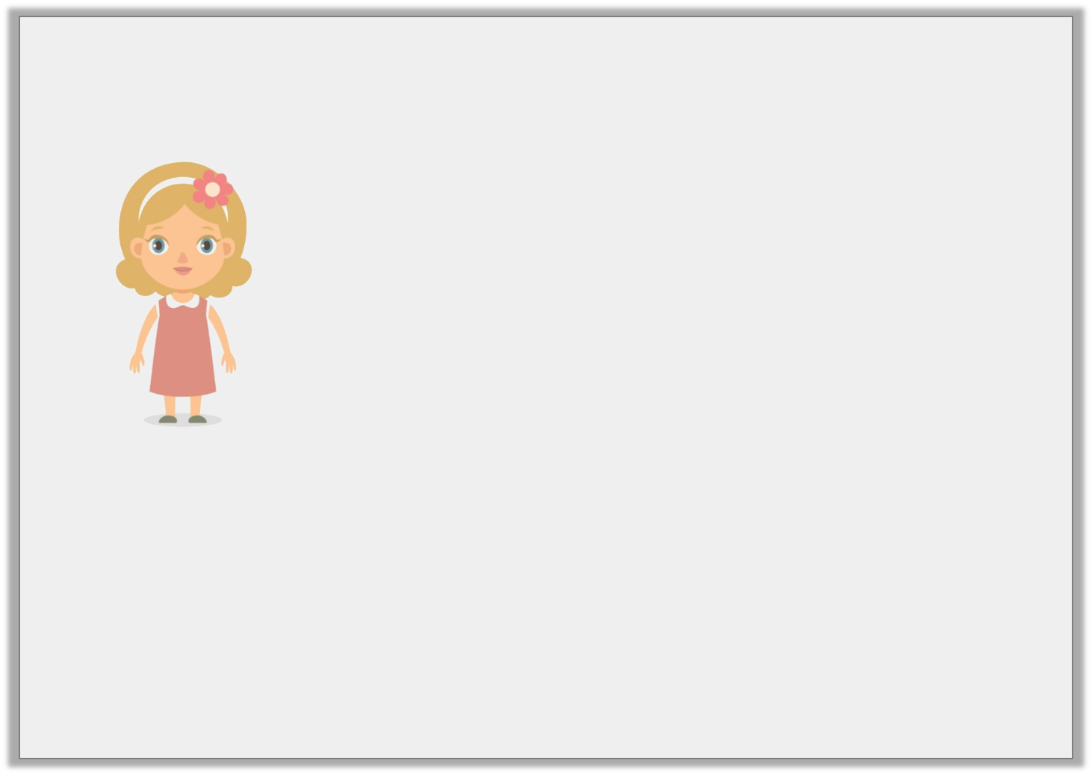
Reasoning 1
Ellie says:
Is that possible? Explain how you know.
Lunchtime is at 12 o’clock. So, whenever a clock shows 12 o’clock it has to be lunchtime.
© Classroom Secrets Limited 2019

Slide 14
Reasoning 1
Ellie says:
Is that possible? Explain how you know.
Ellie is incorrect because …
Lunchtime is at 12 o’clock. So, whenever a clock shows 12 o’clock it has to be lunchtime.
© Classroom Secrets Limited 2019

Slide 15
Reasoning 1
Ellie says:
Is that possible? Explain how you know.
Ellie is incorrect because a clock can say 12 o’clock in the middle of the night and in the middle of the day. Only one of those is lunchtime.
Lunchtime is at 12 o’clock. So, whenever a clock shows 12 o’clock it has to be lunchtime.
© Classroom Secrets Limited 2019

Slide 16
Reasoning 2
True or false?
“Today the sunset was at 8 o’clock. That means every day must finish at 8 o’clock.”
Explain how you know.
© Classroom Secrets Limited 2019

Slide 17
Reasoning 2
True or false?
“Today the sunset was at 8 o’clock. That means every day must finish at 8 o’clock.”
Explain how you know.
False because…
© Classroom Secrets Limited 2019

Slide 18
Reasoning 2
True or false?
“Today the sunset was at 8 o’clock. That means every day must finish at 8 o’clock.”
Explain how you know.
False because the sun sets at different times (depending on the season) and this doesn’t always mean the day has ended.
© Classroom Secrets Limited 2019

Slide 19
Problem Solving 1
How many days in this month are not weekend days?
Mo | Tu | We | Thu | Fri | Sa | Su
 |  |  | 1 | 2 | 3 | 4
5 | 6 | 7 | 8 | 9 | 10 | 11
12 | 13 | 14 | 15 | 16 | 17 | 18
19 | 20 | 21 | 22 | 23 | 24 | 25
26 | 27 | 28
© Classroom Secrets Limited 2019

Slide 20
Problem Solving 1
How many days in this month are not weekend days?
20 days are not weekend days
Mo | Tu | We | Thu | Fri | Sa | Su
 |  |  | 1 | 2 | 3 | 4
5 | 6 | 7 | 8 | 9 | 10 | 11
12 | 13 | 14 | 15 | 16 | 17 | 18
19 | 20 | 21 | 22 | 23 | 24 | 25
26 | 27 | 28
© Classroom Secrets Limited 2019

