Slide 1
L.I - Can I find fractions of an amount?
Steps to success
- I can identify the numerator and denominator.
- I can use the division symbol to find fractions.
- I can write this as a number sentence.
Challenge: True or false?

Slide 2


In Focus Task
Look at the marbles.
How many different ways can you divide these into equal groups?
Which operation do we use to find a fraction of an amount?

Slide 3


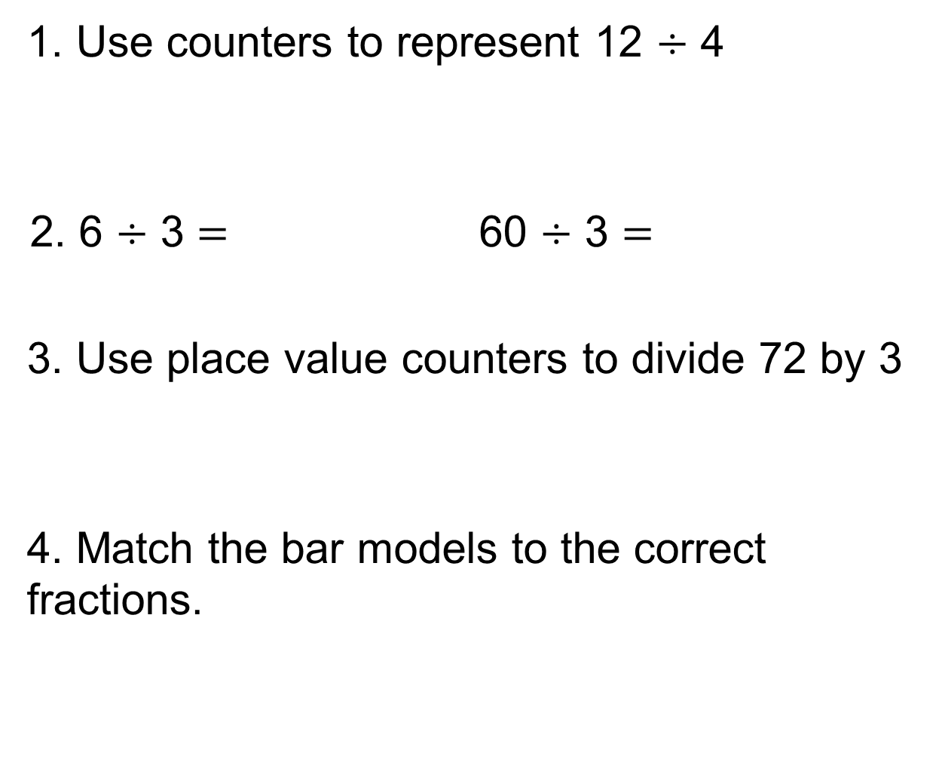




New Learning
1. Use counters to represent 12 $÷$ 4
2. 6 $÷$ 3 $=$ 60 $÷$ 3 $=$
3. Use place value counters to divide 72 by 3
4. Match the bar models to the correct fractions.
$\frac{\text{1}}{\text{3}}$
$\frac{\text{1}}{\text{4}}$
$\frac{\text{1}}{\text{2}}$
$\frac{\text{1}}{\text{6}}$

Slide 4

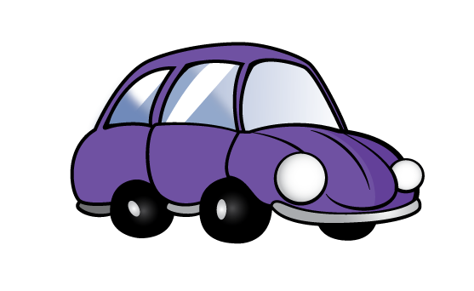

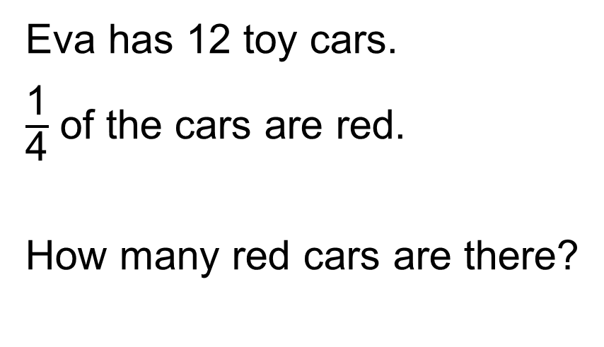
Talk Task
Eva has 12 toy cars.
$\frac{\text{1}}{\text{4}}$ of the cars are red.
How many red cars are there?
What do you notice about the denominators and the groups?
How would you write this as a division number sentence?

Slide 5
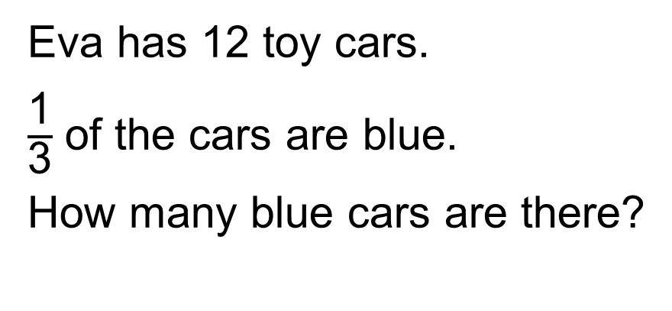
Develop Learning
Eva has 12 toy cars.
$\frac{\text{1}}{\text{3}}$ of the cars are blue.
How many blue cars are there?
How would you write this as a division number sentence?

Slide 6
Develop Learning
Eva has 12 toy cars.
$\frac{\text{1}}{\text{3}}$ of the cars are blue.
How many blue cars are there?
How would you write this as a division number sentence?

Slide 7
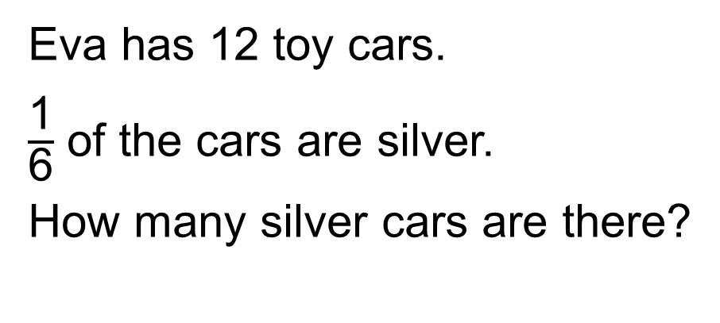
Develop Learning
Eva has 12 toy cars.
$\frac{\text{1}}{\text{6}}$ of the cars are silver.
How many silver cars are there?
12
2
2
2
2
2
2
How would you write this as a division number sentence?

Slide 8
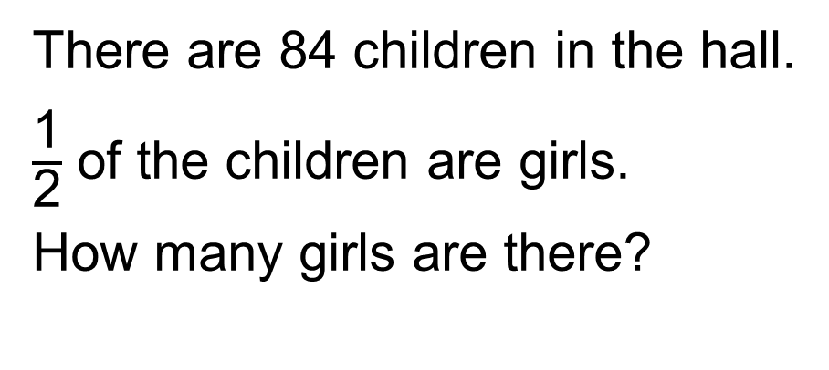
Develop Learning
There are 84 children in the hall.
$\frac{\text{1}}{\text{2}}$ of the children are girls.
How many girls are there?
84
How would you write this as a division number sentence?

Slide 9
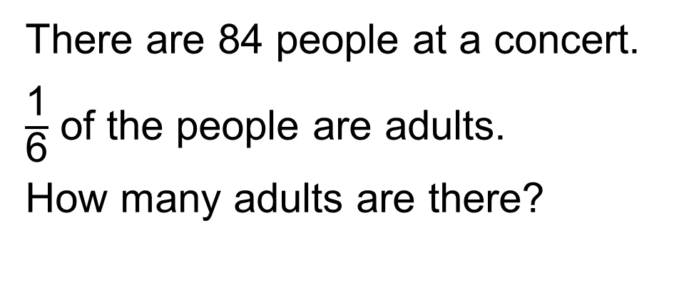
Develop Learning
There are 84 people at a concert.
$\frac{\text{1}}{\text{6}}$ of the people are adults.
How many adults are there?
84
How would you write this as a division number sentence?

Slide 10
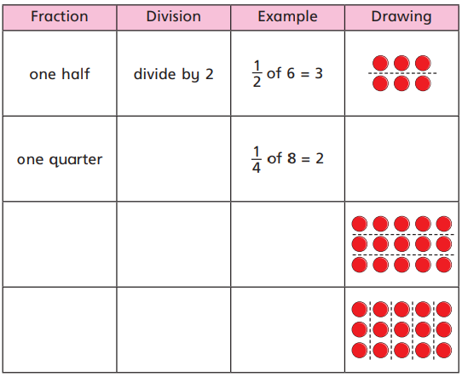
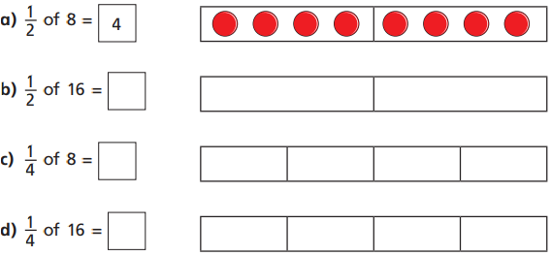
Independent Task
Circle ¼ of the counters.
How many counters did you circle?
What is ¼ of that amount of counters?
Complete the table.
a
b
c
Draw counters in the bar models to help you complete each number sentence. The first one has been done for you.

Slide 11

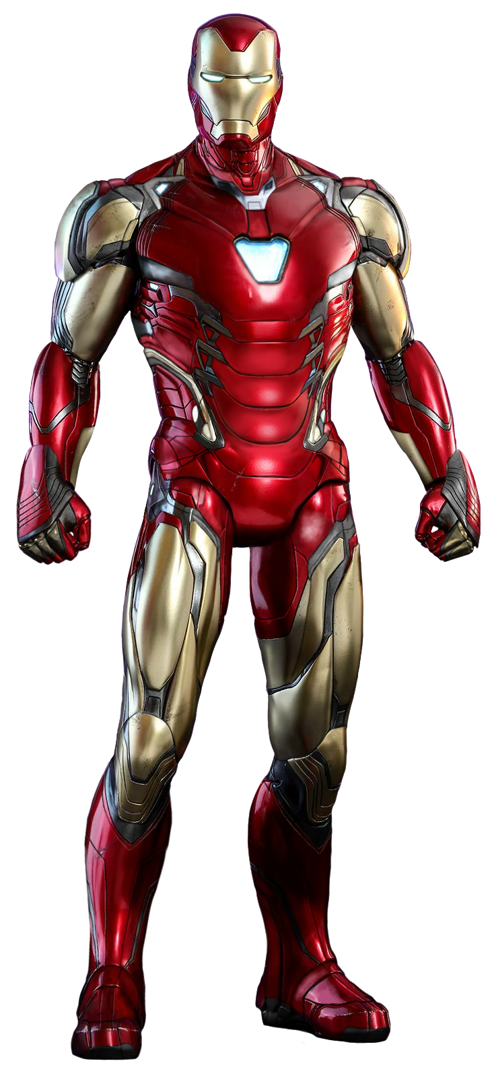

Independent Task
Iron Man uses a bar model and place value counters to find 1/3 of 36.
Use Iron Man’s method to complete the calculations.
a) 1/3 of 96 b) 1/5 of 60 c) 1/4 of 52

Slide 12
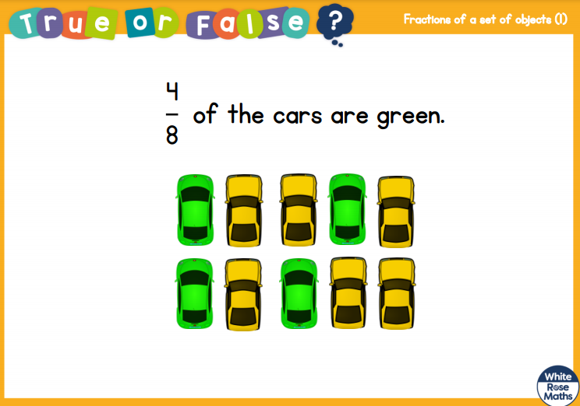
Plenary

