Slide 1
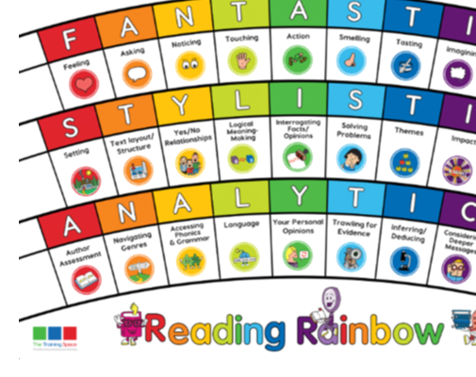
^{Monday 26th} April 2021
Lesson 1: Initiate
BOOK TALK

Slide 2
Our LI’s for the week: Band 3/4 - Can I Identify vocabulary within a text that gives the best description of the setting or character? - Can I identify word classes taught and discuss the meaning of these words?

Slide 3
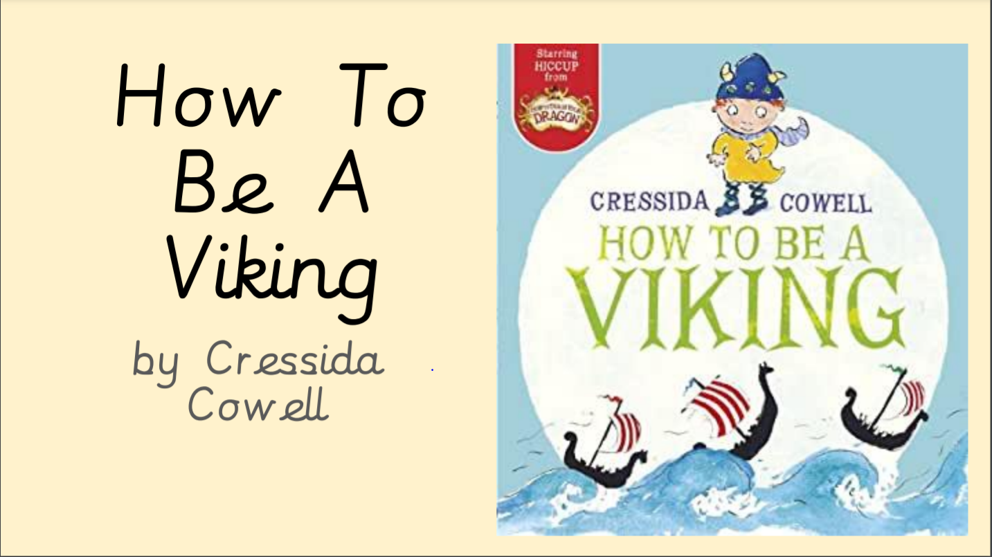
Fiction: How to be a Viking
We are focusing on these 2 lenses
this week:
FANTASTICS: Noticing
ANALYTICS: Accessing phonics and grammar

Slide 4
Sentence starters:
In your books, write down the following sentence starters for each of the lenses. These will help you when you write your answers this week.
Noticing:
We see the world through the main characters eyes when………
An image is created in the readers mind when……
Accessing Phonics and Grammar:
The most arresting adjectives used by the writer are _______ .
A sentence that ‘caught our eye’ was ______________ because….

Slide 6
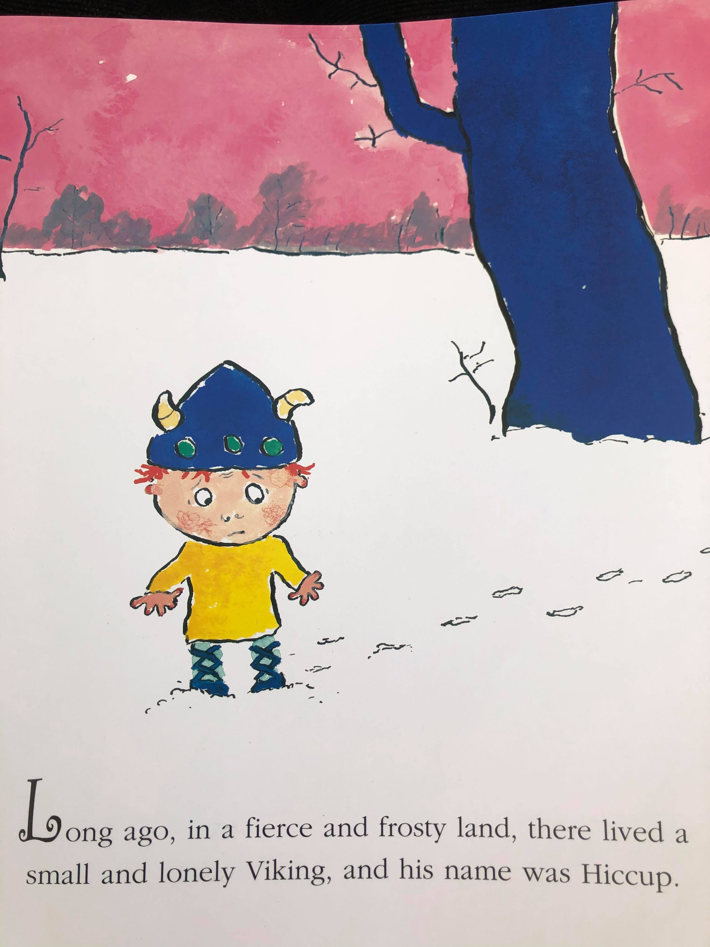
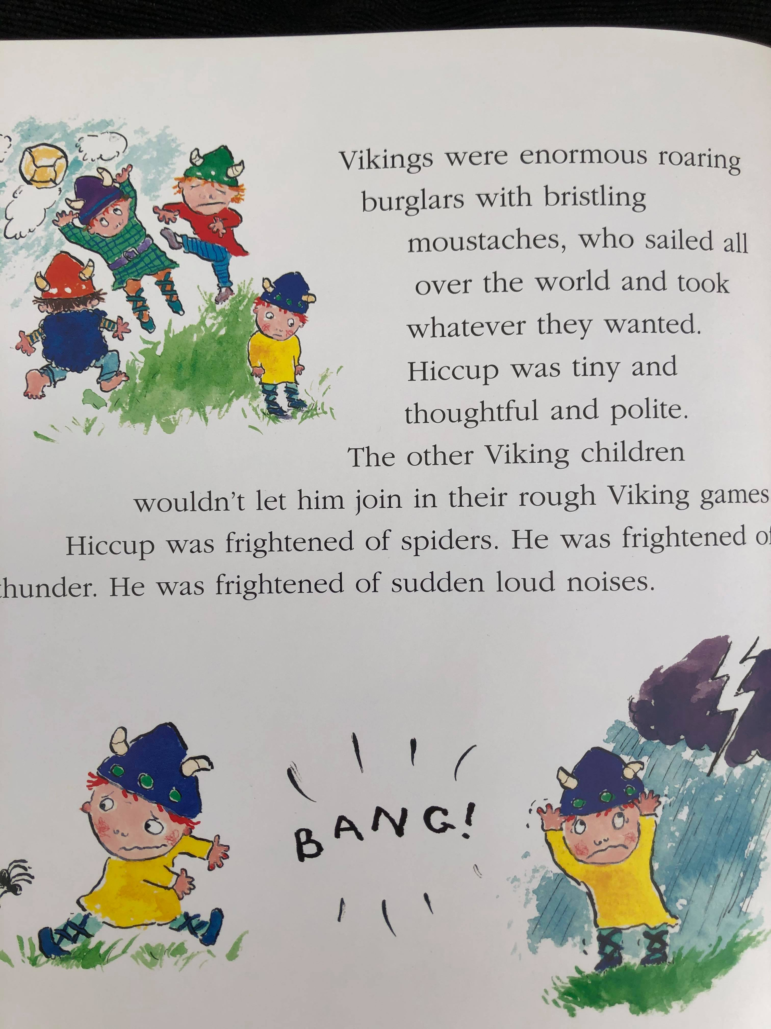

Slide 7
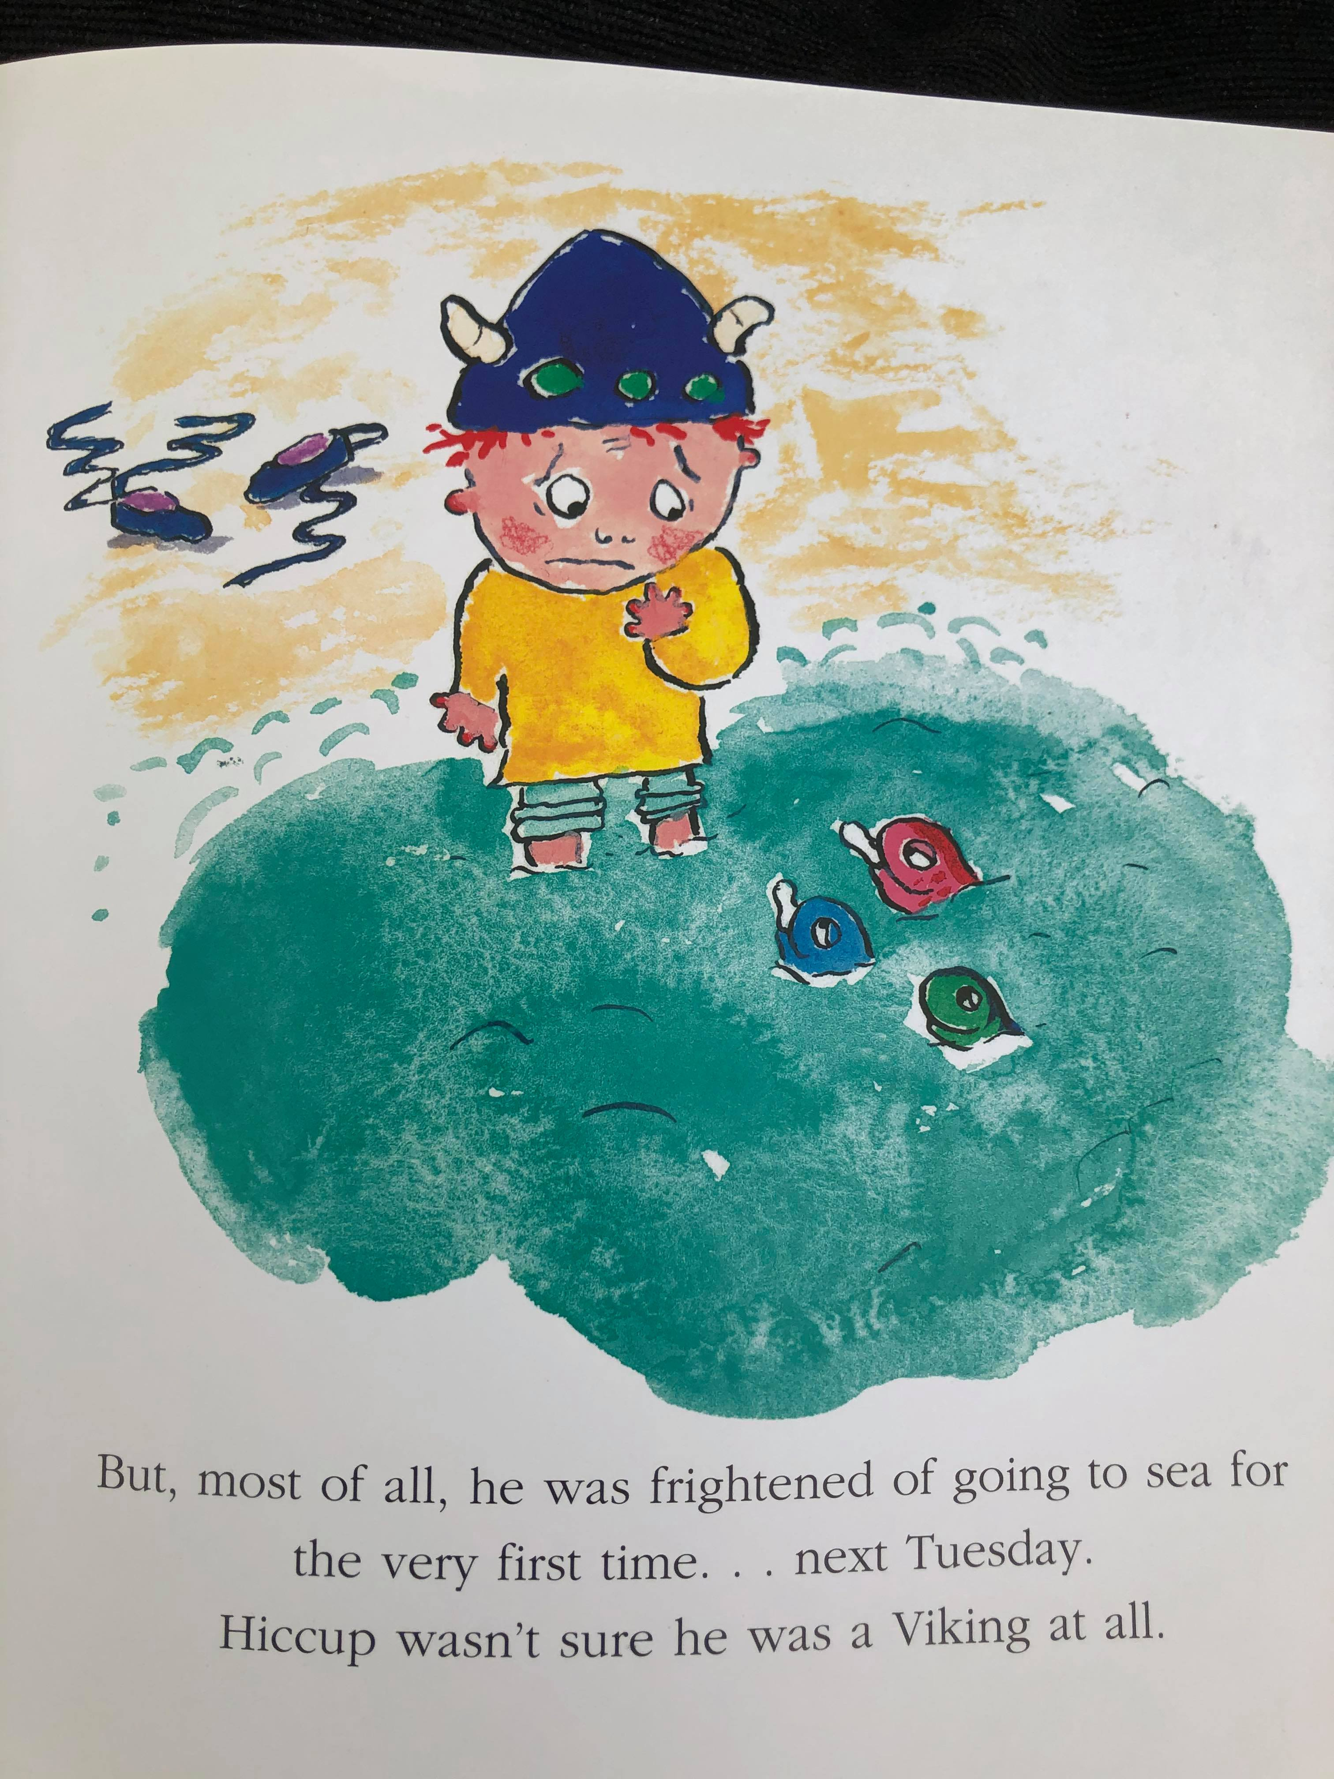

Slide 8
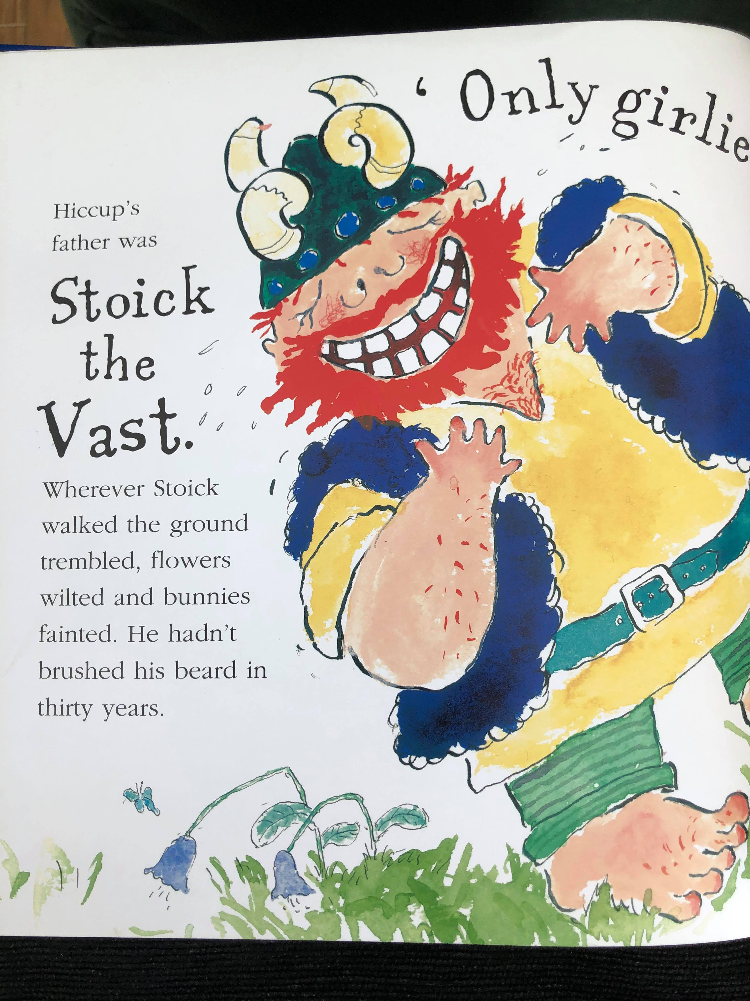
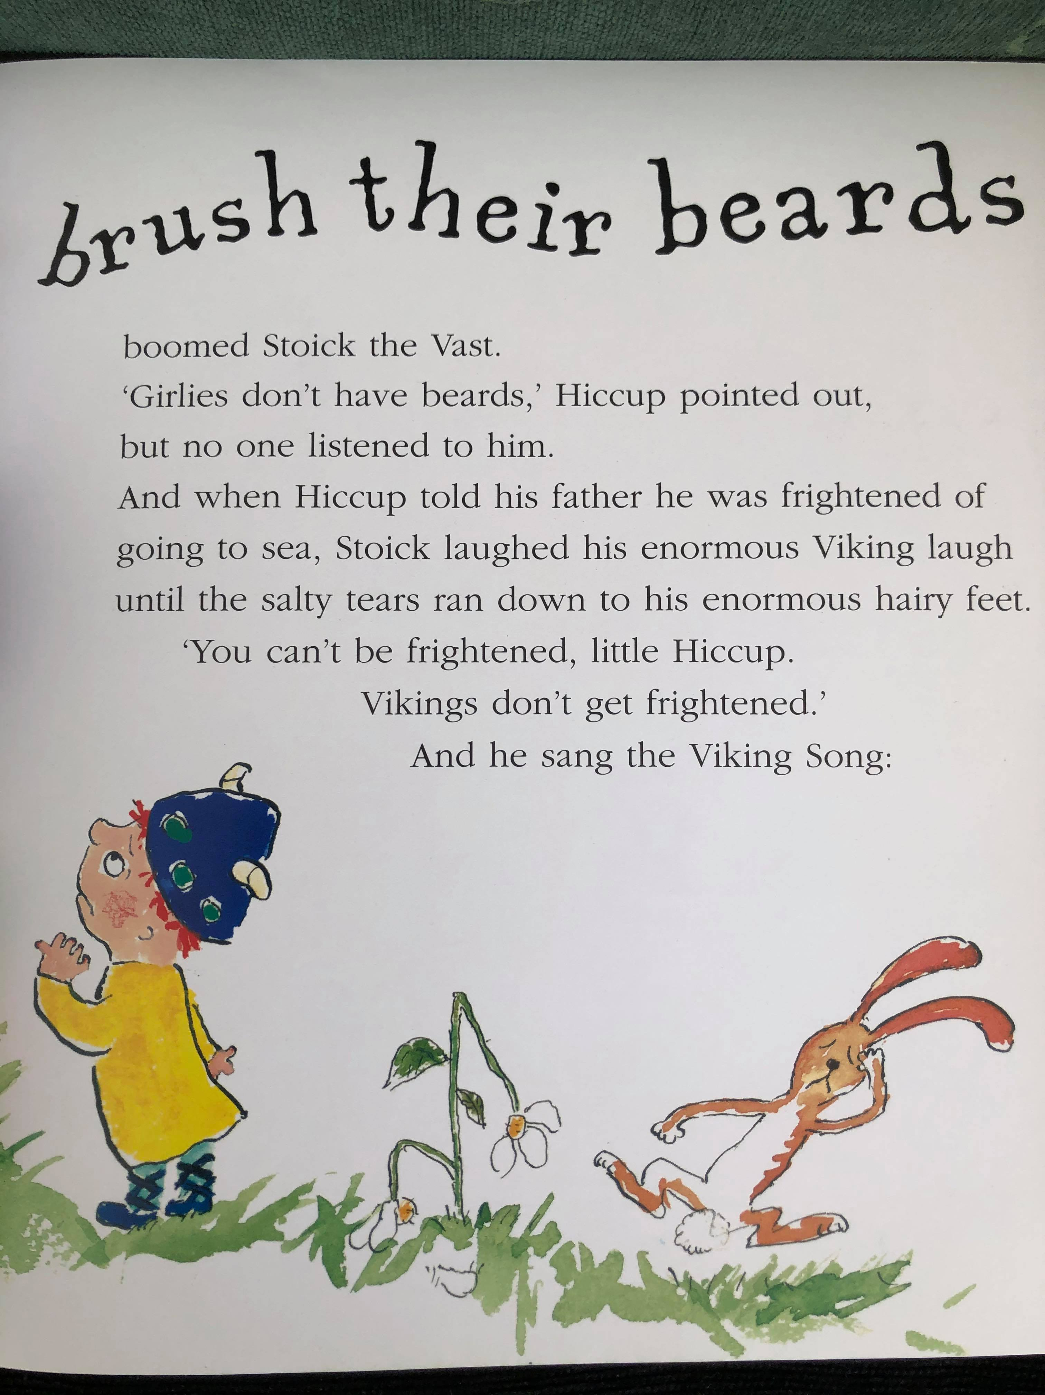

Slide 9
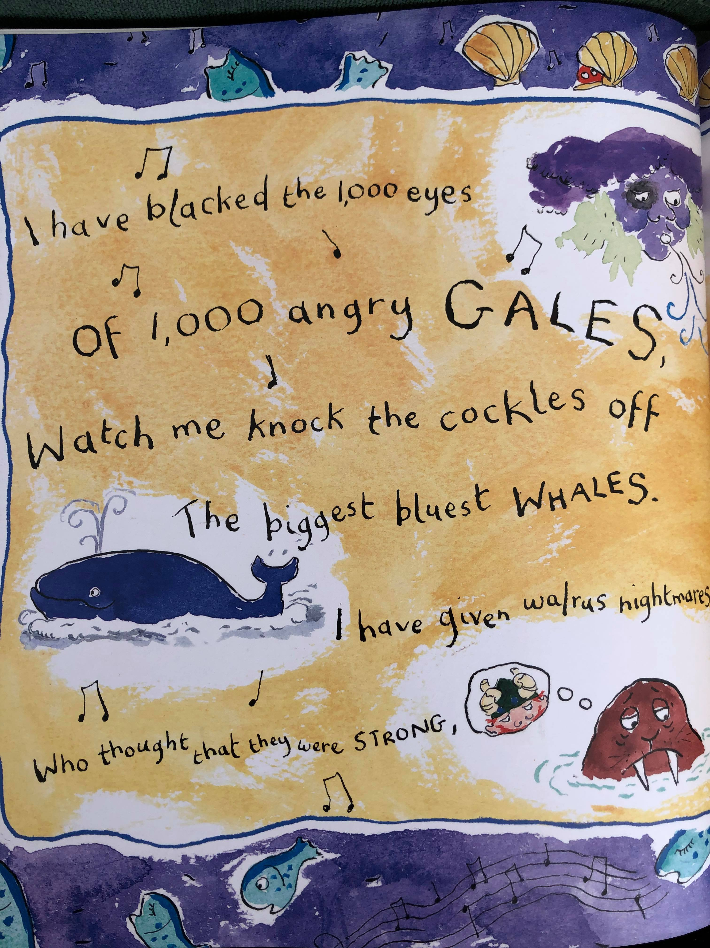
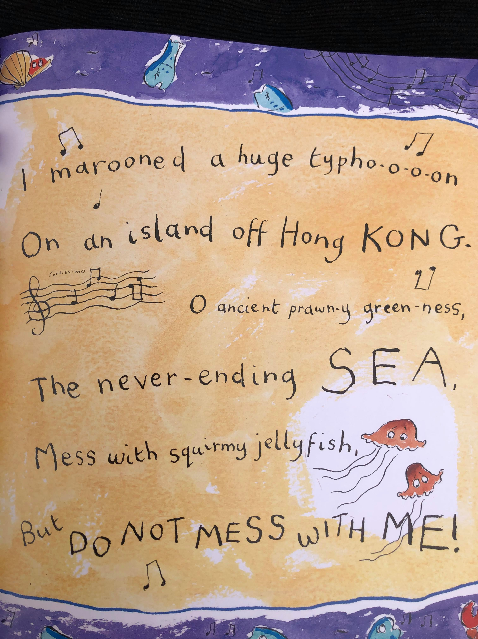

Slide 10
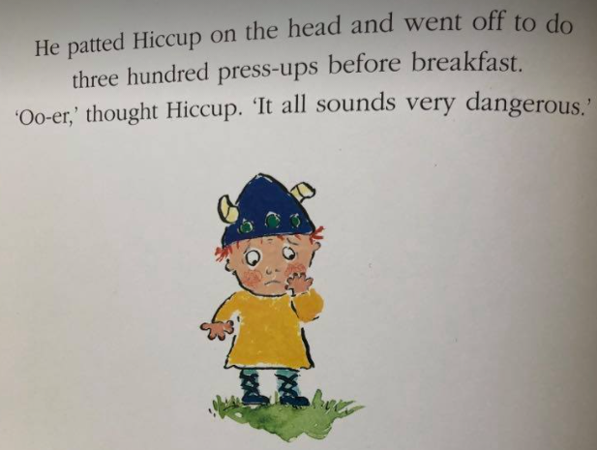

Slide 11
Noticing:
Can you verbally answer the questions using a sentence starter? (2 points)
What do you notice about how the main character Hiccup sees the world?
We see the world through the main characters eyes when………
How does the author describe Stoik the Vast to make the reader understand what sort of a man he is?
An image is created in the readers mind when……

Slide 12
Accessing Phonics and Grammar:
Can you verbally answer the questions using a sentence starter? (2 points)
Find three adjectives that best describe Stoik the Vast.
The most arresting adjectives used by the writer are _______
How does the writer use verbs to show how terrifying Hiccups father is?
A sentence that ‘caught our eye’ was ______________ because….

Slide 13
^{Tuesday 27th} April 2021
Lesson 2:
MODEL

Slide 14
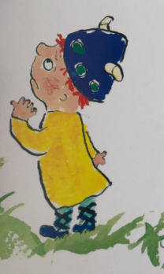
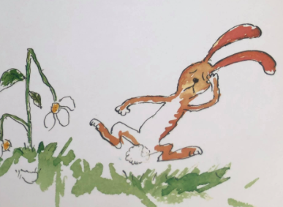
Lesson 2 – Model
We are focusing on these 2 lenses
this week:
FANTASTICS: Noticing
ANALYTICS: Accessing phonics and grammar
We will write the answers together, but you can add in extra information if you would like to.

Slide 15
Noticing:
Accessing phonics and Grammar:
What do you notice about how the main character Hiccup sees the world?
We see the world through the main characters eyes when………
How does the author describe Stoik the Vast to make the reader understand what sort of a man he is?
An image is created in the readers mind when……
Find three adjectives that best describe Stoik the Vast.
The most arresting adjectives used by the writer are _______
How does the writer use verbs to show how terrifying Hiccups father is?
A sentence that ‘caught our eye’ was ______________ because….

Slide 16
^{Thursday 28th} April 2021
Lesson 3:
ENABLE

Slide 17
Lesson 3: Enable
Non Fiction: Famous scientists
Today is your turn to answer questions on your own.
Please use the sentence starters from this week to help you.
FANTASTICS: Noticing
ANALYTICS: Accessing phonics and Grammar

Slide 18
Lesson 3: ENABLE (Independent comprehension)
Year 3
Find and copy a sentence where the writer has used personification to describe the setting.
2) How does the author use vocabulary to best describe Vikings?
The most arresting adjectives used by the writer are …….
3) How does the author show us how Stoik the Vast is brave and fearless?
We see the world through the main characters eyes when………
Bonus question
4 )
A sentence that ‘caught our eye’ was ______________ because….
Year 4
1) Find and copy a sentence where the author has used personification to describe the setting.
2) How does the author use vocabulary to best describe vkings
The most arresting adjectives used by the writer are …….
3)
4)

