Slide 1
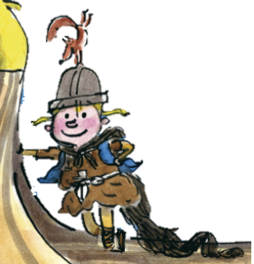
The Littlest Viking
Stories with different points of view
Tuesday 4 May 2021

Slide 2
LI: Can I gather interesting vocabulary?
Stories with different points of view
Steps to success:
I can notice details and match the object to its name
I can listen carefully and identify sounds
I can identify different smells

Slide 3
Experience session
We are going to gather vocabulary and phrases to use in our writing over the next few week.
We are going to use

Slide 4
Flotsam, sound and smells
We are going to look for flotsam and look closely at the details we notice.
We are going to listen to the sounds of the sea and identify good sound words.
We are going to smell the sea and think of great words and phrases to describe them.

Slide 5
Sounds of the sea
Listen to the videos
https://www.youtubekids.com/watch?v=wasGNXNdVgo
https://www.youtube.com/watch?v=s5APVDMDNXk
I want you to identify all the sounds you can hear
We are going to list good sound words to use later this week.

Slide 6
Smells of the sea
I want you to smell the different smelling pots.
Write down what you smell.
Are there any other smells you associate with the sea?
We are going to list good smelling words to use later this week.

Slide 7
Flotsam on the beach
We are going to find and identify flotsam from the beach.
We are going to list good noticing words to use later this week.

Slide 8
Experience session
What favourite (new) words or phrases have you found today?

