Slide 1
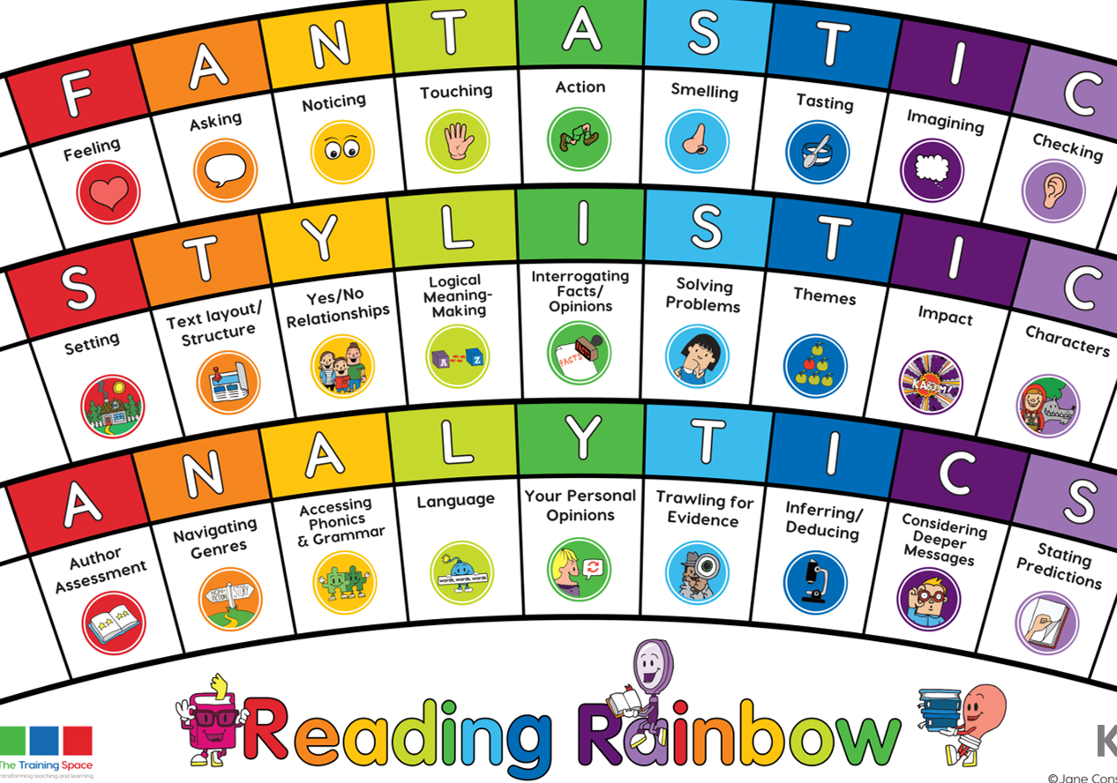
Our LI’s for the week: Skim and scan to find key words given. Read fluently without sounding out words.
Lesson 1:
Initiate

Slide 2
Lenses:
Text Layout
Genres
Sentence Starters:
Text Layout:
Information in this non-fiction text is made eye-catching by…
Genres:
It is clear that this text is an example of a non-fiction text, due to…

Slide 4
Lesson 2:
MODEL
Please write this in the margin.

Slide 5
Text layout
In this piece of text, do you think it is eye-catching? Why do you get this impression?
Together: scan for eye-catching vocabulary and images and chot down the evidence.

Slide 6
Genres
Give at least two pieces of evidence that shows me this is a piece of non-fiction text.
Together: read through the text again. Chot down examples of why this piece of text is factual.

Slide 7
Lesson 3:
ENABLE please write this in the margin.

Slide 8
Session 3 – Enable (Independent comprehension)
Why has the author design the layout in this way?
2) Find and copy words and phrases that show this piece of text is non-fiction.
Bonus question: Year 3
3) Find and copy two examples of eye-catching subheadings.
Bonus question: Year 4
3) Find and copy examples of subheadings used in the text.

