Slide 1
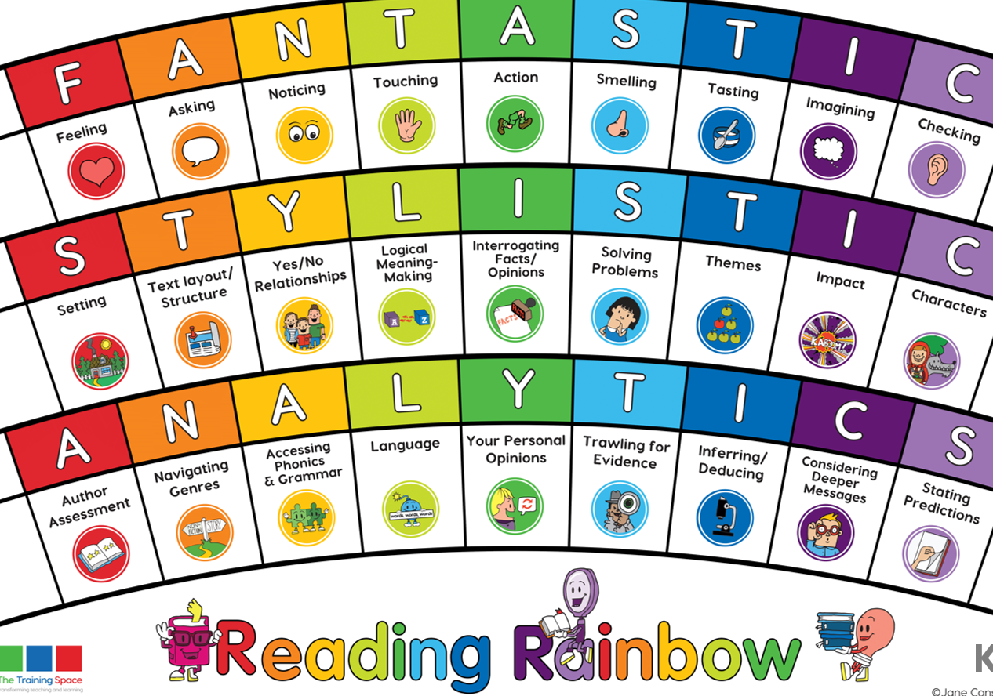
Our LI’s for the week: Skim and scan to find key words given. Read fluently without sounding out words.
Lesson 1:
Initiate

Slide 2
Lenses:
Language
Themes
Sentence Starters:
Language:
The writer uses poetic devices such as…
Theme:
The theme of nature is most notably demonstrated by…

Slide 3
Lesson 2:
MODEL
Please write this in the margin.

Slide 4
Language
The poet uses several poetic devices in this poem.
Together: scan for examples of poetic devices and chot down the evidence.

Slide 5
Theme
Give at least two pieces of evidence that show that the main theme of the poem is nature.
Together: read through the text again. Chot down examples of where the theme of nature is most evident.

Slide 6
Lesson 3:
ENABLE please write this in the margin.

Slide 7
Session 3 – Enable (Independent comprehension)
The writer uses poetic devices such as…
2) The theme of nature is most notably demonstrated by…
Bonus question: Year 3
3) Why has the poet chosen to use repetition in this poem?
Bonus question: Year 4
3) Why has the poet italicised the word ‘I’ in the line ‘Anywhere, anywhere. I don’t know.’?

