Slide 1
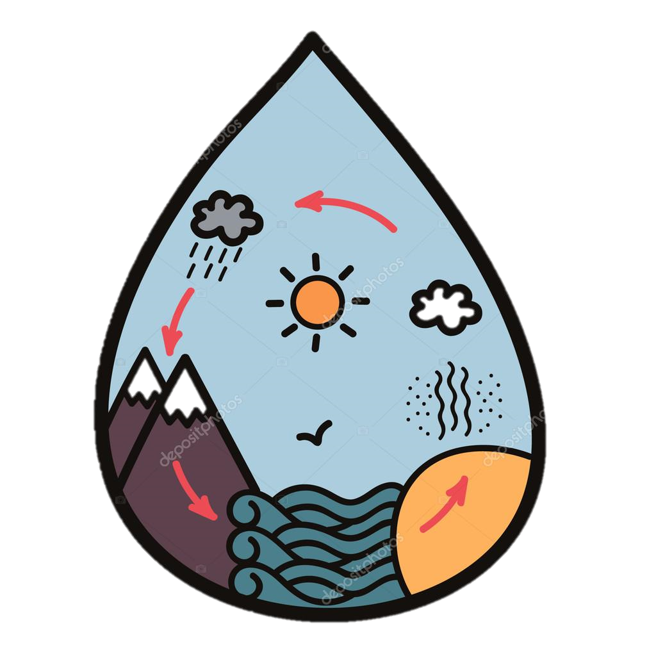
The Water Cyle
Explanation Text
Monday 7 June 2021

Slide 2
LI: Can I gather topic related vocabulary?
Explanation Text
Steps to success:
I can take notes
I know the four stages of the water cycle
I can find five water facts

Slide 3
1
2
3
4
5
6

Slide 4
The Water Cycle never stops
Watch the video and collect key words.
Geography KS1/KS2: The water cycle - BBC Teach

Slide 5
The Water Cycle never stops
Water on Earth is constantly moving. It is recycled over and over again. This recycling process is called the water cycle.
1. Water evaporates into the air
The sun heats up water on land, in rivers, lakes and seas and turns it into water vapour. The water vapour rises into the air.
2. Water vapour condenses into clouds
Water vapour in the air cools down and changes back into tiny drops of liquid water, forming clouds.

Slide 6
The Water Cycle never stops
Water on Earth is constantly moving. It is recycled over and over again. This recycling process is called the water cycle.
3. Water falls as precipitation
The clouds get heavy and water falls back to the ground in the form of rain or snow.
4. Water returns to the sea
Rain water runs over the land and collects in lakes or rivers, which take it back to the sea. The cycle starts all over again.

Slide 7
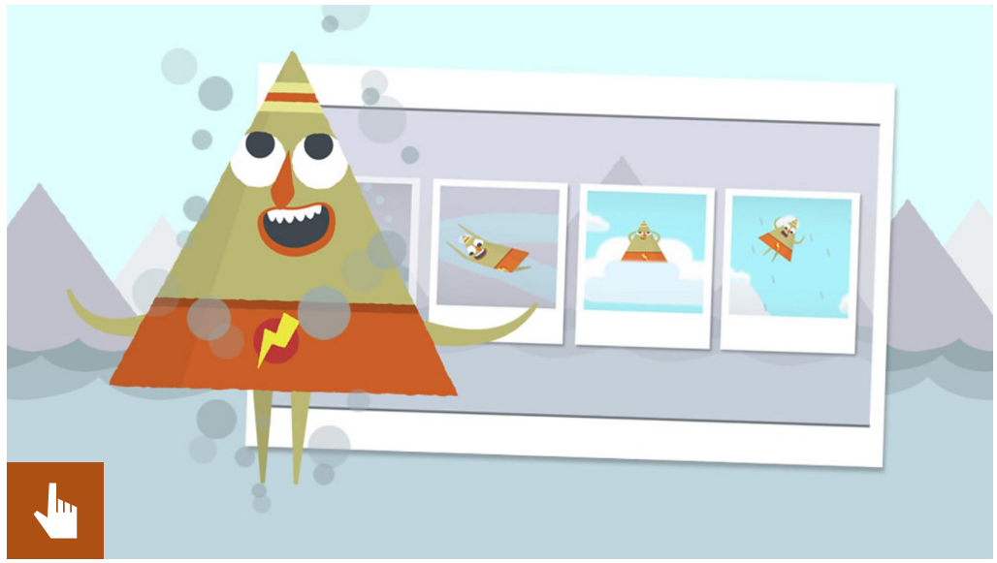
The Water Cycle never stops
Play the Water Cycle Quiz

Slide 8
Water Facts
Let’s read
Listen out for some good water facts and write them down.

Slide 9
Water Facts
Let’s read
Find more interesting water facts and write them down.

Slide 10
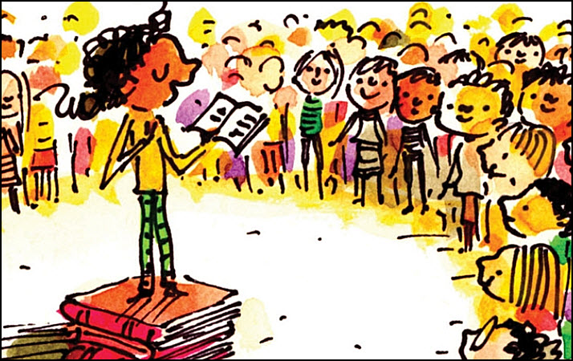
Share and feedback
Share your work
What interesting facts have you found?

