Slide 1
The Water Cycle
Explanation Text
Wednesday 9 June 2021

Slide 2
LI: Can I draft and write an explanation text?
Explanation Text
Steps to success:
I can use the touch lens to describe the feel of the sun
I can use a complex sentence
I can use feeling words and precise verbs to keep the reader engaged

Slide 3
Evaporation
Watch the first 19 seconds of this video.
What is needed for the water to heat up on the surface of the earth?
Find similar words for the sun’s shining.
Write them in the first box.
1

Slide 4
Evaporation
Here are some of my ideas.
Beaming
Radiant
Glowing
Shimmer
1

Slide 5
Evaporation
Let’s collect some words to describe the surface of the water.
Write them in the second box.
2

Slide 6
Evaporation
Here are some of my ideas.
Ripples
Waves
Skin
Face
2

Slide 7
Evaporation
Model sentence:
Perfect! The sun is shining. Can you feel that heat on your skin or should I say surface?
Your task:
Describe the sun and create a question to get visitors to notice how the sun feels on their bodies.
Deepen the moment: Use an adjective to show your pleasure that the sun is warm.

Slide 8
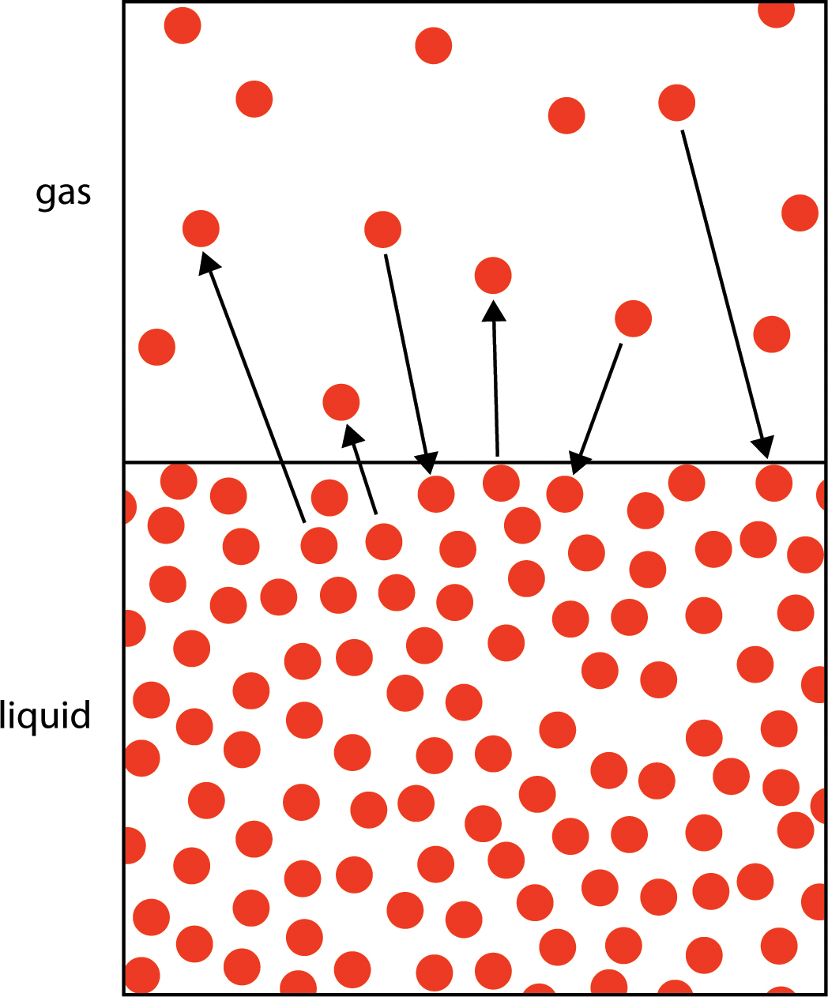
Evaporation
What happens to water molecules when they get heated?
How can we describe the sun’s energy? The va-va-voom, zing, spark, vitality?
Write your ideas in the third box.
3

Slide 9
Evaporation
Here are some of my ideas:
Spirit
Vigour
Life
Exuberance
Effervescence
Power
Dynamism
Ardour
Bounce
Solar spark
3

Slide 10
Evaporation
Model sentence:
Feeling hot yet? When, the sun’s energy warms you up enough, all that solar sparkle turns you into water vapour. Feeling lighter? You are a gas! Off we go up into the atmosphere like a released balloon. Woo-hoo!
Your task:
Ask your visitors if they feel warm. Describe what happens when the sun warms liquid water using an adjective for the sun’s energy. Tell your visitors they are a gas
Deepen the moment: Use a simile to describe the feeling of floating.

Slide 11
Evaporation
What would it feel like to float up in the sky?
Write some positive feeling words in the fourth box.
4

Slide 12
Evaporation
Here are some of my ideas:
Fun
Thrilling
Delightful
Exciting
Exhilarating
Alive
Like freedom.
4

Slide 13
Evaporation
How can we describe the movement of the water vapour molecules?
Write your ideas in the last box.
5

Slide 14
Evaporation
Here are some of my ideas:
Bounce around
Wander
Meander
5

Slide 15
Evaporation
Model sentence:
This is called evaporation. Fun, isn’t it? Trail the sky, drift around, feel like a bird.
Your task:
Explain this process as evaporation and ask the visitor how it feels. Tell them to enjoy the experience using positive action and feeling words.
Deepen the moment: Write a step sentence to link to the next paragraph of condensation or add a relevant water fact.

Slide 16
Share and feedback
Share your work
What sentence are your proud of?
What does the class think of the work?
How could we make it even better?

