Slide 1
Year 4
L.I - Can I calculate money in pounds and pence?
Steps to success
- I can identify the value of the notes and coins.
- I can use the value of notes and coins to calculate totals.
-Challenge: True or false?
Year 3
L.I - Can I solve simple problems involving pounds and pence?
Steps to success
- I can identify the value of the notes and coins.
- I can use the value of notes and coins to find totals and solve simple problems
-Challenge: True or false?
Alternative provision
L.I - Can I recognise the symbols aor £ and pence and combine amounts to make a total?
Steps to success
- I can identify the value of the notes and coins.
- I can use the value of notes and coins to calculate totals.
-Challenge: True or false?

Slide 2
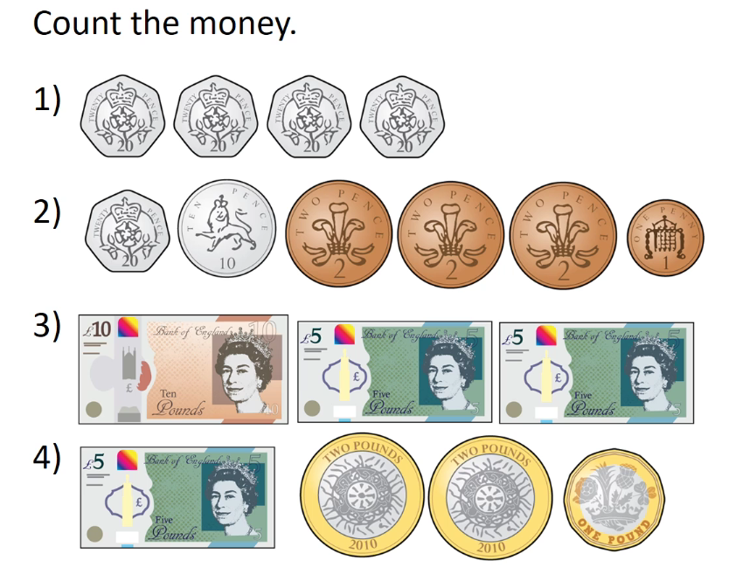
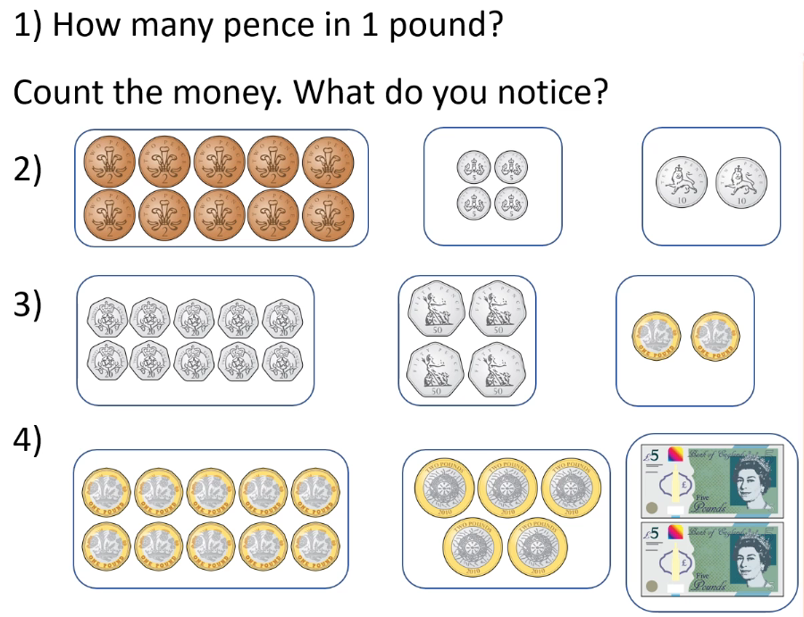
In Focus Task
Year 3
Year 4
How many different ways could you make £10 ?

Slide 3
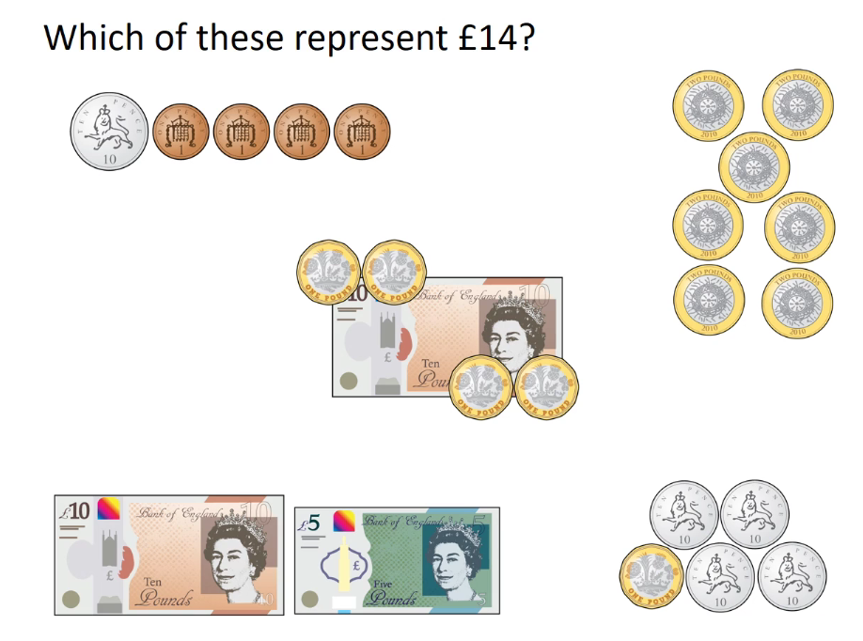
Talk Task
Can you make £14 a different way?

Slide 4
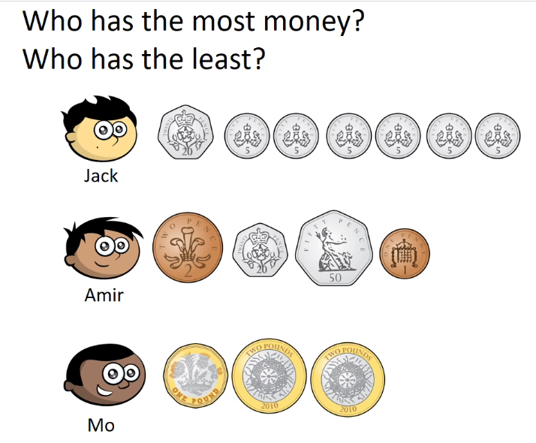
Develop Learning

Slide 5
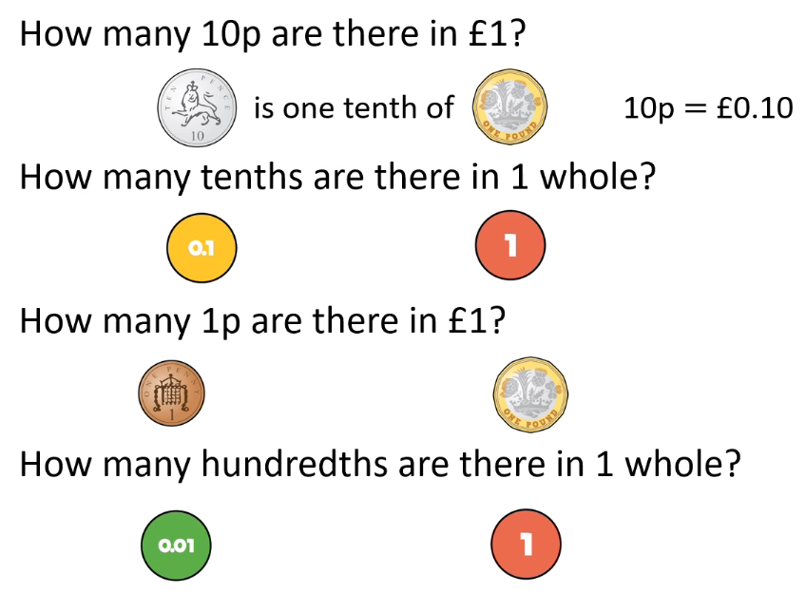
Develop Learning
Year 3
Year 4
She says
How many ways can you find?
Try only using bronze coins?

Slide 6
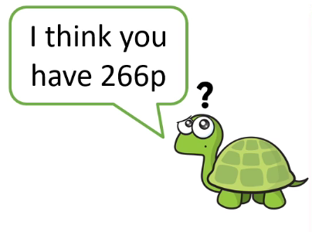
Develop Learning
First sort the money into pounds and pence to help you count it

Slide 7
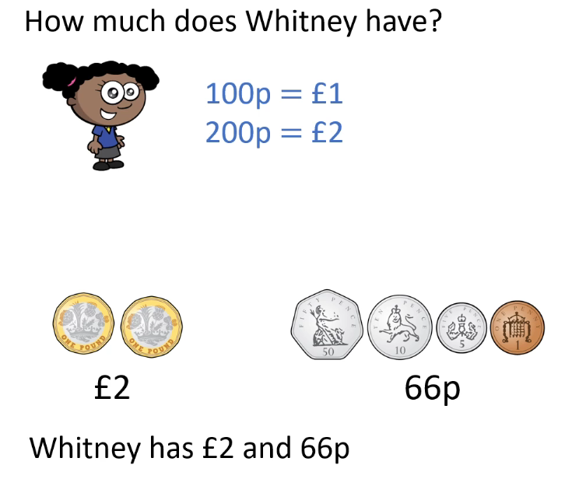
Develop Learning
Now all try this one
Year 4
Remember to sort the money into pounds and pence in order starting with the largest amount first.
Year 4 can you write this as a decimal?
Lets look at how we can write this as a decimal:
Remember 10p is 1/10 of a pound so 60p would be 6/10 or __________
1p is 1/100 of a pound so 6p would be ________ or 0.06
Now for the £2

Slide 8
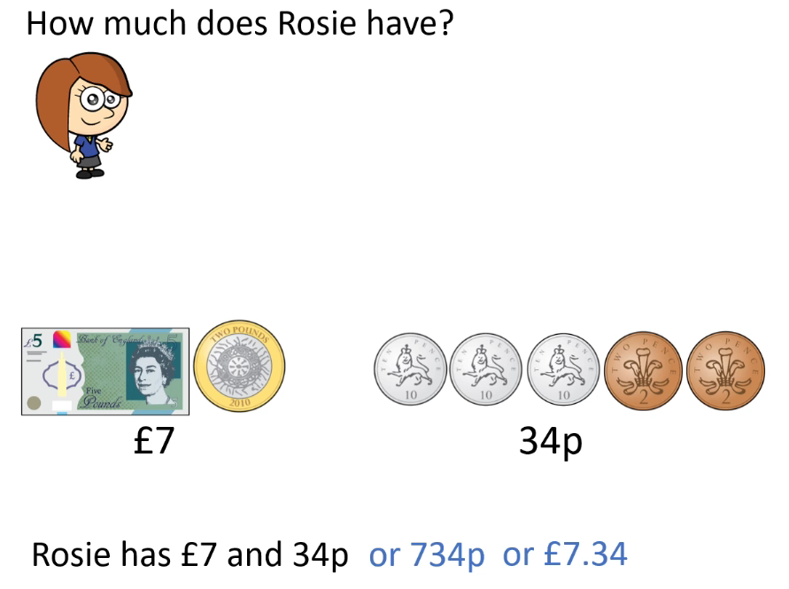
Develop Learning
How did you get on?

Slide 9
Develop Learning
Year 3
Year 4
Now try dropping a different coin. How much has she got left now?

Slide 10
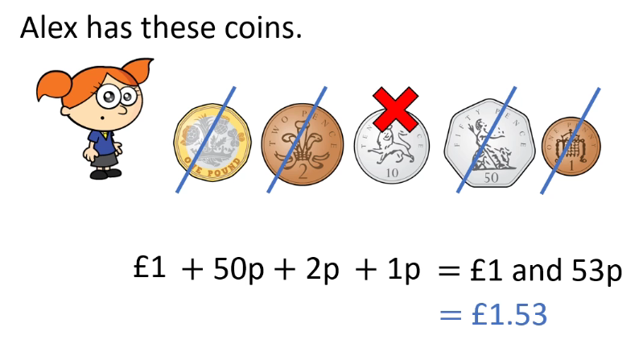
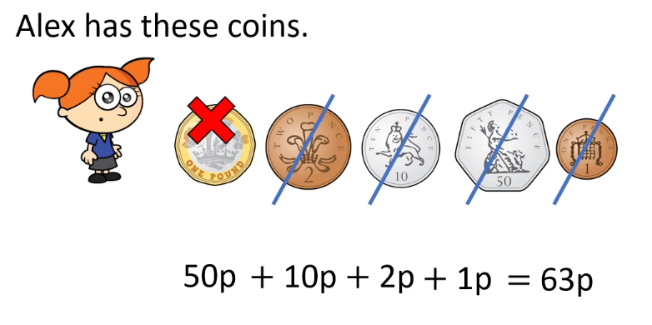
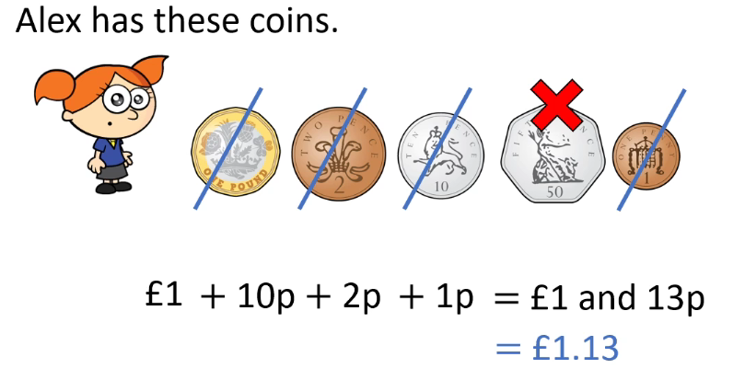
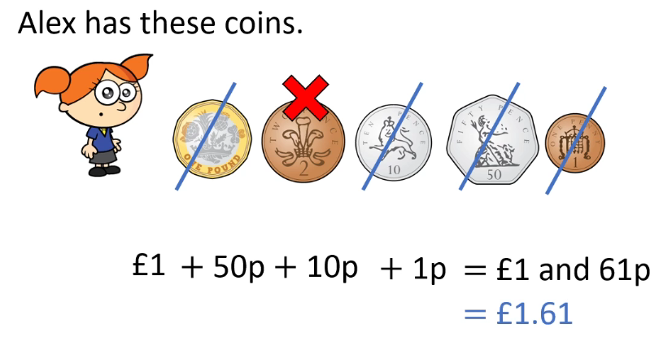
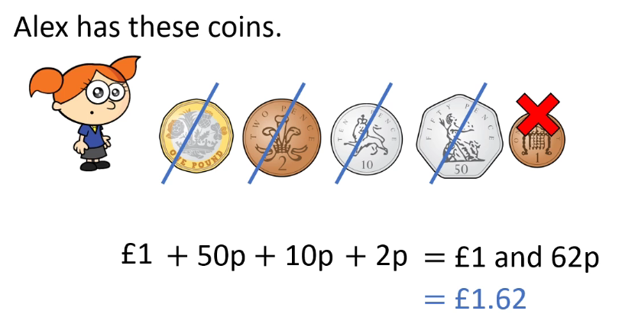
Develop Learning
Year 3
Year 4
How many did you get?

Slide 11
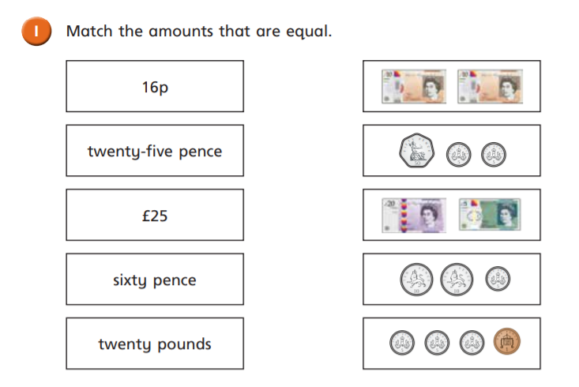
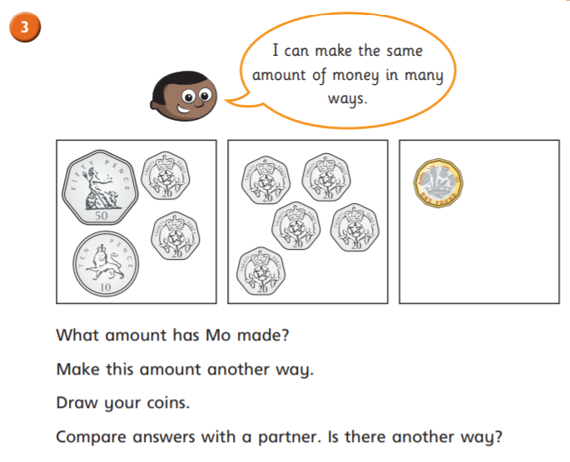
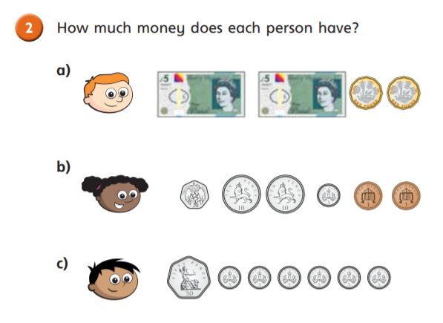
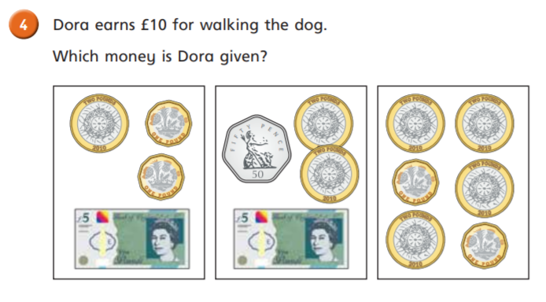
Independent Task
Year 3

Slide 12
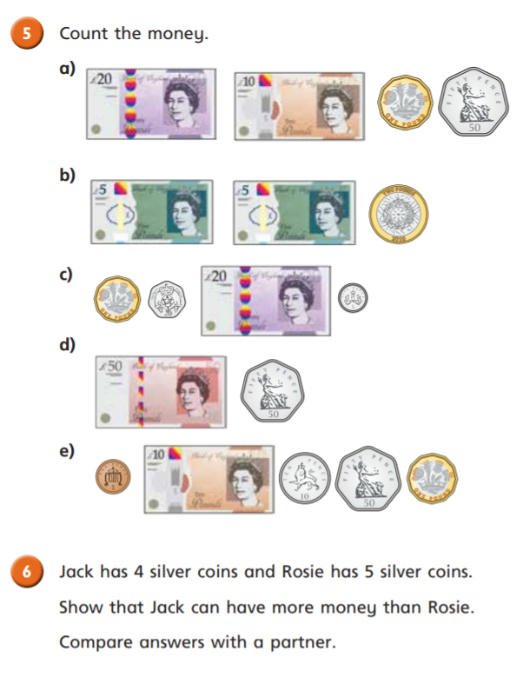
Independent Task
Year 3

Slide 13
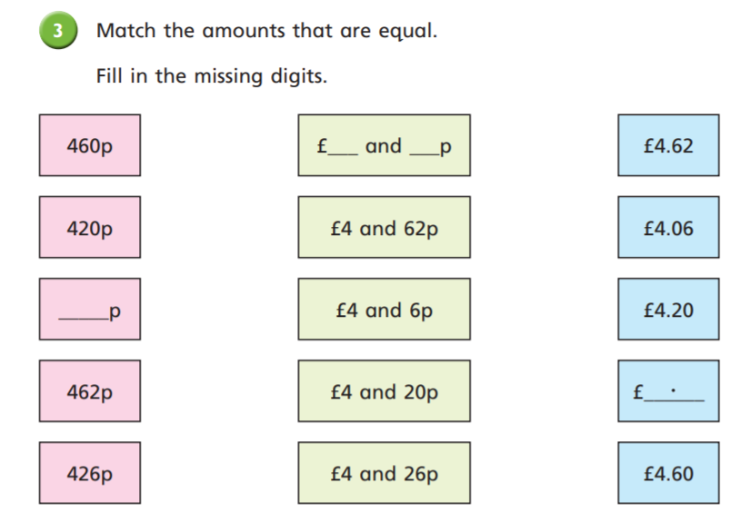
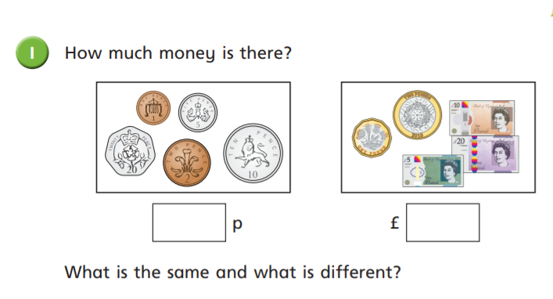
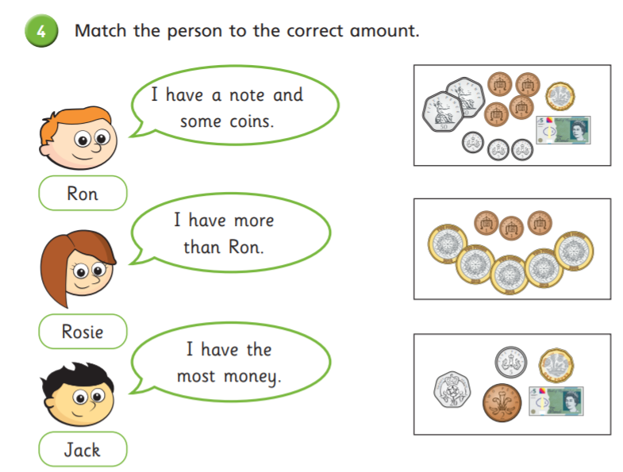
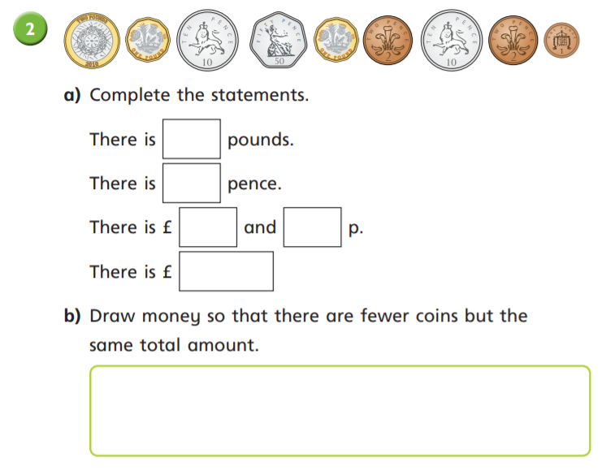
Independent Task
Year 4

Slide 14
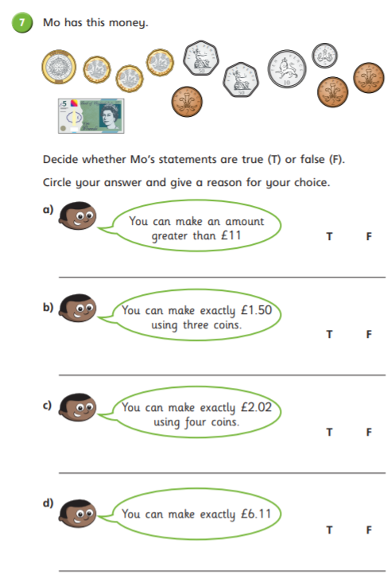
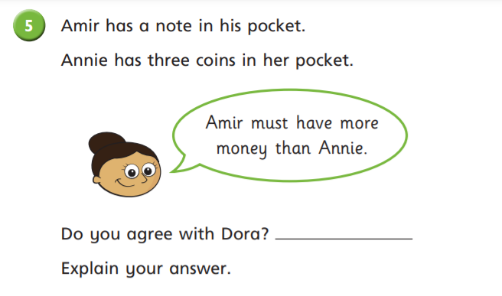
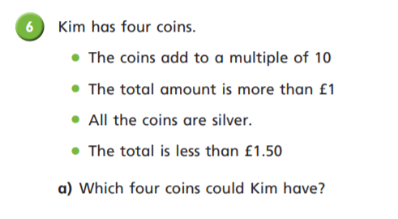
Independent Task
Year 4

Slide 15
Plenary
Year 4
Year 3

