Slide 1
Year 2 – Summer Block 3 – Time
Can I tell the time to 5 minutes?
https://mathsframe.co.uk/en/resources/resource/116/telling-the-time
© Classroom Secrets Limited 2019

Slide 2
Introduction
These numbers are all multiples of 5.
Identify the missing multiples.
5 |  | 15
 | 30 | 35 | 40
45 |  | 55
60 |  | 50 | 45
 | 35 |  | 25
20 |  | 10
© Classroom Secrets Limited 2019

Slide 3
Introduction
These numbers are all multiples of 5.
Identify the missing multiples.
5 | 10 | 15 | 20
25 | 30 | 35 | 40
45 | 50 | 55 | 60
60 | 55 | 50 | 45
40 | 35 | 30 | 25
20 | 15 | 10 | 5
© Classroom Secrets Limited 2019

Slide 4
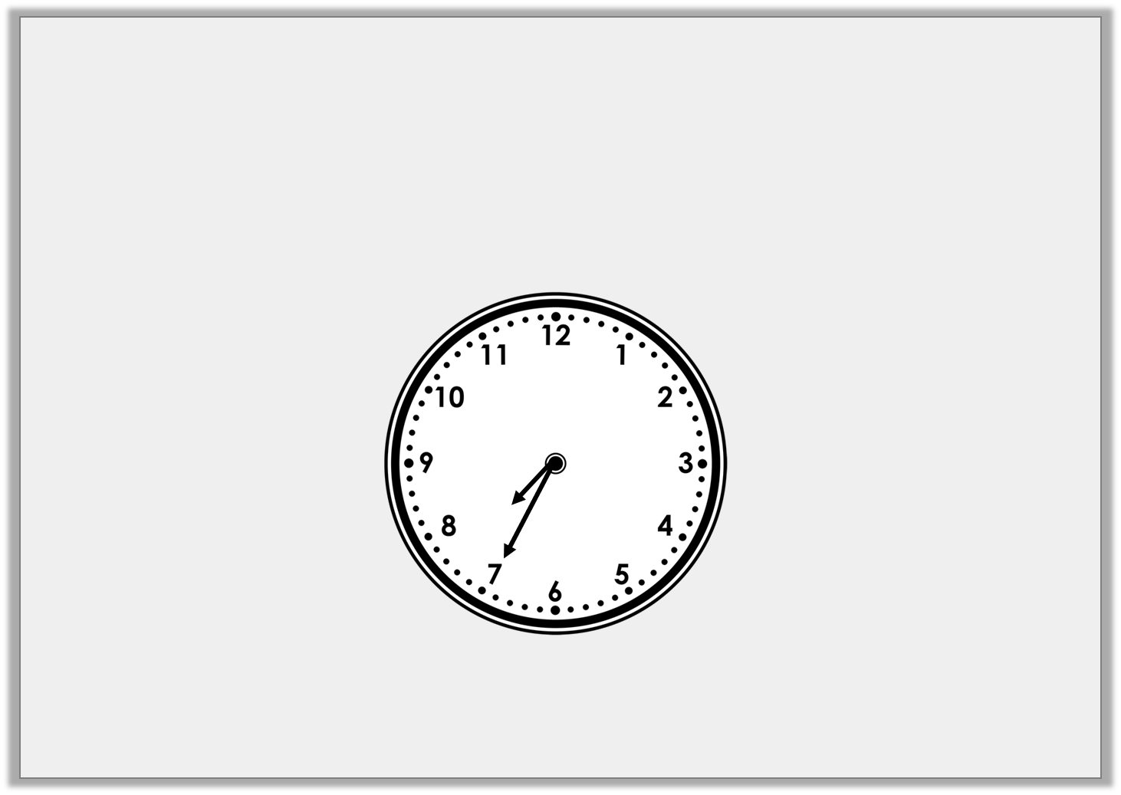
Varied Fluency 1
True or false?
The clock shows the time to 8.
© Classroom Secrets Limited 2019

Slide 5
Varied Fluency 1
True or false?
The clock shows the time 25 past 8.
True, the clock shows the time 25 to 8.
© Classroom Secrets Limited 2019

Slide 6
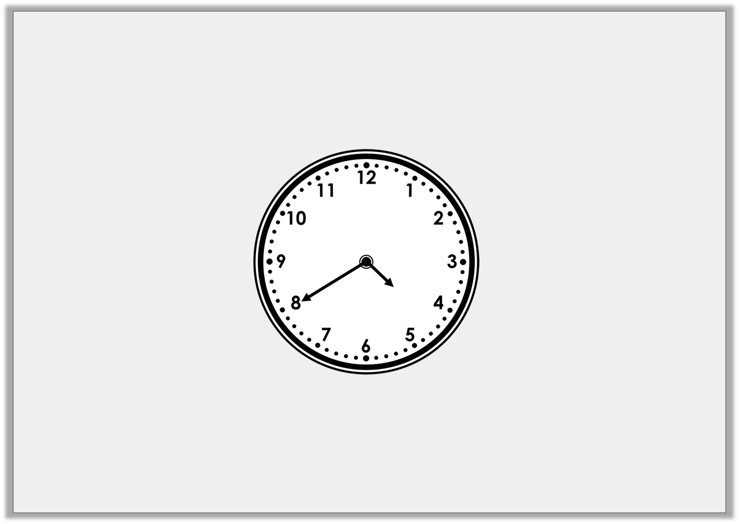
Varied Fluency 2
What is the time?
© Classroom Secrets Limited 2019

Slide 7
Varied Fluency 2
What is the time?
20 to 5
© Classroom Secrets Limited 2019

Slide 8
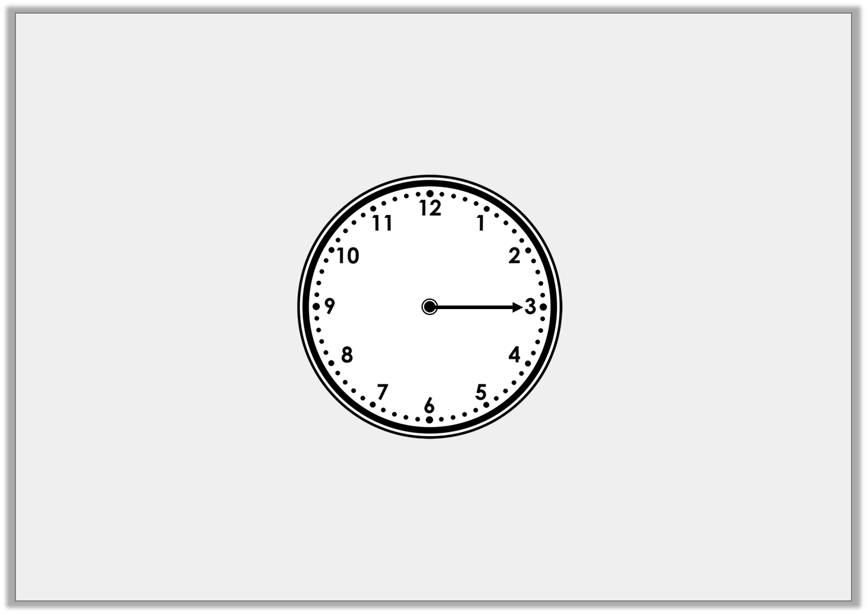
Varied Fluency 3
What is the time 20 minutes after the time shown?
© Classroom Secrets Limited 2019

Slide 9
Varied Fluency 3
What is the time 20 minutes after the time shown?
25 to 1
© Classroom Secrets Limited 2019

Slide 10
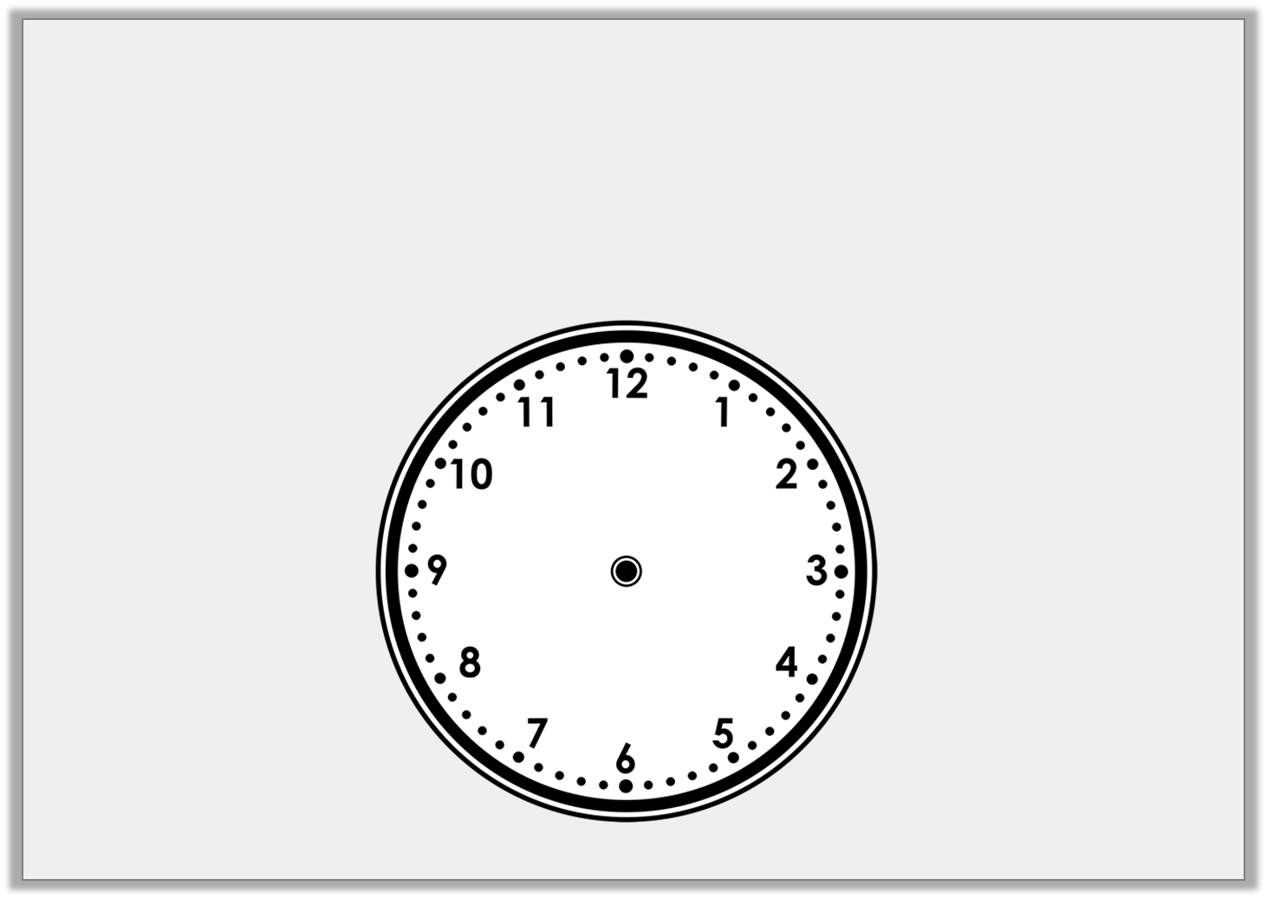
Varied Fluency 4
Draw the time below on the clock.
20 past 9
© Classroom Secrets Limited 2019

Slide 11
Varied Fluency 4
Draw the time below on the clock.
20 past 9
© Classroom Secrets Limited 2019

