Slide 1
Year 2 – Summer Block 3 – Time
Can I calculate durations of time?
© Classroom Secrets Limited 2019

Slide 2
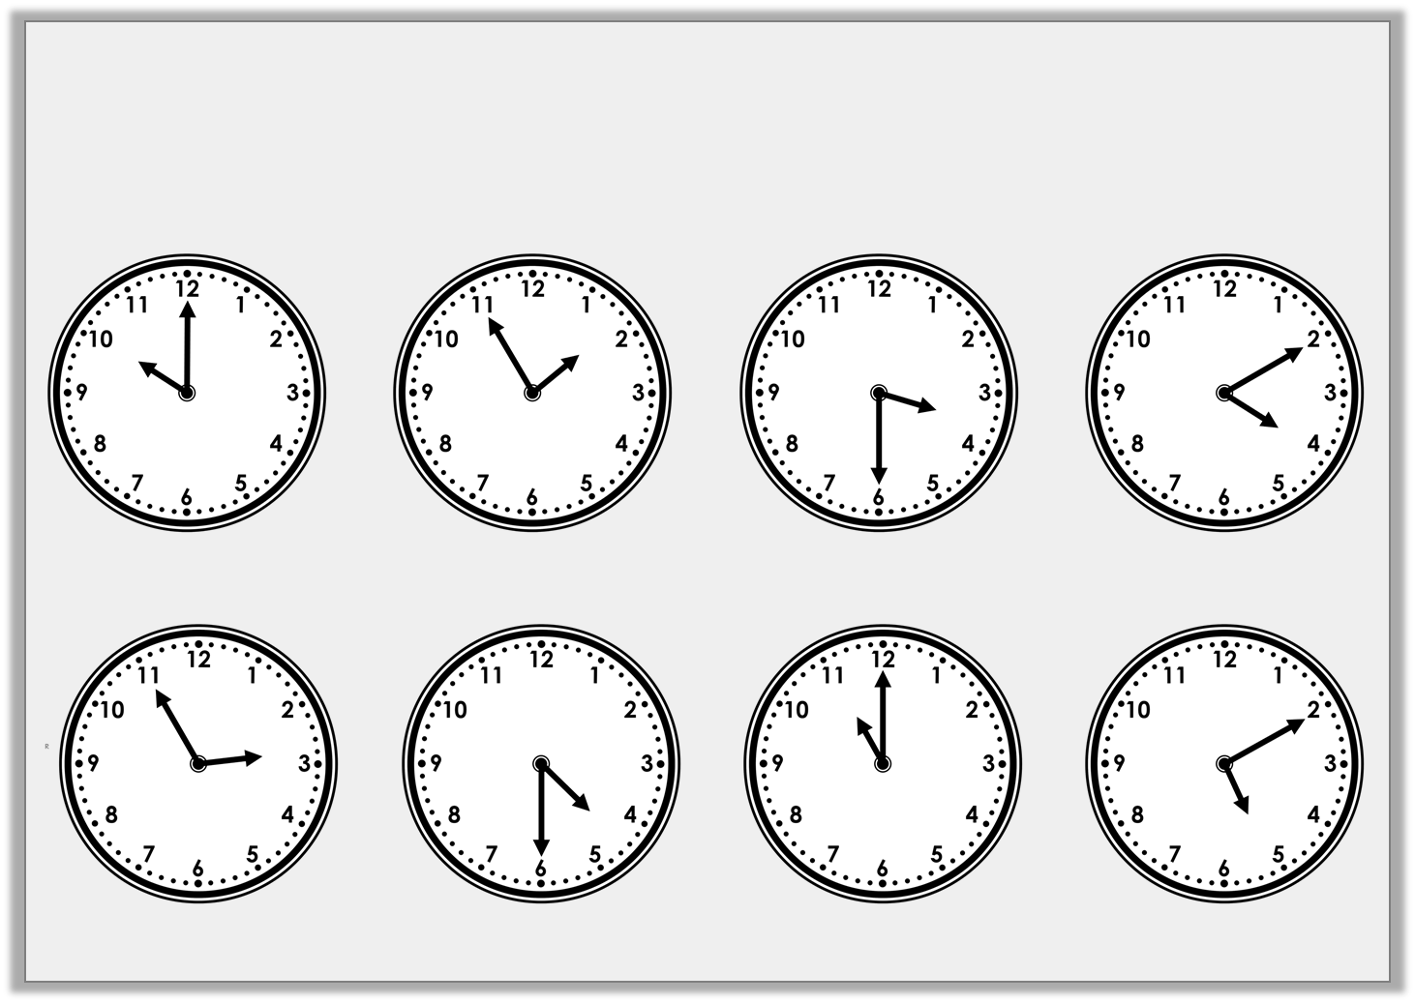
Introduction
Match each time to the time it will be one hour later.
© Classroom Secrets Limited 2019

Slide 3
Introduction
Match each time to the time it will be one hour later.
© Classroom Secrets Limited 2019

Slide 4
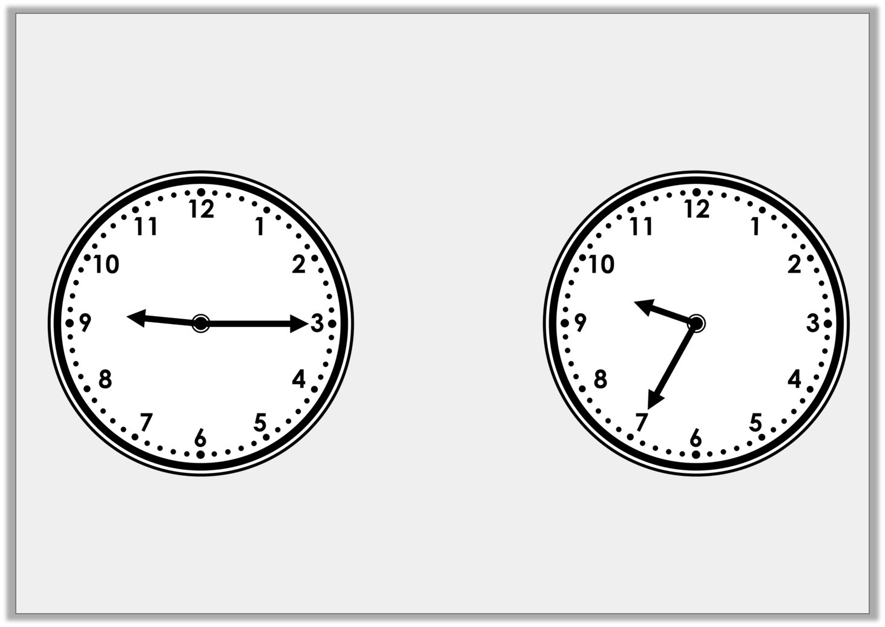
Varied Fluency 1
How much time has passed?
© Classroom Secrets Limited 2019

Slide 5
Varied Fluency 1
How much time has passed?
20 minutes
© Classroom Secrets Limited 2019

Slide 6
Varied Fluency 2
How much time has passed?
25 minutes past 3
25 minutes to 4
© Classroom Secrets Limited 2019

Slide 7
Varied Fluency 2
How much time has passed?
10 minutes
25 minutes past 3
25 minutes to 4
© Classroom Secrets Limited 2018

Slide 8
Varied Fluency 3
A cartoon starts at 25 minutes to 7 and last for 20 minutes.
Circle the time it finishes.
20 minutes to 7
5 minutes to 7
10 minutes to 7
© Classroom Secrets Limited 2019

Slide 9
Varied Fluency 3
A cartoon starts at 25 minutes to 7 and last for 20 minutes.
Circle the time it finishes.
20 minutes to 7
5 minutes to 7
10 minutes to 7
© Classroom Secrets Limited 2019

Slide 10
Varied Fluency 4
Hallie starts her dinner at 5 minutes past 12.
She finishes her dinner at 25 minutes to 1.
Circle the duration that she was eating her dinner for.
15 minutes
20 minutes
30 minutes
35 minutes
© Classroom Secrets Limited 2019

Slide 11
Varied Fluency 4
Hallie starts her dinner at 5 minutes past 12.
She finishes her dinner at 25 minutes to 1.
Circle the duration that she was eating her dinner for.
15 minutes
20 minutes
30 minutes
35 minutes
© Classroom Secrets Limited 2019

