Slide 1
RE Day Christian prayer and worship

Slide 2
LI: Can I understand that Churches are houses of worship, prayer and reflection? Steps to success - I can say why people feel it important to go to Church. - I can create a stained glass window to help me reflect or pray.

Slide 3
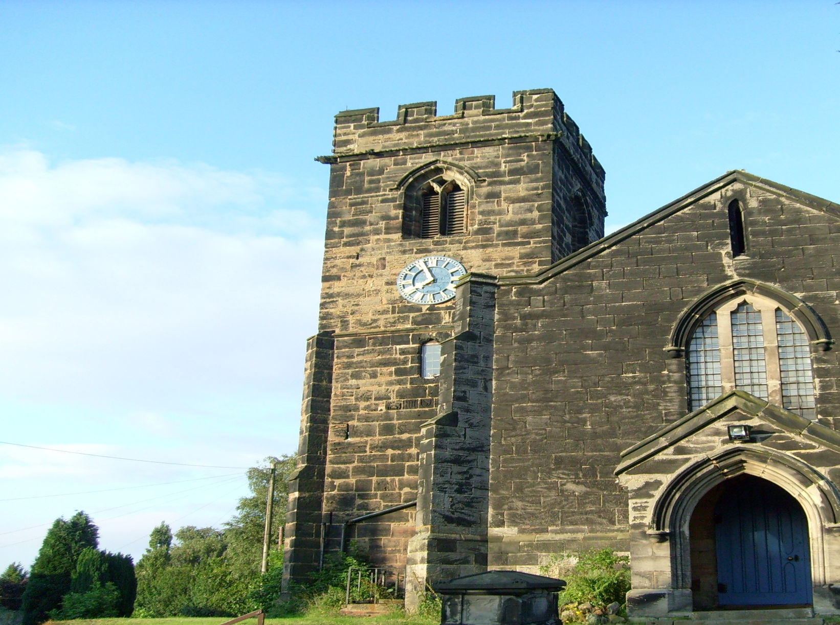
What is this building called?
A church

Slide 4
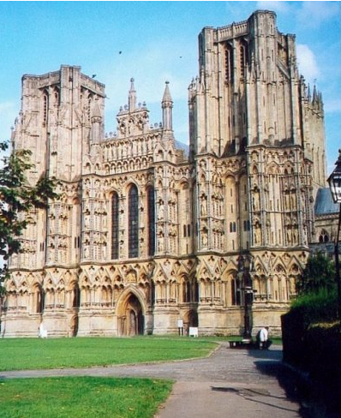
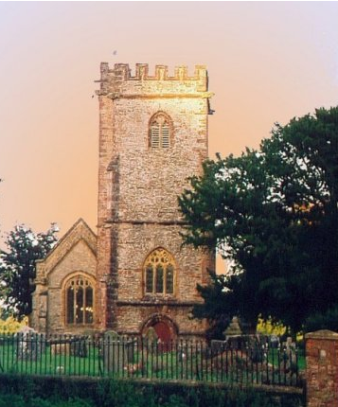
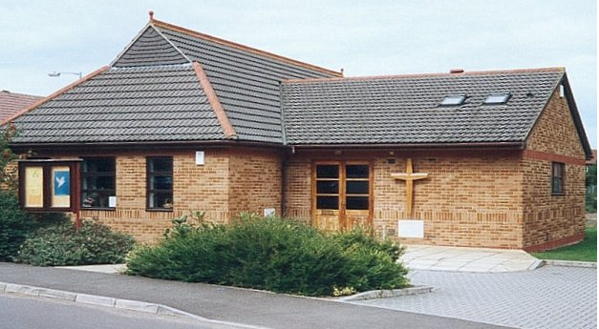
Church
buildings

Slide 5
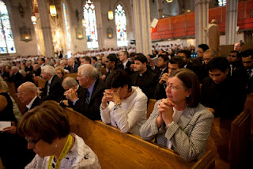
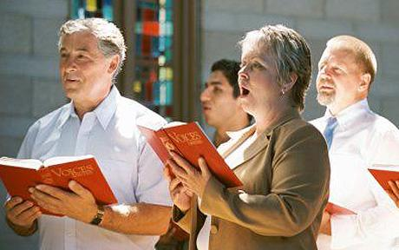
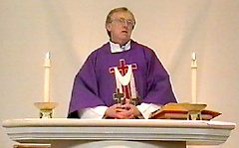
What happens inside a church?
Praying
Singing
Eucharist (Holy Communion)
Christian worship involves praising God in music and speech, readings from the Bible, prayers, and sermons.

Slide 6
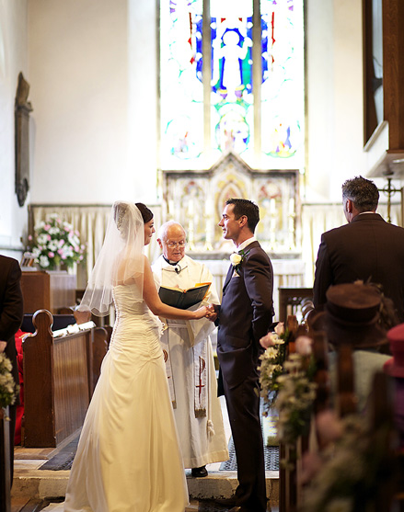
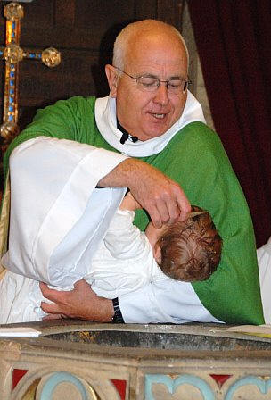
What happens inside a church?
Weddings
Baptism

Slide 7
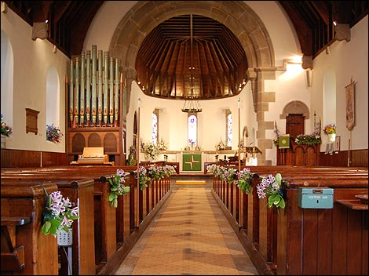
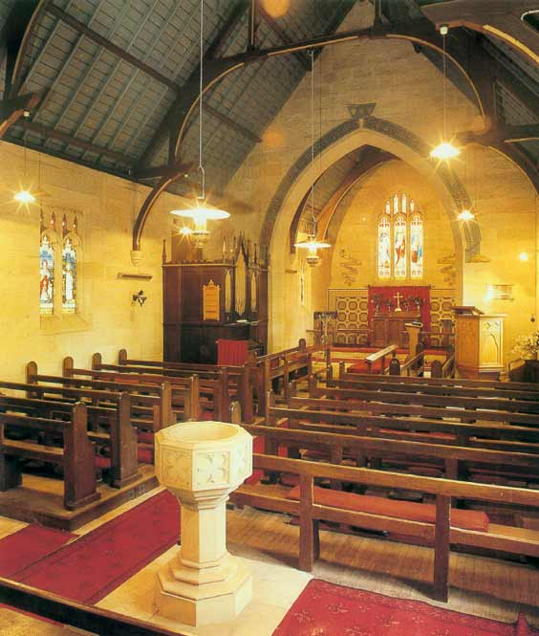
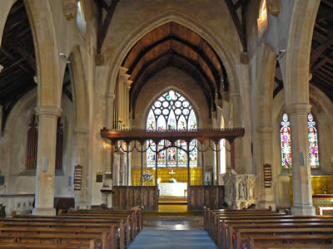
What will you see inside a church?

Slide 8
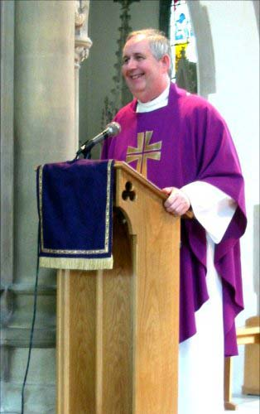
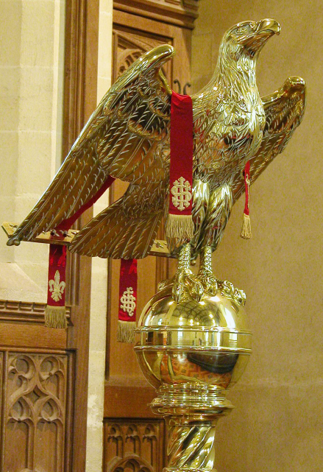
Lectern
The Lectern is also known as the reading stand. Members of the congregation stand here to read passages from the Bible, lead the congregation in prayer and make announcements.
Many lecterns are carved in the shape of an eagle to symbolise St Matthew. They also symbolise the good news travelling around the world.

Slide 9
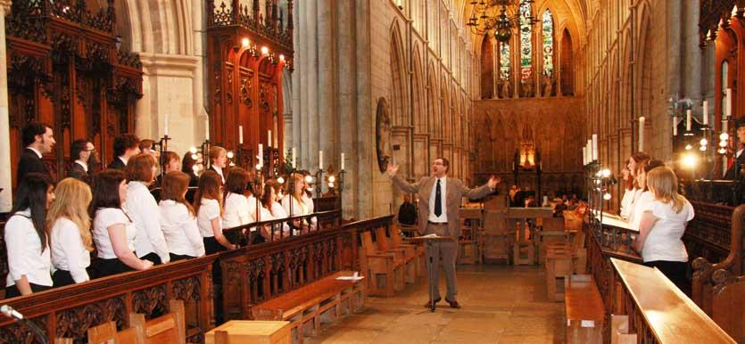
Choir stalls
This is where the people who sing during the service may sit..
Choir stalls are located between the nave and the chancel. They are separated from the nave by a choir screen.

Slide 10
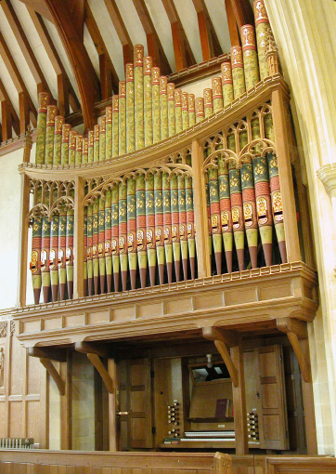
Organ
This is the musical instrument that is played at the beginning of every service and accompanies hymns.

Slide 11
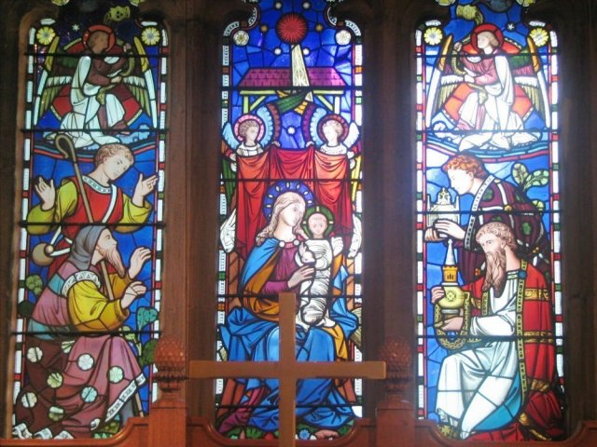
Stained glass windows
Stained glass windows show pictures of things that happened in the Bible.
People often look at them when they pray.

Slide 12
Stained glass windows
Your task
You are going to make a ‘stained glass window’ using card and tissue paper.
What design would help you when you reflect or pray?

