Slide 1
Persuasive Writing
Banning single-use plastic from British supermarkets
Wednesday 30th June 2021

Slide 2
LI: Can I proofread for errors and edit my work?
Persuasive Writing
Steps to success:
I can check I have used all my steps to success;
I can read the letter back to myself to check it makes sense;
I can correct punctuation, grammar and spelling mistakes.

Slide 3
Proofreading, editing and improving
Remember how we can best do this?
Reread your work over and over again, focussing on one thing at a time.
Top tip is to read your work quietly aloud.
There are five things we want you to check and improve. Mark them off and give examples on your checklist.

Slide 4
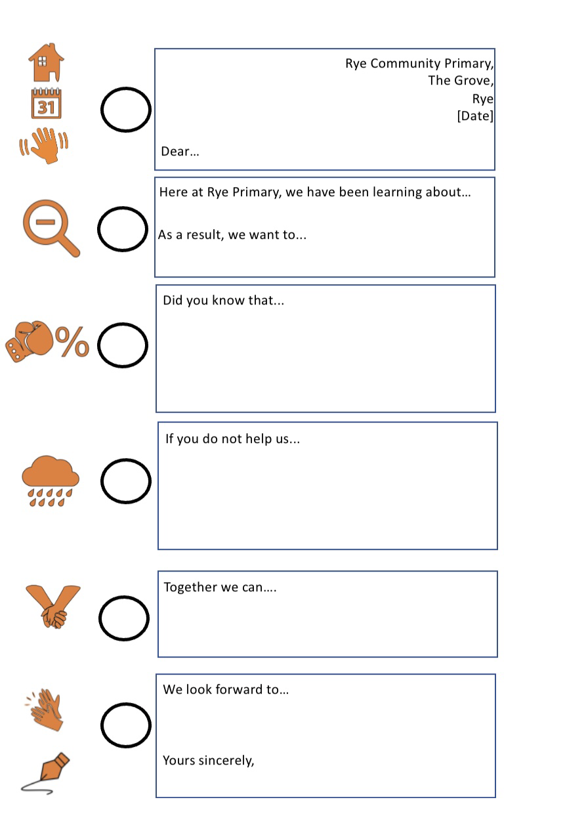
1. Check the steps to success
Have you included all the lenses you set yourself to include?
Underline where you have used the lens.
Check and add more writing if you haven’t included them.
Re-write if you think of better ideas.

Slide 5
2. Edit your work
Use the Punctuation Point and Grammar Grove and Spelling Square editing mats to check your work and make small improvements.
Remember to go through each ‘station’ separately. For example, visit Full Stop Farm, then Capital Letter Court. This will help you to really think about any changes you have to make.

Slide 6
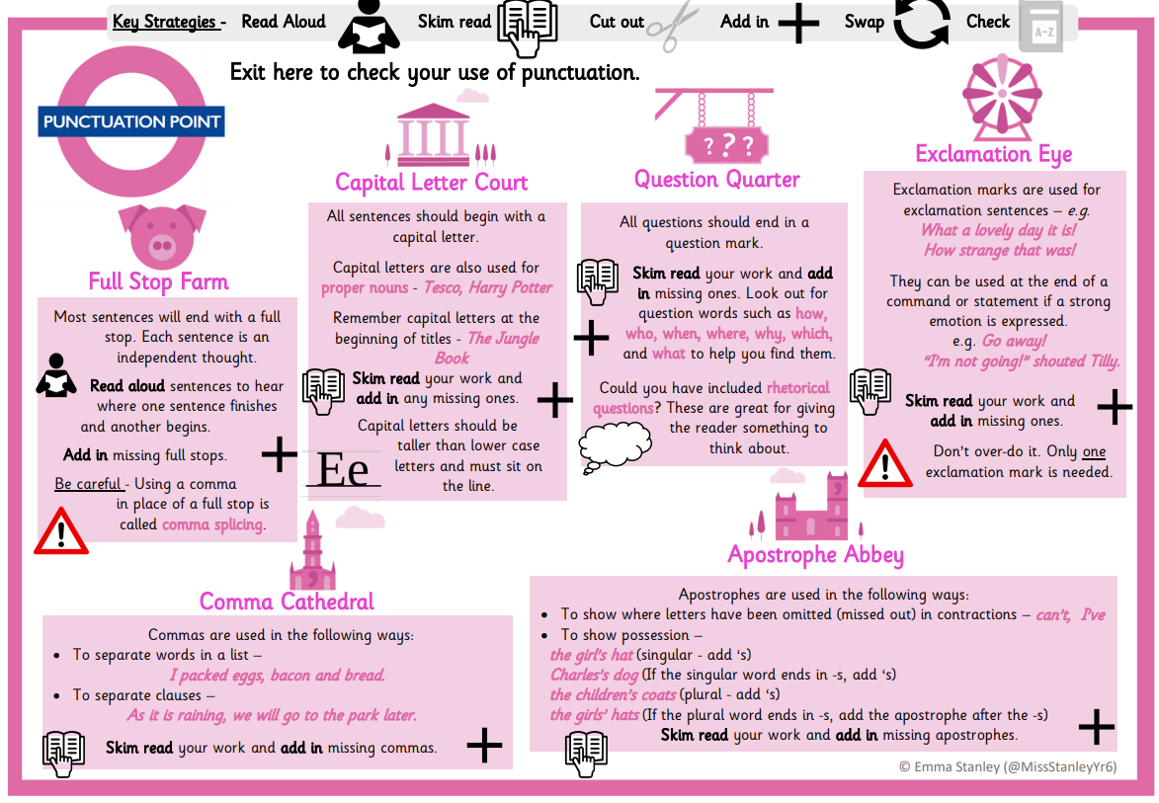

Slide 7
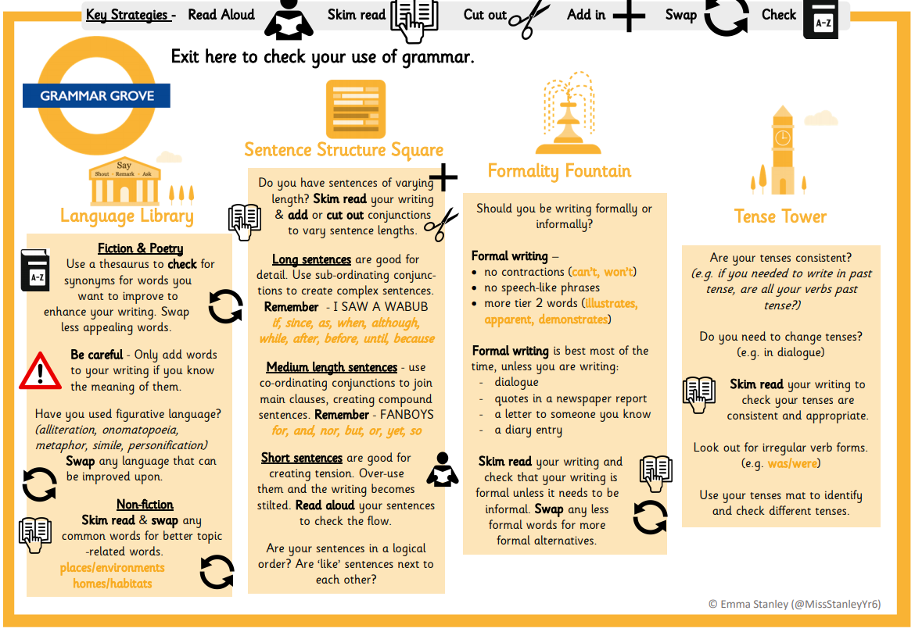

Slide 8
3. Are you proud?
Ask yourself this question: Are you proud of your work?
If the answer is no, then what could you change or add to make yourself proud?
If the answer is yes, come and share it with us.

