Slide 1
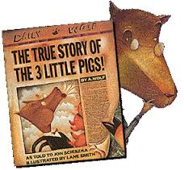
The Three Little Pigs
A traditional tale
Tuesday 14th September 2021

Slide 2
LI: Can I write an alternative version of a traditional tale?
A traditional tale
Steps to success:
I can use a fronted adverbial;
I can use a simile;
I can write a descriptive sentence.

Slide 3
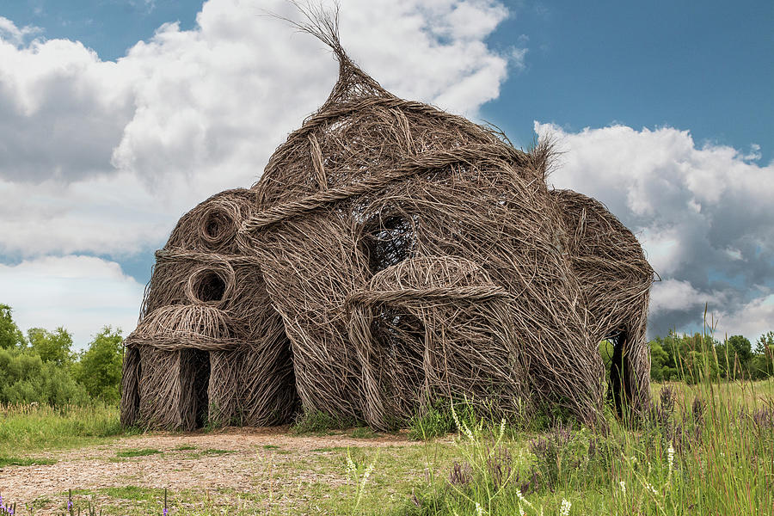
A house made of sticks
We are going to gather good ‘when’ adverbials to move the story on. Use your wordmat to find some and write them in the first box.
1.

Slide 4
A house made of sticks
Let’s gather your ideas.
Remember, tick ideas we have shared and made it on the board.
Add other people’s good ideas.
Let me know if there is one you do not know the meaning of.
1.

Slide 5
Model sentence
An hour later, the wolf strolled down to the second pig’s house.
Your task:
Start your sentence with a fronted adverbial.
Challenge: you can deepen the moment by using a precise verb for walking.

Slide 6
A house made of sticks
We are going to write a simile to describe the ‘browness’ of the stick house.
You can use the brown word mat to help you find good words Write them in the second box.
2.

Slide 7
A house made of sticks
What are we going to compare the brown stick house with? Let’s gather your ideas.
Remember, tick ideas we have shared and made it on the board.
Add other people’s good ideas.
2.

Slide 8
Model sentence
The house was as brown as caramel treacle dripping off ice-cream.
Your task:
Use a brown simile.
Challenge: deepen the moment.

Slide 9
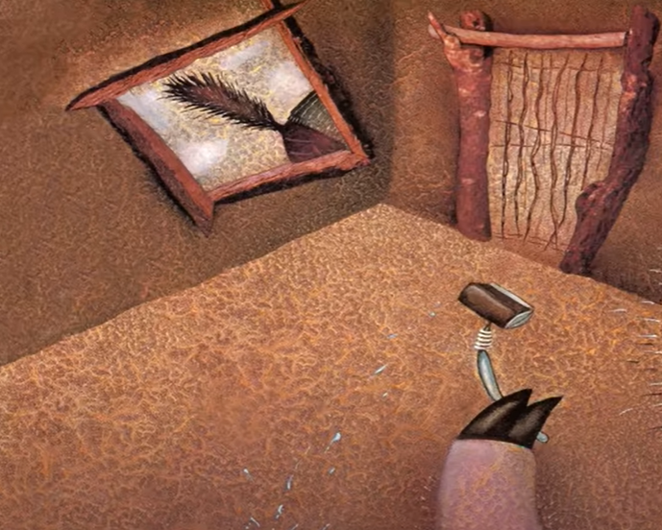
A house made of sticks
The second pig sees the wolf walking past.
Let’s gather good adjectives for the wolf’s tail.
3.

Slide 10
A house made of sticks
Here are a few I thought of: scraggy, spiky, matted, smelling, stinky, bristly, wiry, brush-like, ultra slender, extraordinary, enormous, elevated.
3.

Slide 11
Model sentence
The pig saw an arched tail in the window – long, scruffy and spiky.
Your task:
Choose your four favourite adjectives and use them in the sentence.
Challenge: deepen the moment using the feeling lens.

Slide 12
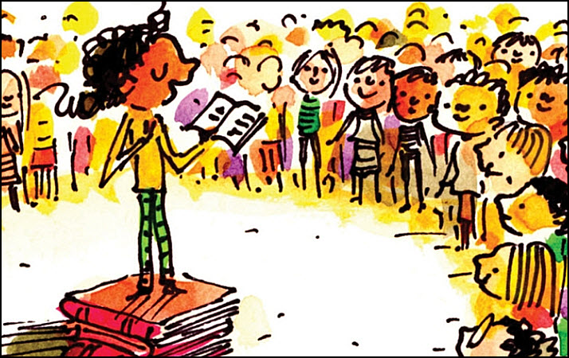
Share and feedback
Share your work
What sentence are your proud of?
What does the class think of the work?
How could we make it even better?
Which learning zone were you in today?
Write the letter in the circle on the LI.

