Slide 1
The Three Little Pigs
A traditional tale
Thursday 16th September 2021

Slide 2
LI: Can I write an alternative version of a traditional tale?
A traditional tale
Steps to success:
I can use adjectives;
I can use adverbs and precise verbs;
I can include dialogue.

Slide 3
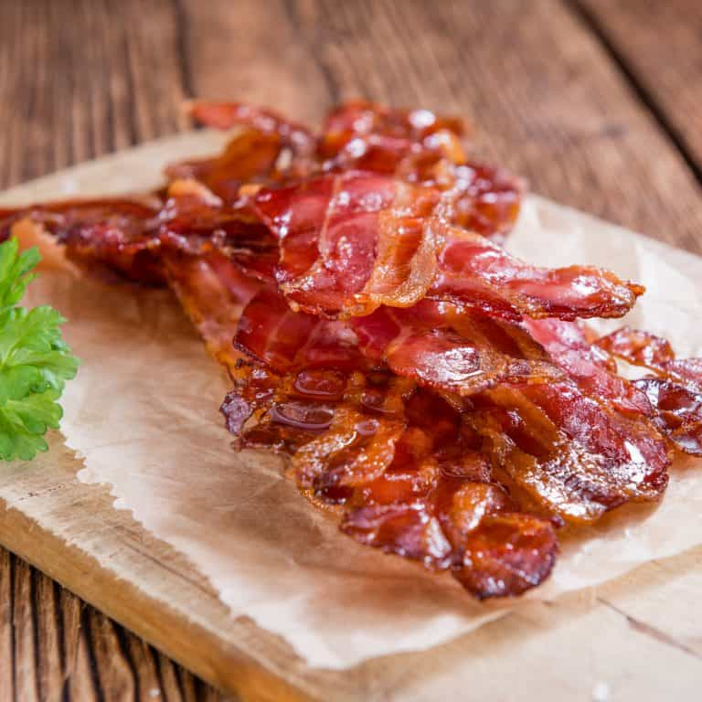
Off to the brick house
The wolf is looking at the dead pig and sees bacon!
Gather descriptive words to describe the look, smell and taste of bacon.
Write it in the first box.
Hmmm, bacon!
1.

Slide 4
Off to the brick house
Let’s gather your ideas.
Remember, tick ideas we have shared and made it on the board.
Add other people’s good ideas.
salty, crunchy, tasty, meaty, chewy, fatty, crispy, reddish.
1.

Slide 5
Model sentence
The wolf looked at the meaty, fatty, pink pig.
Your task:
Use the power of three to write a mouth-watering description of the pig.
Challenge: Can you deepen the moment using the smelling lens?

Slide 6
Off to the brick house
How do you think the wolf ate the pig?
Let’s brainstorm precise verbs for eating.
+
eating
2.
_

Slide 7
Off to the brick house
Where would you put these on the shadometer?
chewed, swallowed, stuffed, scoffed, gobbled
+
eating
2.
_

Slide 8
Model sentence
Greedily, he swallowed the pig whole and continued to the next pig’s house.
Your task:
Use a precise verb to tell this part of the story.
Challenge: deepen the moment with a ‘how’ fronted adverbial.

Slide 9
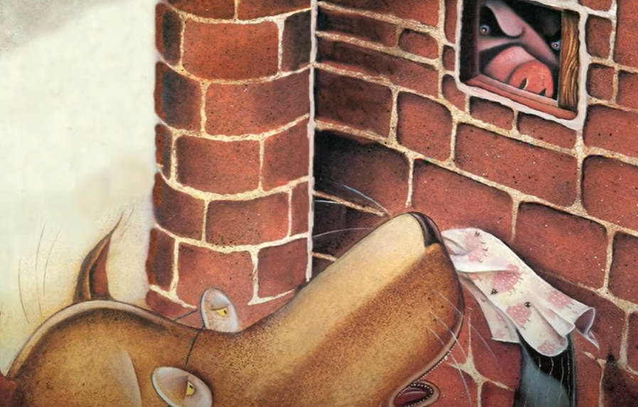
Off to the brick house
Let’s act out this scene. I need someone to play the wolf, knock on the door and ask to be let in. Remember you want to borrow some sugar.
3.

Slide 10
Off to the brick house
In the third box, write down some ideas of what the wolf said to the third little pig.
?
3.

Slide 11
Off to the brick house
When we punctuate direct speech we need to use inverted commas.
The sentence inside the inverted commas needs to start with a capital letter and end with the correct punctuation.
“Little pig, little pig, let me in.”
3.

Slide 12
Model sentence
At the brick house he said, “Let me in please. I need a cup of sugar.”
Your task:
Add your own choice of dialogue to the sentence.
Challenge: can you deepen the moment using a better word for ‘said’?

Slide 13
Share and feedback
Share your work
What sentence are your proud of?
What does the class think of the work?
How could we make it even better?
Which learning zone were you in today?
Write the letter in the circle on the LI.

