Slide 1
Am I aware of and able to recognise different types of sentences?
I can recognise statements.
I can recognise questions.
I can recognise commands.
I can recognise exclamations.

Slide 2
Am I aware of and able to recognise different types of sentences?
I can recognise statements.
I can recognise questions.
I can recognise commands.
I can recognise exclamations.

Slide 3
Statements
1
Statements are sentences which tell you a fact, opinion or idea.
Example:
A rainbow has 7 colours.
They are beautiful to look at.

Slide 4
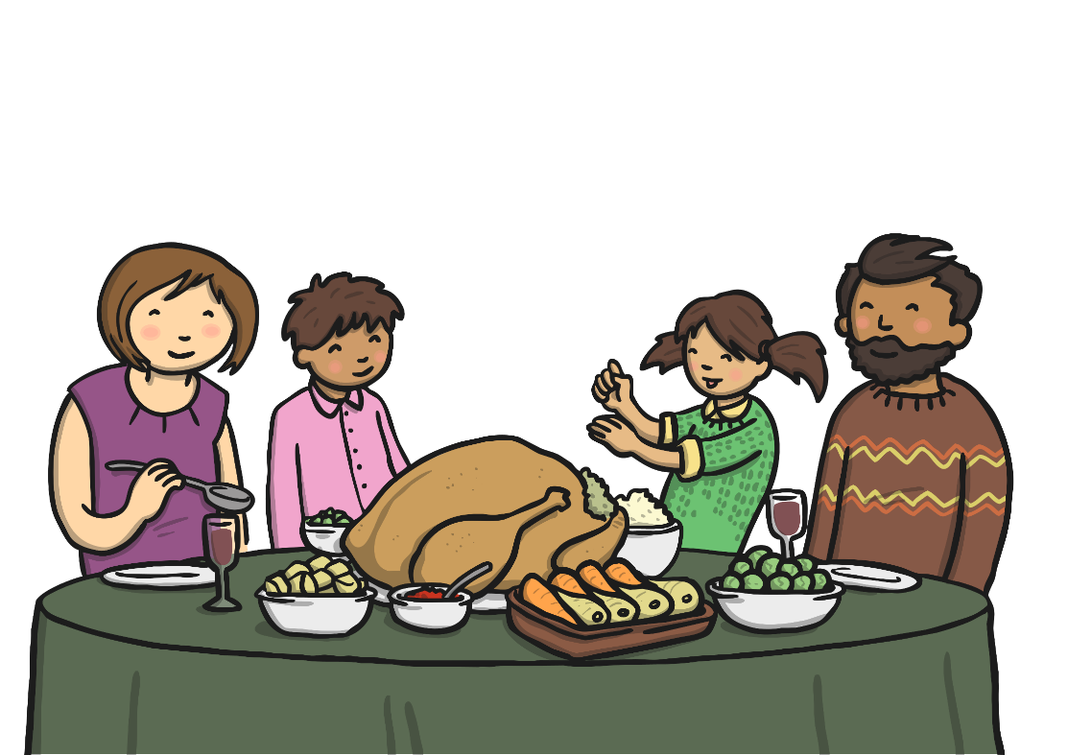
Questions
2
Questions are sentences that ask you something.
They usually end with a question mark.
Example:
What did you have for dinner?

Slide 5
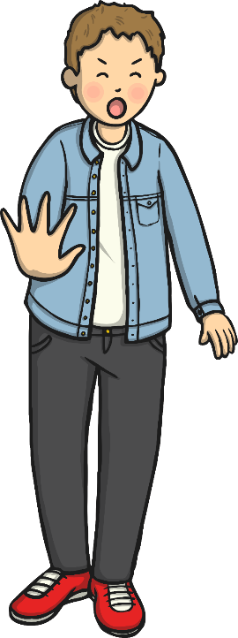
Commands
3
They are often urgent or angry, can be very short and contain an imperative verb. Commands Imperative verbs are also known as ‘bossy verbs’- they tell people what to do.
Example:
Help me! Stop it.

Slide 6
Exclamations
4
An exclamation is used when someone is surprised.
It always starts with ‘How’ or ‘What’ and contains a noun and a verb.
Example:
What big feet you have!

