Slide 1
Timetable for the week:
Groups | Session 1 | Session 2 | Session 3 | Session 4
Roald Dahl | Guided reading with T Initiate and Model | Follow-up task from guided reading Enable | Independent Comprehension activity | Vocabulary work based on the same extract as class teacher group or science/topic vocabulary lists
Jacqueline Wilson | Vocabulary work based on the same extract as class teacher group or science/topic vocabulary lists | Guided reading with T Initiate and Model | Follow-up task from guided reading Enable | Independent Comprehension activity
Julia Donaldson | Independent Comprehension activity | Vocabulary work based on the same extract as class teacher group or science/topic vocabulary lists | Guided reading with T Initiate and Model | Follow-up task from guided reading Enable
Michael Morpurgo | Follow-up task from guided reading Enable | Independent Comprehension activity | Vocabulary work based on the same extract as class teacher group or science/topic vocabulary lists | Guided reading with T Initiate and Model

Slide 2
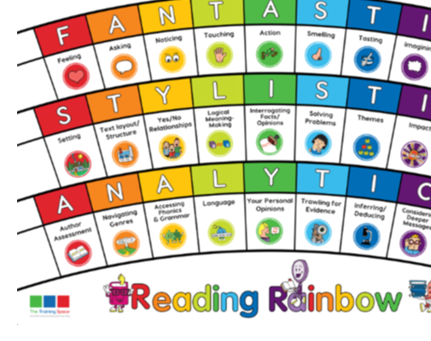
Our LI’s for the week: Y2: Make inferences of the basis of what is being said and done in a book read independently Y3: Draw inferences such as inferring characters' feelings, thoughts and motives from their actions, and justifying inferences with evidence. Y4: Draw inferences such as inferring characters' feelings, thoughts and motives from their actions and justifying inferences with evidence clearly taken from the text
Initiate/Model – write this in your margin.

Slide 3
Lenses: Band 3/4
Feeling
Inferring/Deducing
Sentence Starters:
Feeling:
The character’s emotions change when…
Inferring/Deducing:
I believe that the central character is…
(thinking, feeling, going to…)

Slide 4
cease,
Feeling:
The character’s emotions change when…
Chot down ideas together that show different emotions.
Can you identify a specific moment when they change?
Inferring/Deducing:
I believe that the central character is…
(thinking, feeling, )
Chot down ideas together:Why is the character feeling like that? What are they thinking about what is happening? What might they do next because of it?
Vocabulary Task Roald Dahl & Jaqueline Wilson: Find words in the text that mean the same as: ceased, Be quiet, unusual, observed, chuckled, ridiculous Vocabulary Task Michael Morpurgo: peculiar, observe, precipice, evening, scowled, report, slashed

Slide 5
Lenses: Band 1/2
Feeling
Inferring/Deducing
Sentence Starters:
Feeling: ____________________ feelings are…
Inferring/Deducing: If I were ______________________, I would…

Slide 6
Vocabulary Task Roald Dahl & Jaqueline Wilson: Find words in the text that mean the same as: ceased, Be quiet, unusual, observed, chuckled, ridiculous Vocabulary Task Michael Morpurgo: peculiar, observe, precipice, evening, scowled, report, slashed
Feeling
Inferring/Deducing
___________________’s_ (name the character) feelings are…
Chot down ideas together exploring what the different characters feelings are and why.
If I were ______________________, I would… because…
Chot down ideas together of what you might do if you were that particular character. Why would you do that?

Slide 7
ENABLE – please write this in the margin.

Slide 8
Session – Enable (Independent follow-up task) MM
Feeling:
Explain a point in the text when the main character’s feelings change. What caused this to happen?
The character’s emotions change when…
Inferring/Deducing:
How would Hogarth have felt when he saw The Iron Man on the cliff?
I believe that the central character… because…
Bonus question: JW, RD
Why did the farmer at the next farm laugh at Hogarth’s father?
Bonus question: MM
How do you think Hogarth’s father felt when the farmer next door laughed at him when he told him what his son had said? Why?

Slide 9
Session – Enable (Independent follow-up task) JD
Language:
1. What are Hogarth’s feelings when he sees The Iron Man on the cliff?
___________________’s_ feelings are…
Language:
2. What would you do if you were Hogarth?
If I were ______________________, I would…
Bonus question: Band 1 / 2
What would you do if you were Hogarth’s Father?

