Slide 1
LI: Can I draft and write in narratives, creating settings, characters and plot? (B3) Steps to success I can design and draw my own creature I can annotate my design with phrases that describe my creature. I have included a variety of powerful and effective vocabulary.

Slide 2
Your task is to design and describe your own creature in the style of the Iron Man.
There are some ideas for creatures on the next slide,
Talk to the person next to you about how you could describe some of these creatures
Choose a creature that you think you can come up with some excellent descriptive vocabulary for, decide on his/her name. E.g. Iron Dragon, Tree Lady etc.

Slide 3
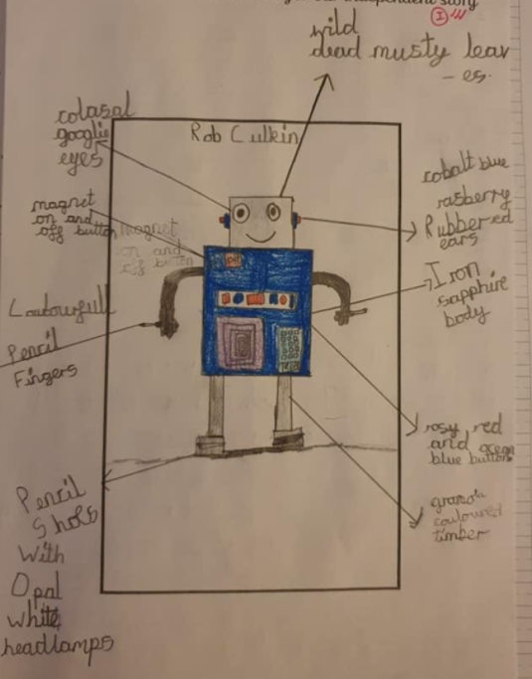
Set your work out like this on your sheet:
Task 1 draw your creature
Task 2 label parts of its body with descriptive vocabulary/ phrases.

Slide 4
