Slide 1
L.I – Can I understand multiplication as adding equal groups?
Steps to success
I can place objects in equal groups
I can describe the groups
I write number sentences to correspond with a picture
Challenge: What does the representation show?

Slide 2
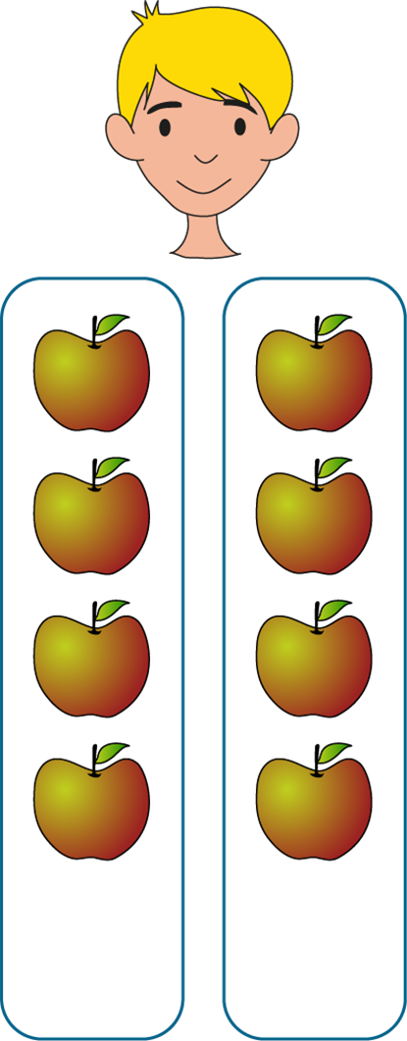
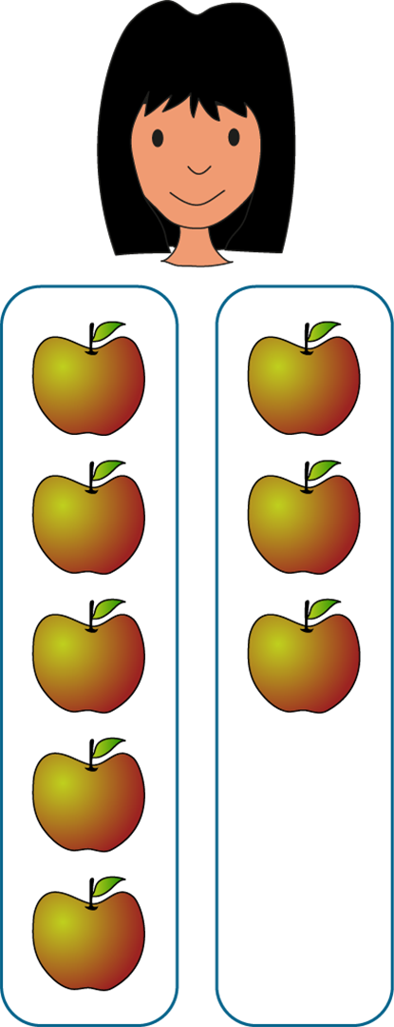
In Focus Task
Max and Lucia each have some apples.
Each of them has put their apples into two groups.
What do you notice about Max’s and Lucia’s apples?
Max
Lucia
Equal
groups
Unequal
groups
Notes:
Max and Lucia each have some apples.
Each of them has put their apples into two groups.
What do you notice about Max’s and Lucia’s apples?
What’s the same?
What’s different?

Slide 3
New Learning
Are the groups equal or unequal?
✓
Equal groups
Unequal groups
Notes:
Tick to say whether the objects are in equal or unequal groups.

Slide 4
New Learning
Are the groups equal or unequal?
✓
Equal groups
Unequal groups
Notes:
Tick to say whether the objects are in equal or unequal groups.

Slide 5
New Learning
Are the groups equal or unequal?
✓
Equal groups
Unequal groups
Notes:
Tick to say whether the objects are in equal or unequal groups.

Slide 6
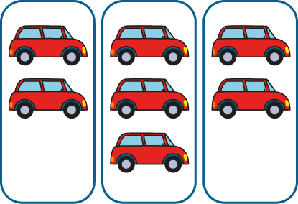
New Learning
Are the groups equal or unequal?
Equal groups
✓
Unequal groups
Notes:
Tick to say whether the objects are in equal or unequal groups.

Slide 7
New Learning
Are the groups equal or unequal?
Equal groups
✓
Unequal groups
Notes:
Tick to say whether the objects are in equal or unequal groups.

Slide 8
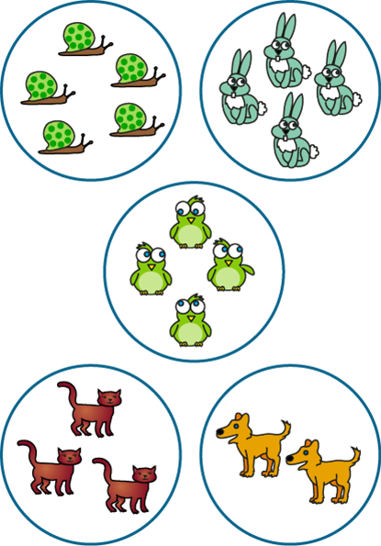
New Learning
Are the groups equal or unequal?
Equal groups
✓
Unequal groups
Notes:
Tick to say whether the objects are in equal or unequal groups.

Slide 9
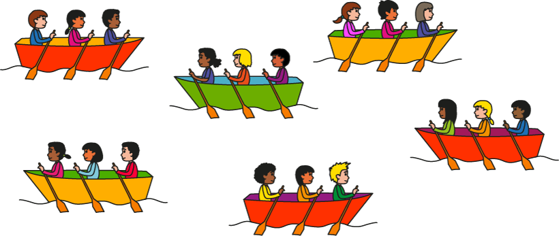
New Learning
Which sentence correctly describes the picture?
✓
There are 6 equal groups.
There are 3 equal groups.
✗

Slide 10
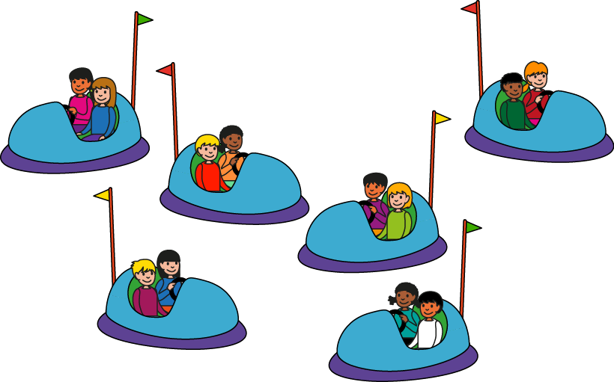
New Learning
Which sentence correctly describes the picture?
✗
There are 2 groups of 6.
There are 6 groups of 2.
✓
Notes:
Which sentence correctly describes the picture?

Slide 11
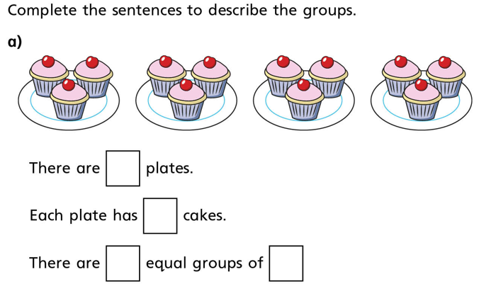
Develop Learning

Slide 12
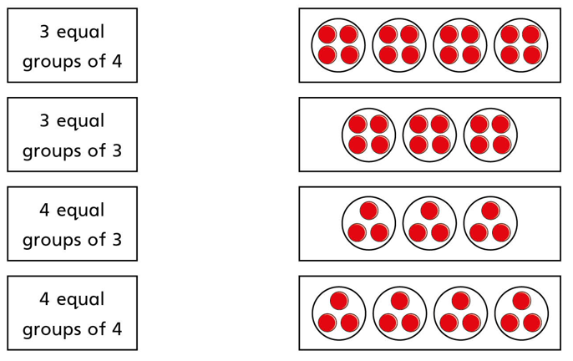
Talk Task
Which statement matches which picture?

Slide 13
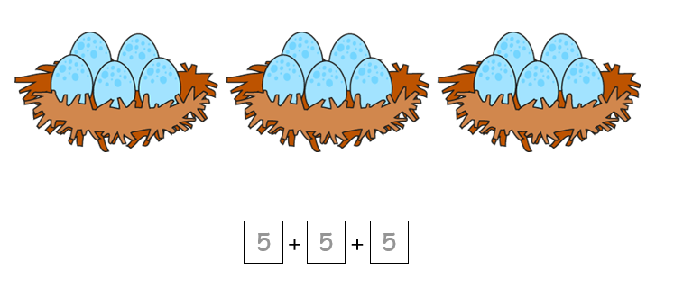
Develop Learning
This picture shows:
We can re-write that as 3 times 5 eggs.

Slide 14
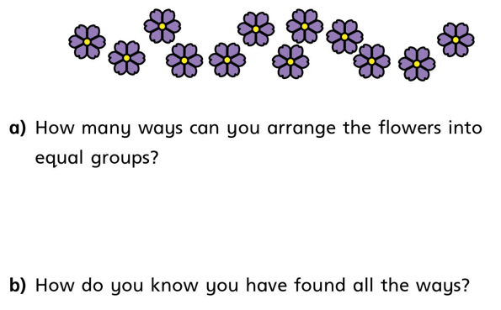
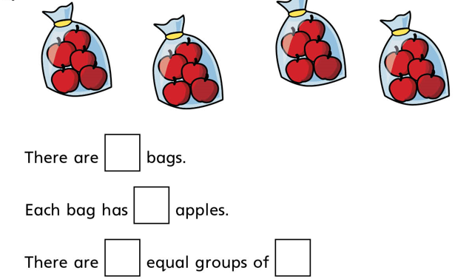
Independent Task
1 Copy into your book
3
2
c) Write a number sentence to go with the picture.

Slide 15
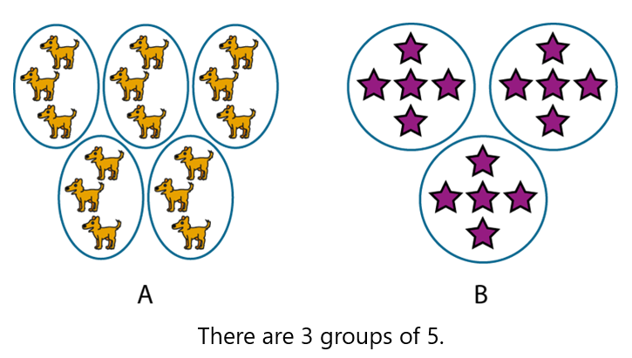
Lightbulb challenge
Circle the representation that shows 3 groups of 5

Slide 16
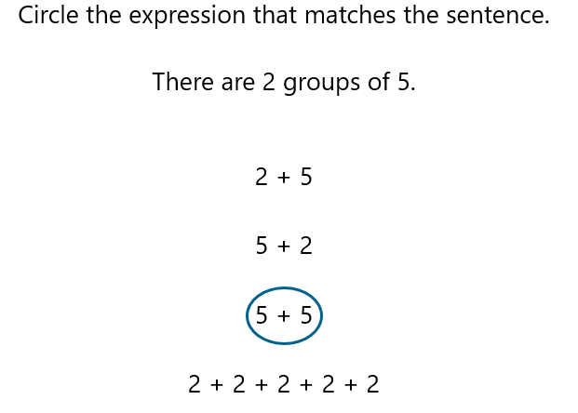
Extend and challenge

