Slide 2
Day 1
Experience Day

Slide 3
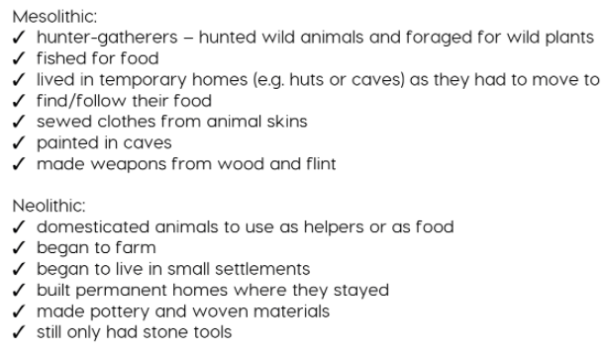
Experience day 1 – To explore and understand life in Stone Age Britain

Slide 4
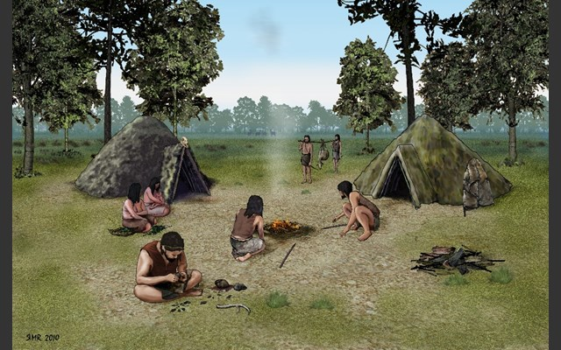
What was life like in the Stone Age?
https://www.bbc.co.uk/programmes/p01zfxnh

Slide 5
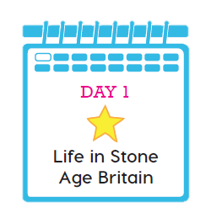
https://www.bbc.co.uk/programmes/p01zfxnh
Rinse the session for vocabulary.

Slide 6
What was life like in Stone Age Britain?
Using ipads, computers, books research in groups of 3 or 4 what life was like in Mesolithic Britain.
Write a list of adjectives using as many of the Fantastics as possible to describe what life was like. Prepare to share your work.

Slide 7
What was life like in Stone Age Britain?
Using ipads, computers, books research in groups of 3 or 4 what life was like in Neolithic Britain.
Write a list of adjectives using as many of the Fantastics as possible to describe what life was like. Prepare to share your work.
What are the main similarities?
What are the main differences?

