Slide 3
Week 2 Day 4
Sentence Stacking Lesson 5

Slide 4
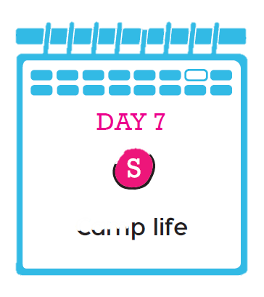
Is this plot point positive or negative?

Slide 5
Learning chunk 1
Learning chunk 1 – Initiate – Time Adverbial
Use a time adverbial to explain when Om showed you around the camp.
Early next morning
The next morning
At dawn
At sunrise
When the sun peeped its head over the horizon
As the sun unfurled its golden rays

Slide 6
Learning chunk 1
Learning chunk 1 – Model – Time Adverbial
Use a time adverbial to explain when Om showed you around the camp.
Early the following morning, Om showed me around the camp.

Slide 7
Learning chunk 1
Learning chunk 1 – Enable – Time Adverbial
Use a time adverbial to explain when Om showed you around the camp.
Choose a time adverbial for the next morning.
Say that Om showed them around the camp.

Slide 8
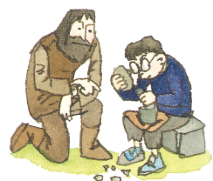
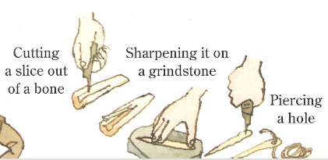
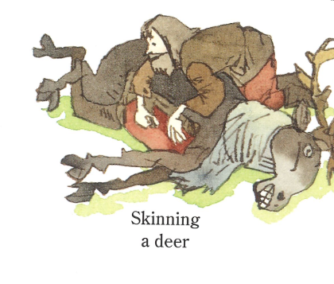
Learning chunk 2 – Initiate - Three verbs
Notes:
We need to remember the tasks on Experience Day 2 – Making fires, striking flint, turning wood, cooking, making tools, sharpening flint, chipping flint, knapping flint, trimming flint, skinning deer, cleaning animal skins, scraping hide, sharpening bone, throwing spears, repairing homes.

Slide 9
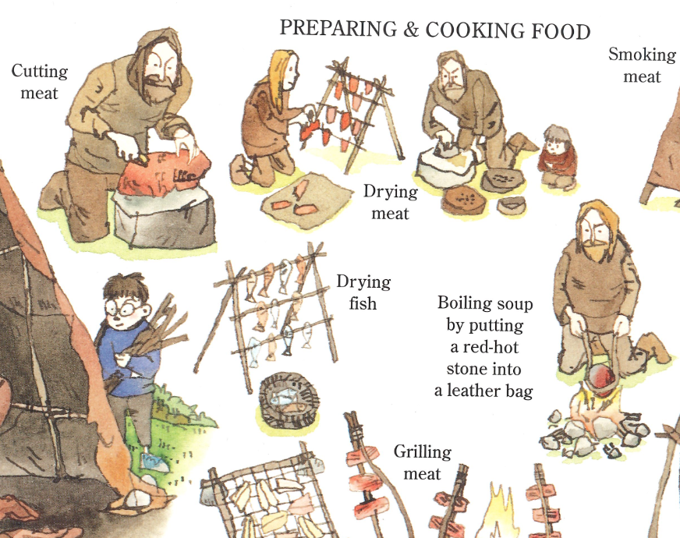
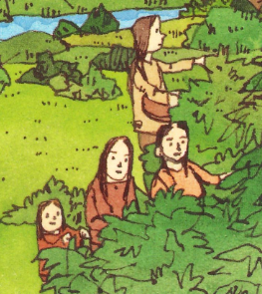
Learning chunk 2 – Initiate - Three verbs

Slide 10
Describe three tasks using powerful ‘ing’ verbs.
Learning chunk 2
What tasks did we learn about?
making fires, striking flint, turning wood, cooking, making tools, sharpening flint, chipping flint, knapping flint, trimming flint, skinning deer, cleaning animal skins, scraping hide, sharpening bone, throwing spears, repairing homes.

Slide 11
What tasks do we remember from the pictures or from Experience Day 2?
Verbs
Skinning
Striking
Making
Sharpening
Cooking
More?
Deer
Flint
Skins
Animal skins
Wood
Homes
bone
Learning chunk 2 – Initiate - Three verbs
Notes:
We need to remember the tasks on Experience Day 2 – Making fires, striking flint, turning wood, cooking, making tools, sharpening flint, chipping flint, knapping flint, trimming flint, skinning deer, cleaning animal skins, scraping hide, sharpening bone, throwing spears, repairing homes.

Slide 12
People busied themselves: striking flint to make flames; skinning deer to make caramel-coloured clothes and shaping bones to make exquisite jewellery.
Learning chunk 2 – Model- Three verbs
Notes:
We need to remember the tasks on Experience Day 2 – Making fires, striking flint, turning wood, cooking, making tools, sharpening flint, chipping flint, knapping flint, trimming flint, skinning deer, cleaning animal skins, scraping hide, sharpening bone, throwing spears, repairing homes.

Slide 13
Describe three tasks using powerful ‘ing’ verbs.
Learning chunk 2 – Enable - Three verbs
Notes:
We need to remember the tasks on Experience Day 2 – Making fires, striking flint, turning wood, cooking, making tools, sharpening flint, chipping flint, knapping flint, trimming flint, skinning deer, cleaning animal skins, scraping hide, sharpening bone, throwing spears, repairing homes.

Slide 14
Give a more detailed description of one of the materials, using a simile.
Learning chunk 3
Noticing words
Thick
Shining flint
Gleaming in the sun
Spears glittering
Rippling in the moonlight
Touching words
Warm fur
Smooth as pebbles
White and smooth
Like a… words
Like a well-cut jewel, gleaming in the sun
Like a stream rippling in the moonlight
Like freshly-poured cream
Learning chunk 3 – Initiate - Simile

Slide 15
Give a more detailed description of one of the materials, using a simile.
Learning chunk 3
thick warm fur like a woolly mammoth’s coat
flint shining like a well-cut jewel gleaming in the sun
spears glittering like a stream rippling in the moonlight
bone necklaces as smooth as pebbles
white and smooth like freshly-poured cream.
Learning chunk 3 – Initiate - Simile

Slide 16
Give a more detailed description of one of the materials, using a simile.
Learning chunk 3
Provided sentence from the book –
Om’s people had none of the materials we have today. Everything was made of wood, stone, animal skins or bone.
Teacher Model –
I wrapped myself in a thick mahogany auroch’s skin, feeling its soft warmth like a rug laid a the feet of the rising sun.
Learning chunk 3 – Model - Simile

Slide 17
Give a more detailed description of one of the materials, using a simile.
Learning chunk 3
Learning chunk 3 – Enable - Simile

