Slide 1
L.I – Can I add amounts of pounds and pence? (B3)
Steps to success
I know to add the pounds (£) first when adding money
When adding pence, I know to exchange it for pounds when over 100p
Challenge: True or false
L.I – Do I know how to order money? (B4)
Steps to success
I can convert money
I can compare amounts of money
Challenge: True or false

Slide 2
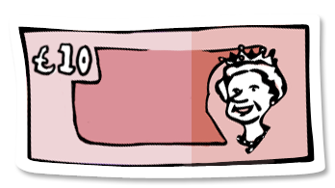
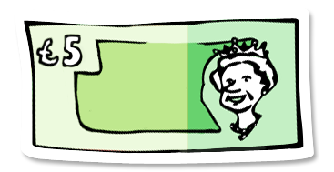
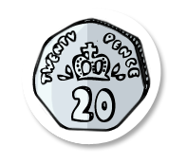
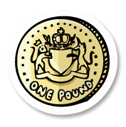
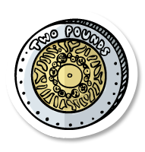
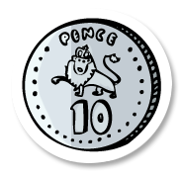
In Focus Task
Who has the most money?

Slide 3
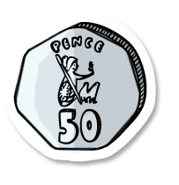
New Learning
5
60
4
50
£10 and 10p
£_____ and _____p + £_____ and _____p
There is £_____ and 110p
110p = £_____ and _____p
Altogether there is £_____ and _____p
9
1
10
10
10
Convert these amounts to pounds.
294p
152p
961p
305p
79p
1514p
£2.94
£1.52
£9.61
£3.05
£0.79
£15.14

Slide 4
New Learning
?
£8 and 25p
First add the pounds, then add the pennies.
Convert if you need to.
>
50p > 33p
<
£4 > £5

Slide 5
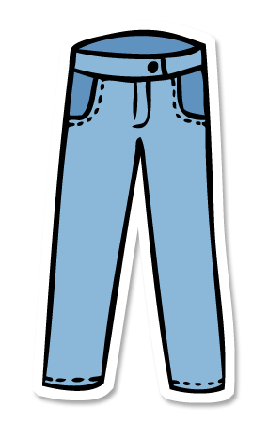
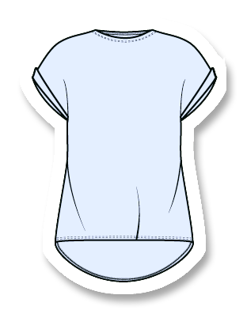
Talk Task
Year 3:
How would you add these two items? What top tips can you remember?
Year 4:
What do look do when you compare amounts of money?
Think aloud.
£7 and 45p
£6 and 90p

Slide 6
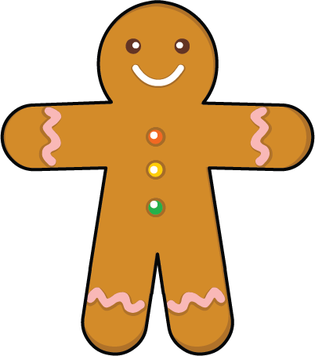
Develop Learning
Henry visits the bakery with £3.
What two items could he buy with £3?
£1 and 40p
£1 and 65p
85p
£1 and 60p
Green
£14.20
Pink
120p
Red
420p
Yellow
£0.14
Put these amounts in ascending order.

Slide 7
Independent Task
Year 3
Year 4
Complete the sheets.
You can write on the sheets.

Slide 8
Lightbulb challenge

