Slide 2
Planning your own story
Today, you are going to plan your own story set in the Stone Age.
You will need to think about how your character travels back in time. Will they fall like the book character?
What will they do and see in the Stone Age? Will they meet any interesting people or children?
How will they get back home?

Slide 3
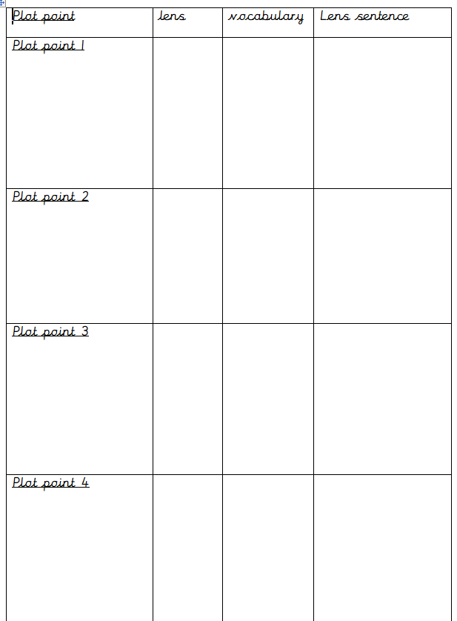
Planning your own story
Going to the Stone Age
In the story we wrote together, we had eight plot points. You will have four to plan.
Think about what will happen in each plot point for your story.
Write some details in the plot point boxes.
Meeting people
Taking part in Stone Age life
Going back home

Slide 4
4-6 lenses for your own story:
Need a success criteria for each plot point. The lenses you choose are your steps to success.
We have used these lenses:
Choose 4-6 lenses. You must choose one from each tier.
Going to the Stone Age
Meeting people
Taking part in Stone Age life
Going back home

Slide 5
Good vocabulary
Gather good vocabulary to go with your lens, just like we do when we chot together.
Challenge:
Can you write a super lens sentence, ready to use tomorrow?
Going to the Stone Age
Meeting people
Taking part in Stone Age life
Going back home

Slide 6
Share and feedback
Share your work
What part do you think will be the most exciting for the reader to read?
What does the class think of the work? Can we make it even better?
Which learning zone were you in today?
Write the letter in the circle on the LI.

