Slide 1
L.I – Can I use scaling when multiplying and dividing?
Steps to success
I can use multiplication facts
- I can answer questions that use the words ‘times as many’
- I can use pictures and models to help me solve scaling problems
Challenge: True or false

Slide 2
In Focus Task
Which sentence best describes the two lines of cubes?
The line of blue cubes is 5 times as long as the line of red cubes.
The line of blue cubes is 4 times as long as the line of red cubes.
The line of blue cubes is 6 times as long as the line of red cubes.
The line of blue cubes is 7 times as long as the line of red cubes.
Notes:
Assessment point for the lesson – ask the pupils to vote for the answer they think is correct.
A – The pupil has found the difference between the two lines.
B – Correct answer
C – The pupil has miscounted the cubes.
D – The pupil has added both lines together.
If answers A, C or D are given, pupils may require extra support through small group or 1:1 discussions. There are support slides covering lessons from the previous learning in Year 3 at the end of these slides.

Slide 3
New Learning
Let’s have a look at some maths language.
What does ‘twice as many’ mean?
Can you write/draw an example?
What does ‘three times as long’ mean?
Can you write/draw an example?

Slide 4
Talk Task
At the zoo there are 3 times as many monkeys as elephants.
Which bar model represents the number of animals at the zoo?
Explain your choice.
Elephants
Monkeys
Elephants
Monkeys
Notes:
Concrete resources – Cubes
Key Questions – Why might someone choose the first bar model? What have they misunderstood?
Misconceptions/ Common Errors – Some pupils may believe the first bar model is correct and have not understood the phrase ‘ times as many’, they have understood the question to mean ‘3 more’ monkeys than elephants.
Further Practice – Practice with towers of cubes, one tower with three red cubes, one tower with nine blue cubes. How many times taller is the blue tower?

Slide 5
I do
New Learning
Look at the towers of cubes and complete the sentences.
The red chain is __________ as long as the blue chain.
The red chain is __________ as long as the green chain.
The green chain is __________ as long as the blue chain.
How can we start?
What do we know?
What can be our next step?
Notes:
Concrete resources – cubes
Key Questions – How many red cubes are there? How many blue cubes are there? How many times bigger than 6 is 12?
Misconceptions/ Common Errors – Pupils may count the cubes and not compare them.
Further Practice – Work with a partner. Pupil A should make a tower of 15 cubes. Pupil B make a tower of 5 cubes. Compare them

Slide 6
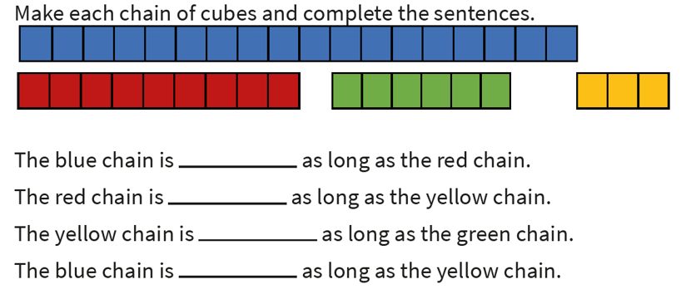
We do
New Learning
Work with a partner. Discuss each step.
18
9
6
3
How can we start?
What do we know?
What can be our next step?

Slide 7
I do
Develop Learning
David has got three teddies.
His friend has 4 times as many.
How many toy teddies does the David’s friend have?
How can we start?
What do we know?
What can be our next step?
Is this strategy helpful?
Notes:
There are various answers for the similarities and differences. Encourage pupils to identify that the methods have the same answer but with the short method, exchanging is shown below the answer space.
Concrete resources – Counters and a place value chart (this can show pupils that these two methods are the same as they are both the same as the counters/ place value chart).
Key Questions – What do you notice about the methods? How are they similar? How are they different? What do you need to remember when using the short method? (Pupils need to remember to exchange and add the exchanged numbers.) Can you represent these using counters/ place value grid? What do you notice?
Misconceptions/ Common Errors – Exchanging can confuse pupils as they need to add the exchanged numbers, despite this being a multiplication question. Pupils may also say 2 x 8 not 20 x 8.

Slide 8
We do
Develop Learning
There are eight birds on the grass.
If there are three times as many in the tree, how many are there in the tree?
How can we start?
What do we know?
What can be our next step?
Is this strategy helpful?
Notes:
There are various answers for the similarities and differences. Encourage pupils to identify that the methods have the same answer but with the short method, exchanging is shown below the answer space.
Concrete resources – Counters and a place value chart (this can show pupils that these two methods are the same as they are both the same as the counters/ place value chart).
Key Questions – What do you notice about the methods? How are they similar? How are they different? What do you need to remember when using the short method? (Pupils need to remember to exchange and add the exchanged numbers.) Can you represent these using counters/ place value grid? What do you notice?
Misconceptions/ Common Errors – Exchanging can confuse pupils as they need to add the exchanged numbers, despite this being a multiplication question. Pupils may also say 2 x 8 not 20 x 8.

Slide 9
I do
Develop Learning
A bag contains coloured balls. There are three times as many red balls as blue. Altogether there are 24 balls.
How many blue balls are there?
Complete the bar model to help you.
Red Balls
6 | 6 | 6
Blue Balls |  | Total = 24
6
How can we start?
What do we know?
What can be our next step?
Is this strategy helpful?
Notes:
Concrete resources – Counters
Key Questions – How does labelling the bar model help us calculate the number of blue balls? Can you use counters to prove your answer is correct?
Misconceptions/ Common Errors – Pupils may show confusion over which operation to use, clarify ‘times as many’ not ‘more than’.

Slide 10
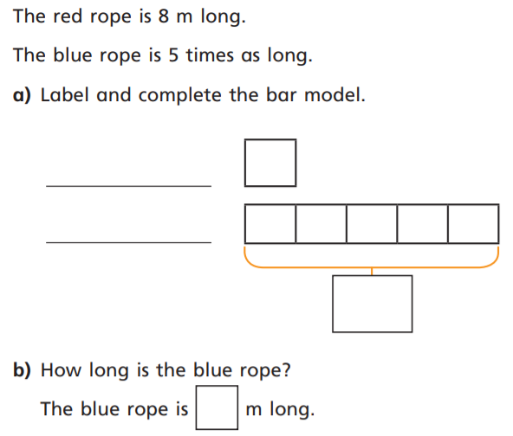
We do
Develop Learning
Work together to solve this scaling problem.
How can we start?
What do we know?
What can be our next step?
Is this strategy helpful?
Notes:
There are various answers for the similarities and differences. Encourage pupils to identify that the methods have the same answer but with the short method, exchanging is shown below the answer space.
Concrete resources – Counters and a place value chart (this can show pupils that these two methods are the same as they are both the same as the counters/ place value chart).
Key Questions – What do you notice about the methods? How are they similar? How are they different? What do you need to remember when using the short method? (Pupils need to remember to exchange and add the exchanged numbers.) Can you represent these using counters/ place value grid? What do you notice?
Misconceptions/ Common Errors – Exchanging can confuse pupils as they need to add the exchanged numbers, despite this being a multiplication question. Pupils may also say 2 x 8 not 20 x 8.

Slide 11
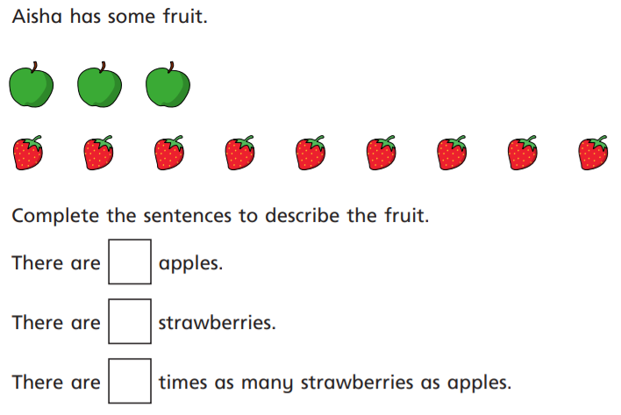
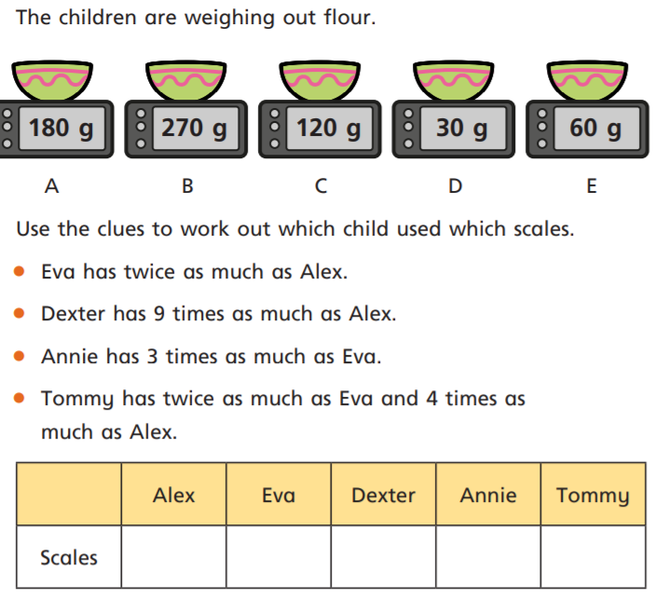
Independent Task
1
3
4
2

Slide 12
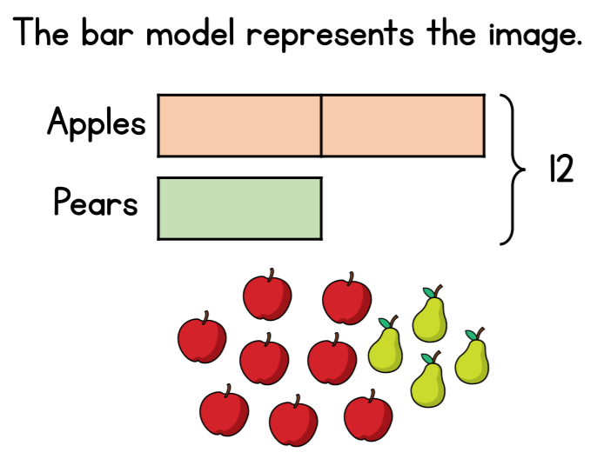
Lightbulb challenge

