Slide 1
L.I – Can I divide a 2-digit number by a 1-digit number?
Steps to success
I know division is sharing into equal groups
- I can partition numbers
- I can use partitioning to divide
Challenge: True or false

Slide 2
In Focus Task
There are 24 children in a PE class. The teacher wants to divide them into groups.
How many children would be in each group if they were divided into:
3 groups
4 groups
8 groups

Slide 3
I do
New Learning
84 sticks shared equally between 4 children. How many sticks each?
84 ÷ 4 =
8 tens ÷ 4 = 2 tens
Notes:
Four tens are one ten each. That’s forty.
Eight tens are two tens each. That’s eighty.
Eight tens divided between four is equal to two tens each.

Slide 4
I do
New Learning
84 sticks shared equally between 4 children. How many sticks each?
84 ÷ 4 =
8 tens ÷ 4 = 2 tens
4 ones ÷ 4 = 1 one
Notes:
Four ones is one each. That’s four.
Four ones divided by four is equal to one one each.

Slide 5
I do
New Learning
84 sticks shared equally between 4 children. How many sticks each?
84 ÷ 4 =
21
8 tens ÷ 4 = 2 tens
4 ones ÷ 4 = 1 one
84 ÷ 4 = 21
Notes:
Eight tens and four ones divided between four is equal to two tens and one one.
Each child gets twenty-one sticks.

Slide 6
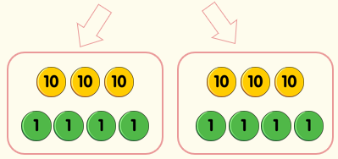
We do
New Learning
Work together to calculate 68 ÷ 2 =
How can we start?
What do we know?
What can be our next step?

Slide 7
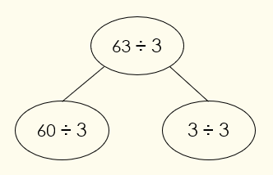
Talk Task
How does this part-whole model show division using partitioning?
Notes:
Concrete resources – Cubes
Key Questions – Why might someone choose the first bar model? What have they misunderstood?
Misconceptions/ Common Errors – Some pupils may believe the first bar model is correct and have not understood the phrase ‘ times as many’, they have understood the question to mean ‘3 more’ monkeys than elephants.
Further Practice – Practice with towers of cubes, one tower with three red cubes, one tower with nine blue cubes. How many times taller is the blue tower?

Slide 8
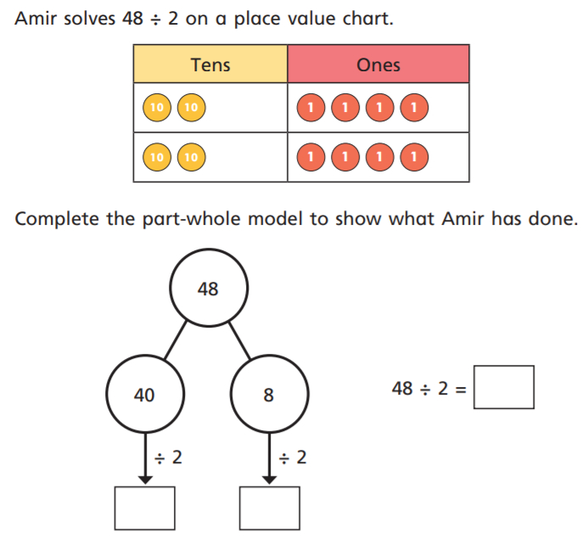
I do
Develop Learning
How can we start?
What do we know?
What can be our next step?
Notes:
Concrete resources – cubes
Key Questions – How many red cubes are there? How many blue cubes are there? How many times bigger than 6 is 12?
Misconceptions/ Common Errors – Pupils may count the cubes and not compare them.
Further Practice – Work with a partner. Pupil A should make a tower of 15 cubes. Pupil B make a tower of 5 cubes. Compare them

Slide 9
We do
Develop Learning
Use partitioning to divide.
84 ÷ 4 =
Work with a partner. Discuss each step.
How can we start?
What do we know?
What can be our next step?

Slide 10
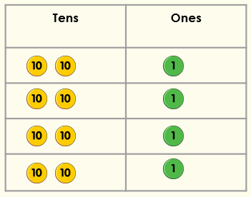
Talk Task
Sophie has used counters to help her divide 84 by 4.
Has she used them correctly?
Notes:
There are various answers for the similarities and differences. Encourage pupils to identify that the methods have the same answer but with the short method, exchanging is shown below the answer space.
Concrete resources – Counters and a place value chart (this can show pupils that these two methods are the same as they are both the same as the counters/ place value chart).
Key Questions – What do you notice about the methods? How are they similar? How are they different? What do you need to remember when using the short method? (Pupils need to remember to exchange and add the exchanged numbers.) Can you represent these using counters/ place value grid? What do you notice?
Misconceptions/ Common Errors – Exchanging can confuse pupils as they need to add the exchanged numbers, despite this being a multiplication question. Pupils may also say 2 x 8 not 20 x 8.

Slide 11
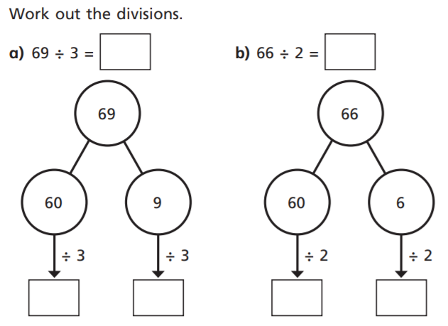
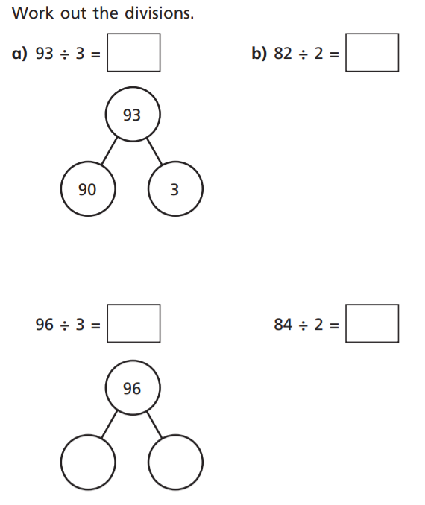
Independent Task
1
2
3

Slide 12
Lightbulb challenge

