Slide 1
Book week

Slide 2
LI: Can I write a letter to an author neatly?
Success Criteria:
I can set my letter out correctly
I can copy my letter using my best handwriting
I can write for a purpose

Slide 3
Class discussion
What is the purpose of this letter?
How do we need to write it so that the author will enjoy reading it?

Slide 4
Class discussion
What is the purpose of this letter?
How do we need to write it so that the author will enjoy reading it?
Writing to author
Trying to impress him
Make him want to read it
Write as neatly as possible

Slide 5
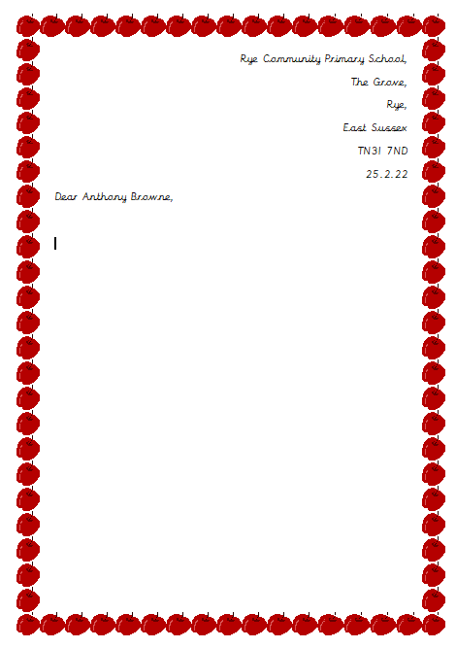

Slide 6
LI: Can I write a letter to an author neatly?
Success Criteria:
I can set my letter out correctly
I can copy my letter using my best handwriting
I can write for a purpose

