Slide 2
Aim
Can I research aspects of daily life and society in ancient Greece.
Steps to success
I can explore how enslavement was central to life in ancient Greece.
I can gather information from secondary sources about aspects of life in ancient Greece.
I can share my research findings with others and pose my own historical questions.

Slide 3
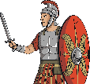
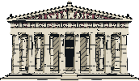
Remember It
Here is a timeline with some key events from the ancient Greek period.
Can you and your partner decide what the missing labels are?
776 BC
650 BC
500 BC
460 BC
338 BC
146 BC
Around this date, the tyrant, Kypselos, takes over Corinth.
Hippocrates ‘Father of Medicine’ is born in Kos.
King Philip II takes control of Greece.
First Olympic Games are held.
Around this date, the Classical period starts.
Greece falls under the Roman Empire.
700 BC
508 BC
472 BC
432 BC
336 BC
Homer writes the ‘Odyssey’ and ‘Iliad’ poems around
this date.
Alexander the Great takes control of Greece.
Male citizens of Athens are allowed to vote.
Greek theatre becomes popular in Athens.
The Parthenon is finished in Athens.
Click here for missing words.
Roman Empire
Alexander the Great
Athens
Father of Medicine
Olympic Games
Homer

Slide 4
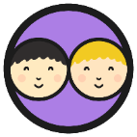
Ancient Greece: Some Key Terms
Do you remember what any of these terms mean in relation to ancient Greece? There are some prompt questions below to help you.
You may have noted down some of these things.
trade
empire
civilisation
The ancient Greeks traded many things including wine, olives, grain, cheese and pottery.
What did they trade?
A civilisation is a human society with well-developed rules and government, often where technology and the arts are considered important.
Empires are formed when a country takes over and rules other countries.
What is meant by the word ‘civilisation’?
What is an empire?
King Philip II and Alexander the Great played an important part in building an empire in ancient Greek times.
Who played an important role in building the empire in ancient Greek times?
They traded with other city states and from around 800 BC they started to trade with other countries.
Who did they trade with?
People might think about democracy, architecture, theatre and art, for example, when they think about ancient Greek civilisation.
What things do people think about when ancient Greek civilisation is mentioned?
Some people wanted to make a powerful empire to make themselves richer and more powerful. They also wanted to spread Greek civilisation.
Why did some people want there to be an empire?
They started off trading by exchanging items but from around 600 BC onwards, they started to use coins.
How did they trade?

Slide 5
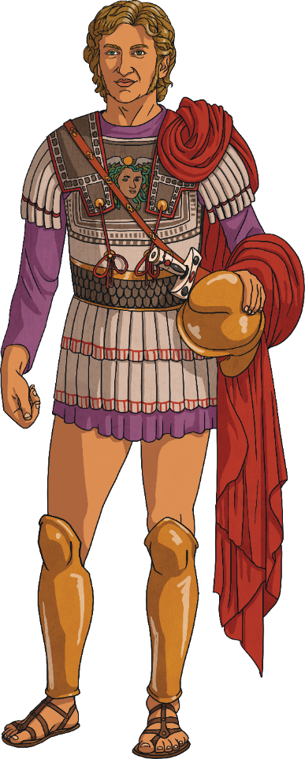
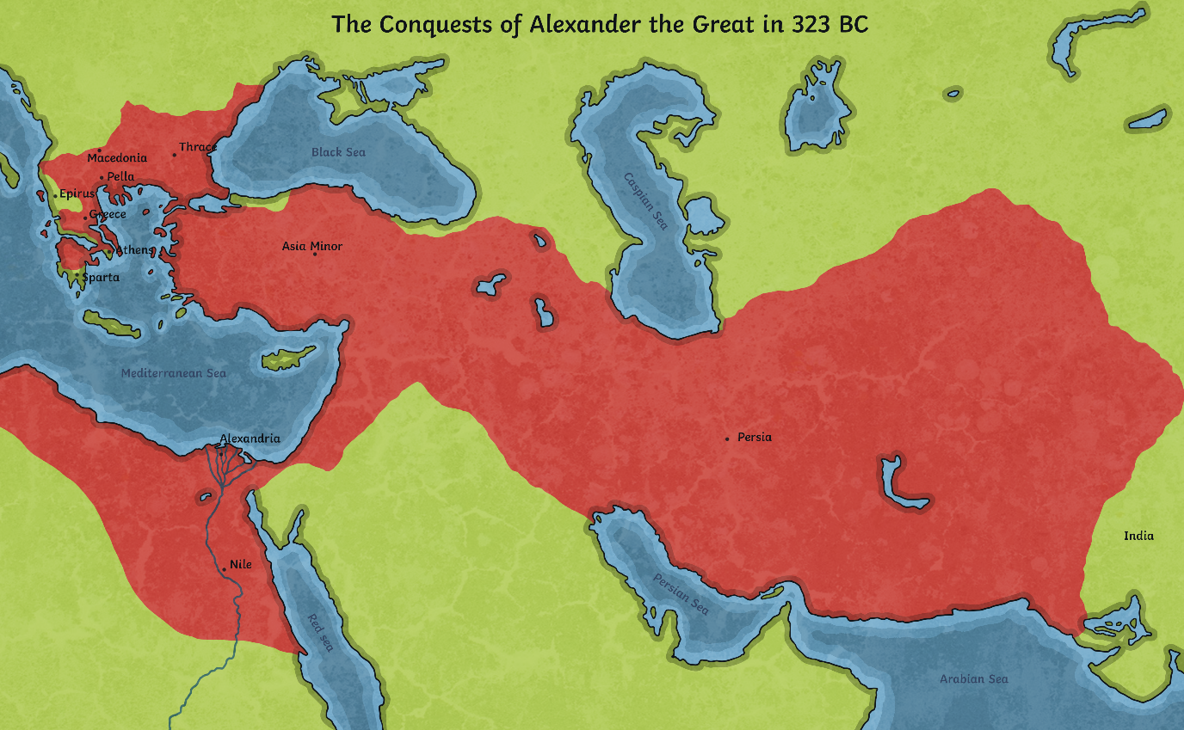
X
Alexander the Great’s Empire
We know that independent city states existed for most of the time in ancient Greece.
However, near the end of the ancient Greek period, King Philip II of Macedonia ruled over all of ancient Greece. Later, his son - Alexander the Great - took over the empire along with other lands that he conquered.
This was Alexander the Great’s Empire.
Click on the map to zoom.
Notes:
Additional Subject Knowledge Notes: King Philip II of Macedonia was killed by one of his own bodyguards in 336 BC and Alexander the Great took over at the age of just 20 years old. He came to power at a time when the city states his father had conquered were revolting.

Slide 6
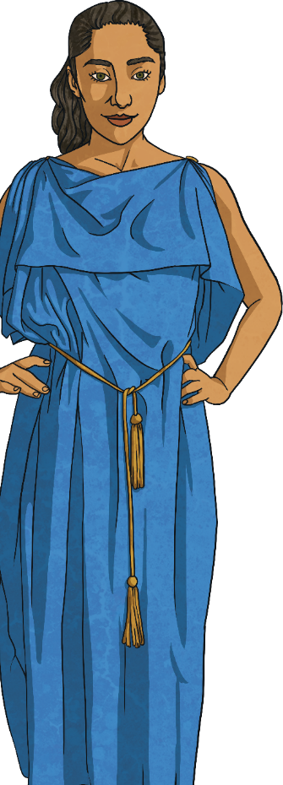
Who Lived in Ancient Greece?
Alexander the Great’s empire grew towards the end of the ancient Greek period.
For the majority of this period, ancient Greece did not have one ruler. Instead, ancient Greece was made up of city states.
These city states usually only joined together to fight a common enemy.
Not all ancient Greeks lived in city centres. Many lived in villages or out in the countryside where they farmed the land.

Slide 7
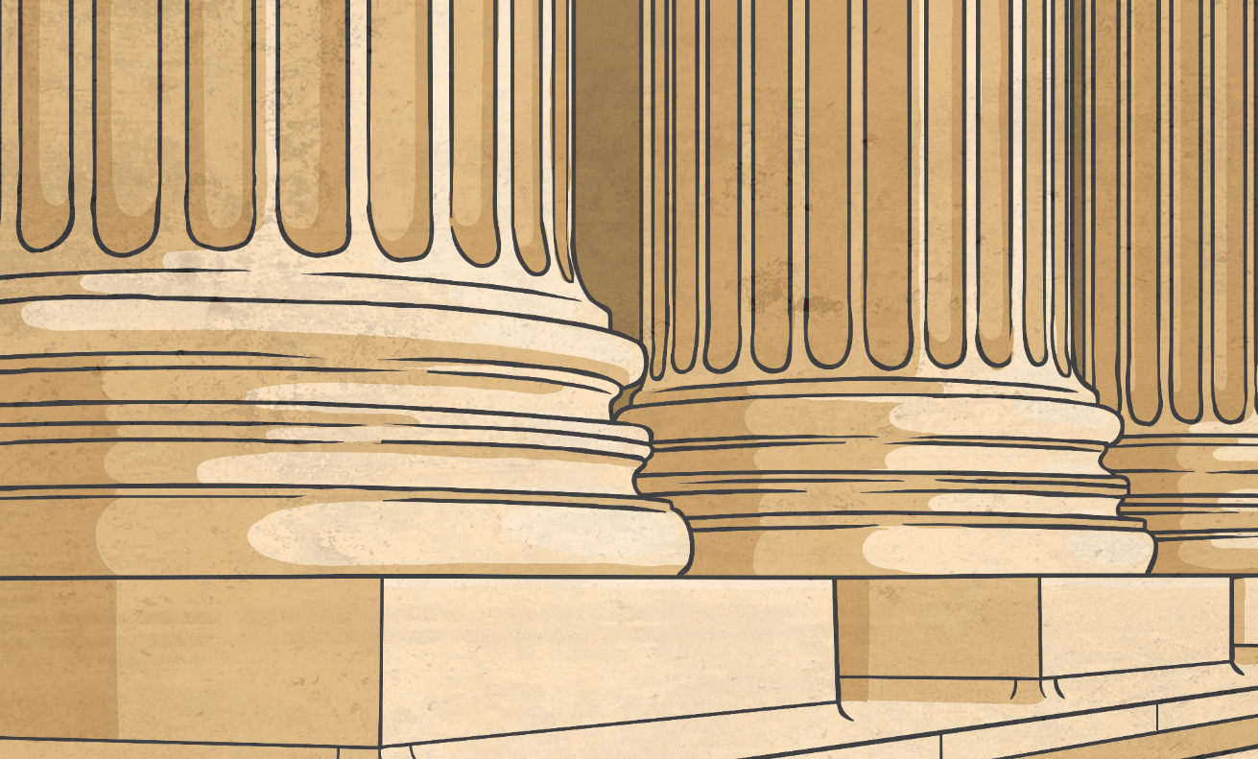
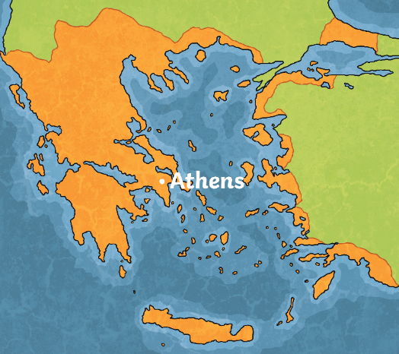
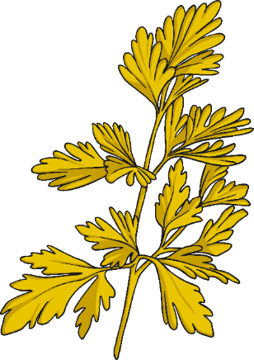
Who Lived in Ancient Greece?
Historians cannot know for sure but it is estimated that in the city state of Athens during ancient Greek times, one in four people were enslaved.
The rest of the Greek population would have been made up of free men, women and children, as well as people from other countries who were living in Greece.

Slide 8
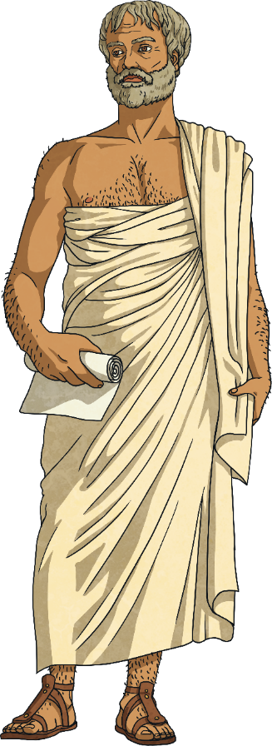
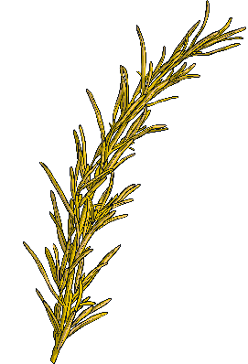
Enslaved People in Ancient Greece
To ‘enslave’ means to treat someone else as if they are property.
By treating people like property, this meant enslaved people were bought and sold and not treated like human beings.
The famous ancient Greek philosopher, Aristotle (tutor to Alexander the Great), defined an enslaved person as ‘a piece of property that breathes’.

Slide 9
Enslaved People in Ancient Greece
How do you think a person came to be enslaved in ancient Greek times?
Talk to your partner about your ideas.
There were four main ways in which people became enslaved.
Can you guess which of these ways are true? Click on the correct answers to see if you were right.
They were born to parents who were already enslaved. The baby would automatically be treated like the property of the owners of the enslaved parents.
They were the eldest child in their family.
They were captured as prisoners of war when the ancient Greeks were fighting with other city states and other countries.
They were captured and sold by people who made a living by selling people as property.
They failed an entrance test to the army.
They got into debt and had to give themselves over as enslaved people as they could not afford to pay the money they owed.

Slide 10
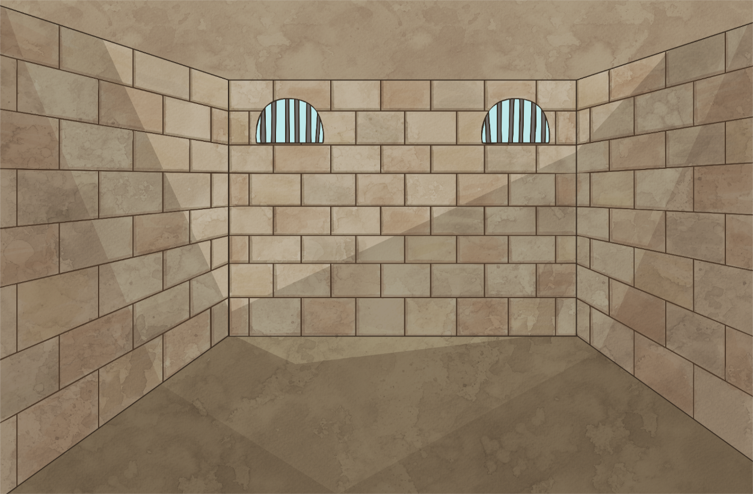
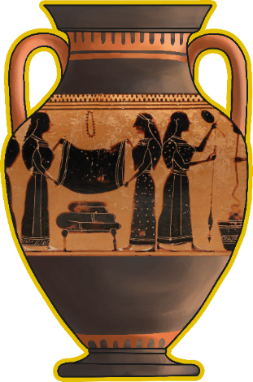
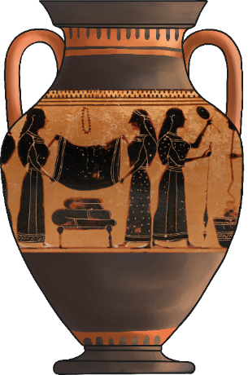
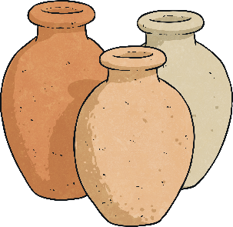
Enslaved People in Ancient Greece
These images are from pottery from ancient Greek times. Talk to your partner about what you can see in the images? What are the people doing?
The women are making woollen cloth. We don’t know if they are enslaved women or not but historians tell us that this was one of the many jobs that enslaved women would do.

Slide 11
Enslaved People in Ancient Greece
Some enslaved people would work farming the land.
Some would do work to earn money for the people who ‘owned’ them.
Any product produced during ancient Greek times was most likely to have been made by an enslaved person.

Slide 12
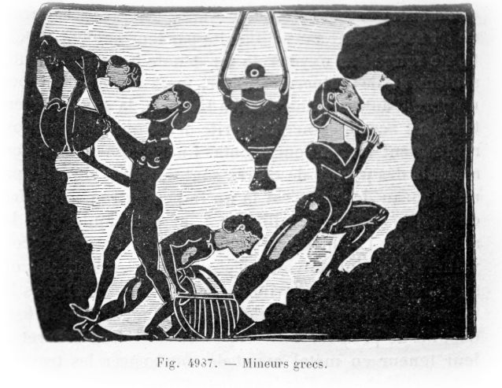
Enslaved People in Ancient Greece
Some enslaved people worked for the state and either fought in the army or worked in jobs that were crucial to keep the city running smoothly.
One of the most dangerous jobs was to work in the silver mines. The temperature was unbearably hot underground and people were at risk from
from the poisonous chemicals in the air down in the mines.
The ancient Greeks never questioned humans being owned and treated as property as this was how they had always known life to be.
How do people today feel about human beings being owned and treated as property?
X
Mineurs grecs 2 by Unknown author is licensed under CC BY 2.0

Slide 13
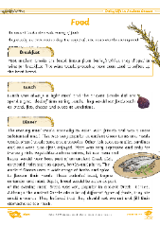
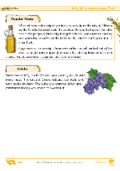
What Was Daily Life Like in Ancient Greece?
Each person in your group will be researching a different aspect of daily life in ancient Greece.
Collect information from secondary sources such as the Daily Life in Ancient Greece Factsheets.
A secondary source is information that was created later by someone who did not experience the time or event first-hand.
Books and websites are other examples of secondary sources.
Do you know what we call a source of historical information that was produced during the time you are learning about?
We call sources of historical information that were created by someone experiencing the time in history 'first-hand' - primary sources. Examples include written sources from the time or artefacts.

Slide 14
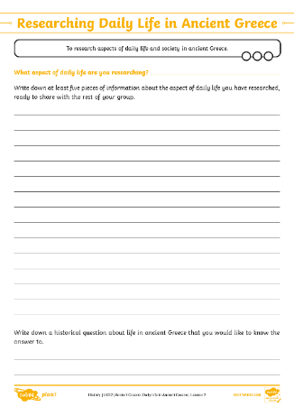
What Was Daily Life Like in Ancient Greece?
These are the topics you will be researching about life in ancient Greece:
food
homes
children
clothing
men
women
Find out as much as you can about the aspect you have been given and be ready to feed back some facts to the rest of your group.
You should prepare at least five facts to share.

