Slide 1
L.I – Can I identify how many equal parts a whole has been divided into?
Steps to success
Identify the whole
Identify one part
Identify how many parts make the whole
Challenge: True or False

Slide 2
New Learning
How many equal parts can the whole shape be divided into?
Notes:
What is the same? What is different?
If _____ is the whole, then _____ is part of the whole.
The whole has been divided into _____ equal/unequal parts.

Slide 3
New Learning
Notes:
What is the same? What is different?
If _____ is the whole, then _____ is part of the whole.
The whole has been divided into _____ equal/unequal parts.

Slide 4
How many equal parts can the whole shape be divided into?
Notes:
What is the same? What is different?
If _____ is the whole, then _____ is part of the whole.
The whole has been divided into _____ equal/unequal parts.

Slide 5
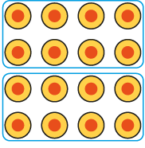
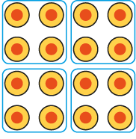
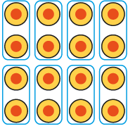
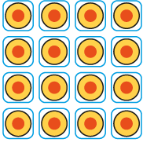
Talk Task
Notes:
What is the same? What is different?
If _____ is the whole, then _____ is part of the whole.
The whole has been divided into _____ equal/unequal parts.

Slide 6
Develop learning
15 people can be shared equally into smaller groups.
Notes:
If fifteen children is the whole, then one team of three children is part of the whole.
The whole has been divided into five equal parts.

Slide 7
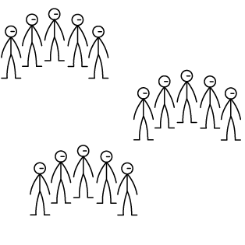
15 people can be shared equally into smaller groups.
Notes:
If fifteen children is the whole, then one team of five children is part of the whole.
The whole has been divided into three equal parts.

Slide 8
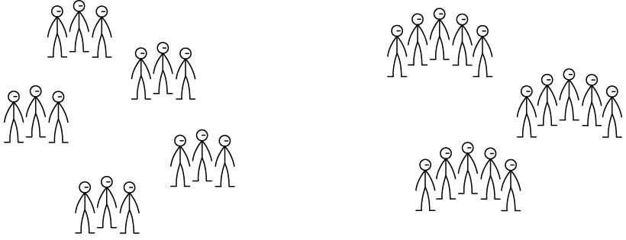
Develop learning
What is the same and what is different between the two groups?
Notes:
What is the same? What is different?

Slide 9
Independent task
Divide this shape into 2, 4, 5 and 8 equal parts.
Notes:
You might find more than one way for each.

Slide 10
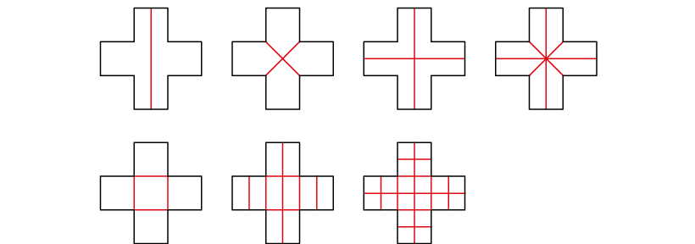
Independent task
Answers
Some ways to divide the shape into 2, 4, 5 and 8 equal parts.
Notes:
You might find more than one way for each.

Slide 11
What other equal parts can you divide it into?
Notes:
What other number of equal parts can you divide it into? (Some possible answers are shown.)
You might find more than one way for each.

Slide 12
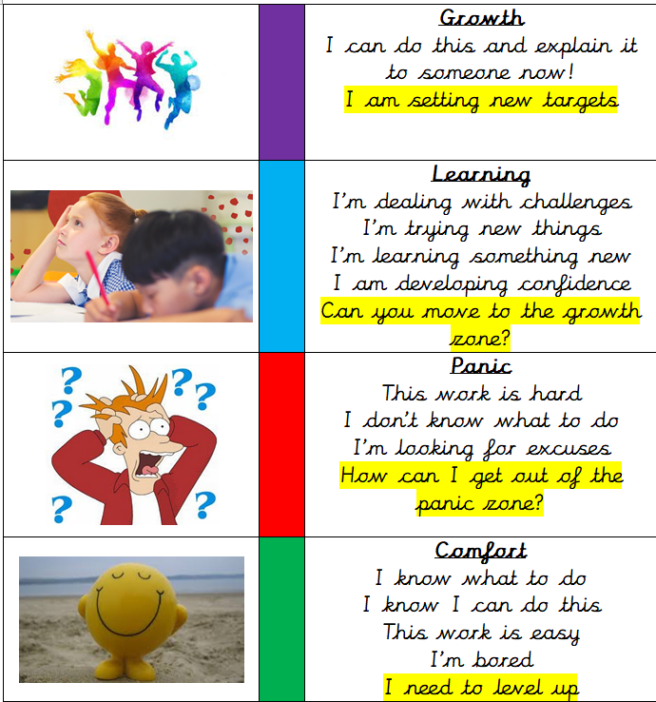
Write a reflection sentence.
Reflection:
I felt I was successful using…
I found it difficult using…
Today, it really helped me to use…
I really understood ____ this lesson…
I struggled to understand ___ this lesson…
Make sure there is a ‘zone of learning’ on the LI.
(Growth/Learning/Panic/
Comfort)

Slide 13
Write a reflection sentence. Here are some examples.
Reflection
I felt I was successful using …..
I found it difficult using ….
An effective strategy I used today was ….
Today, it really helped me to use ….
Perhaps it would have been easier if I had used/asked ….
I asked for help with question 2 because …
A top tip for (adding fractions) is …..

