Slide 1
L.I Y3– Can I say how many part make the whole?
LI Y4 – Can I place mixed numbers on a numberline?
Steps to success
How many equal parts make up the whole?
Write parts as a fraction
Estimate by working out how many intervals a line is divided into to.
Challenge: True or False

Slide 2
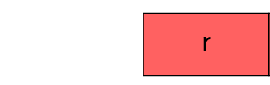
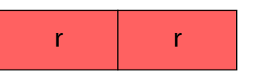

New learning
The red rod is of the whole. What is the whole?

Slide 3
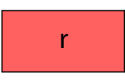
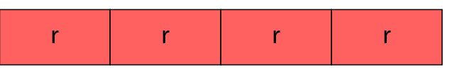

New learning
The red rod is of the whole. What is the whole?

Slide 4



New learning
The red rod is of the whole. What is the whole?

Slide 5
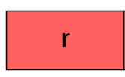
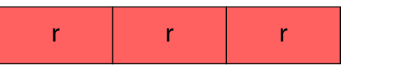

New learning
The red rod is of the whole. What is the whole?

Slide 6
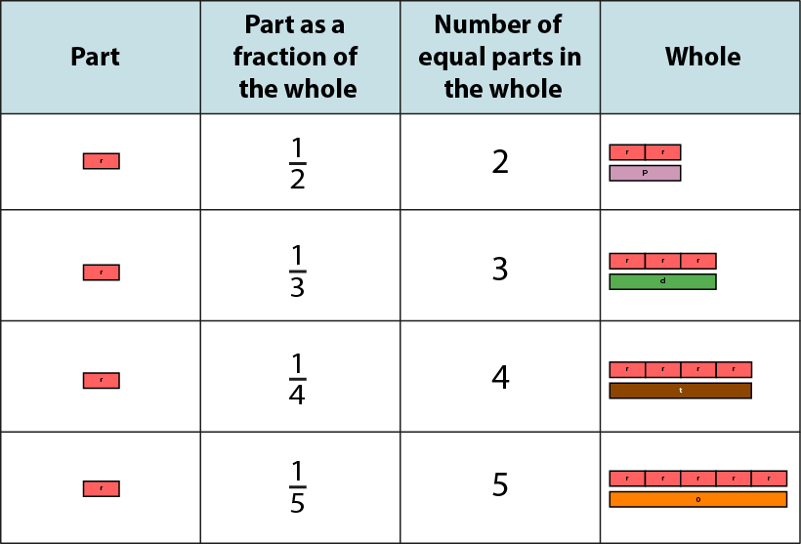

Develop learning
Notes:
If one-half is a part, then the whole is twice as much. Take two parts and put them together to make one whole.
If one-third is a part, then the whole is three times as much. Take three parts and put them together to make one whole.
And so on…

Slide 7
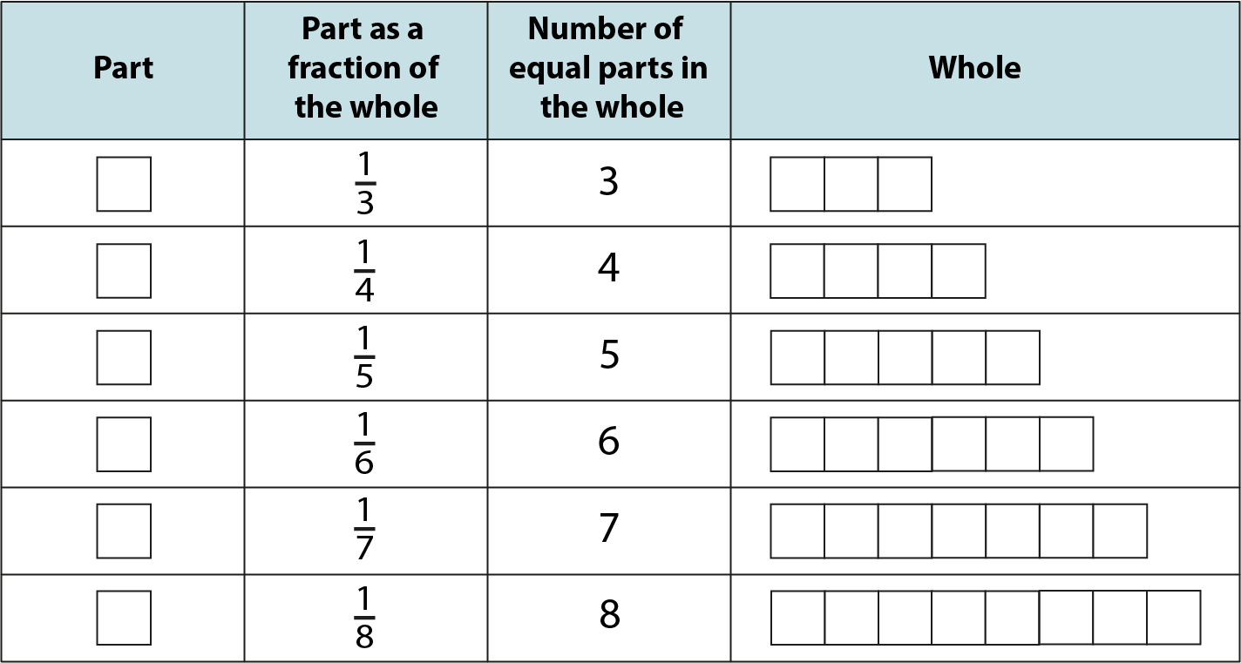
Y3 independent work
Notes:
If one- _____ is a part, then the whole is _____ times as much.
Take _____ parts and put them together to make one whole.

Slide 8


Y3 independent work Y4 stay on carpet
Estimate where the numbers should go on the numberline.
‘Each interval on the line is divided into _________ equal parts. This allows us to count in _______.
Notes:
Estimate the position of the following numbers on this number line.

Slide 9
Estimate where the numbers should go on the numberline.
‘Each interval on the line is divided into _________ equal parts. This allows us to count in _______.
Notes:
Estimate the position of these numbers on this number line.

Slide 10
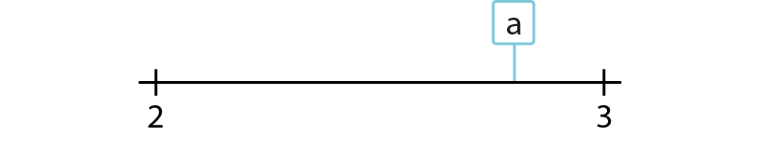
Develop learning
Which of these numbers is represented by ‘a’?
✓

Slide 11
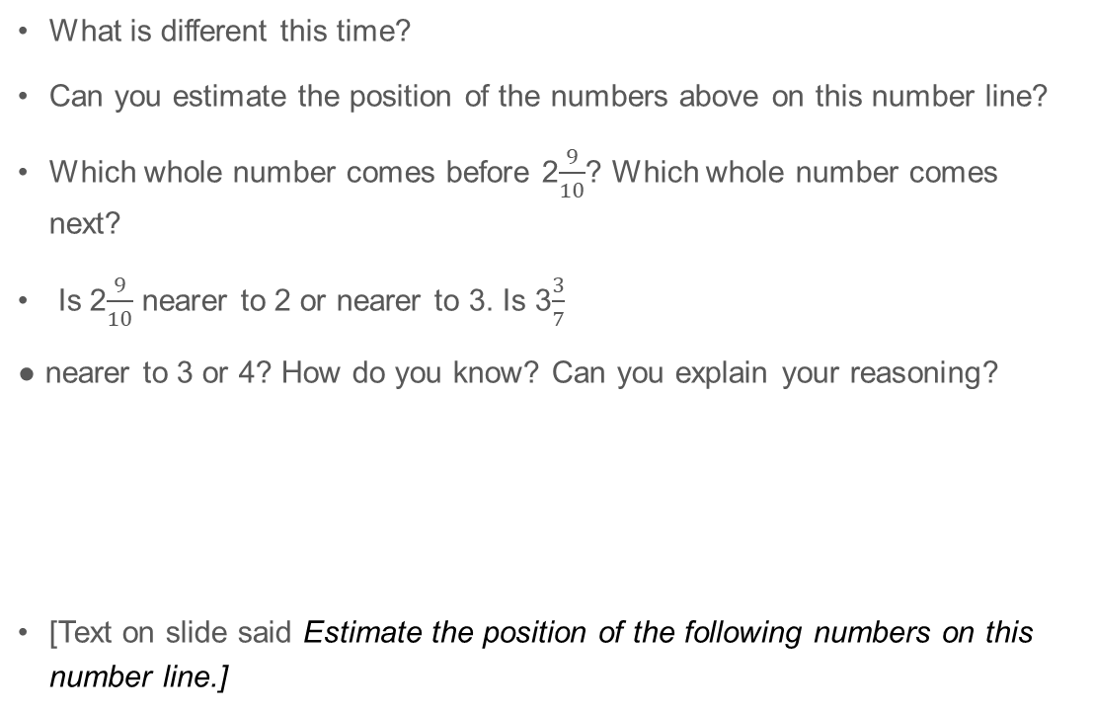
Y4 Independent learning
What is different this time?
Can you estimate the position of the numbers above on this number line?
Which whole number comes before 2$\frac{9}{10}$? Which whole number comes next?
Is 2$\frac{9}{10}$ nearer to 2 or nearer to 3. Is 3$\frac{3}{7}$
nearer to 3 or 4? How do you know? Can you explain your reasoning?
[Text on slide said Estimate the position of the following numbers on this number line.]

Slide 12
Y4 Independent learning
Can you estimate the position of the following numbers on the number line?
What is the previous whole number? The next whole number?
Which of these whole numbers is the arrow nearest to?
Lengths of card and paper clips can be used in a similar way, by specifying a whole number for each end and asking children to slide the paperclip to estimate the position of a mixed number between them.

Slide 13
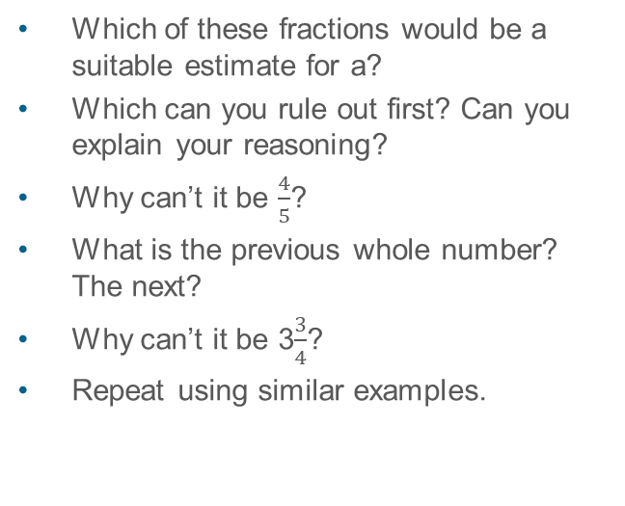
Y4 Lightbulb challenge
Which of these fractions would be a suitable estimate for a?
Which can you rule out first? Can you explain your reasoning?
Why can’t it be $\frac{4}{5}$?
What is the previous whole number? The next?
Why can’t it be 3$\frac{3}{4}$?
Repeat using similar examples.
✓

Slide 14
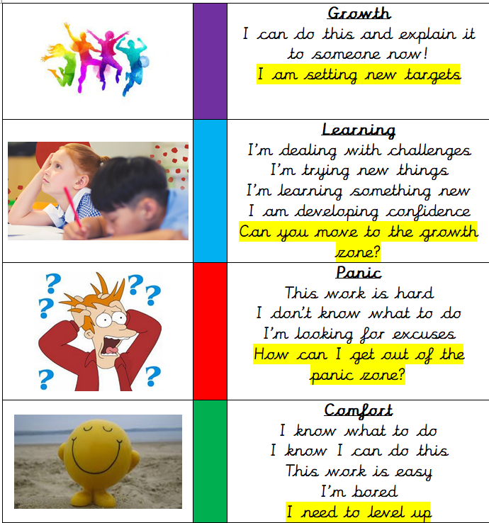
Write a reflection sentence.
Reflection:
I felt I was successful using…
I found it difficult using…
Today, it really helped me to use…
I really understood ____ this lesson…
I struggled to understand ___ this lesson…
Make sure there is a ‘zone of learning’ on the LI.
(Growth/Learning/Panic/
Comfort)

Slide 15
Write a reflection sentence. Here are some examples.
Reflection
I felt I was successful using …..
I found it difficult using ….
An effective strategy I used today was ….
Today, it really helped me to use ….
Perhaps it would have been easier if I had used/asked ….
I asked for help with question 2 because …
A top tip for (adding fractions) is …..

