Slide 1
Y5 LI:I can compare and order fractions that are less than 1.
Y6 (Recap)
Number: Fractions
Lesson 5
Spr2

Slide 2
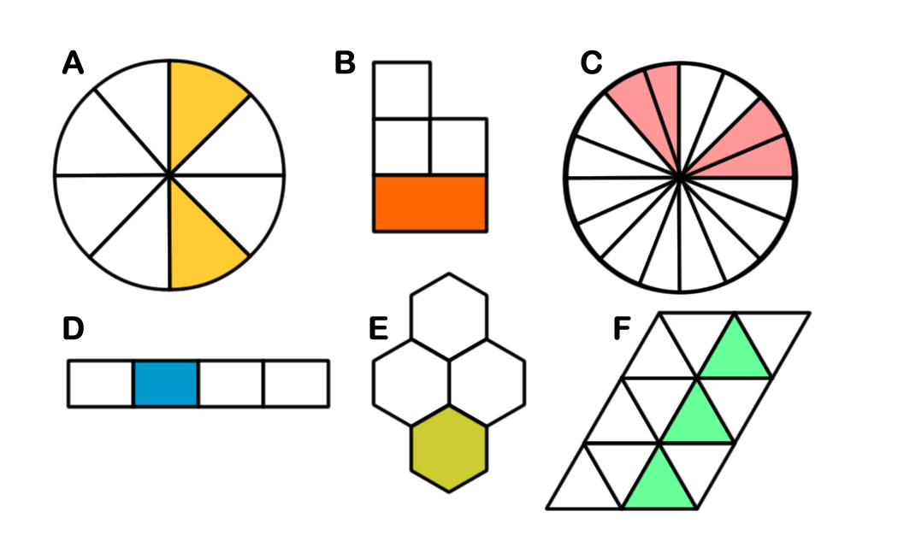
In focus Task:
Success Criteria: I can compare and order fractions less than 1 I can use equivalent fractions to help me I can use bar models to show what I know
Which one is different?

Slide 3
Starter:
Success Criteria: I can compare and order fractions less than 1 I can use equivalent fractions to help me I can use bar models to show what I know
Which one is different?
Shape B is the different. All the other shapes show shaded parts that are equivalent to ¼. However, Shape B’s shaded part is the same as 2/5 because the larger section equals 2/5.

Slide 4
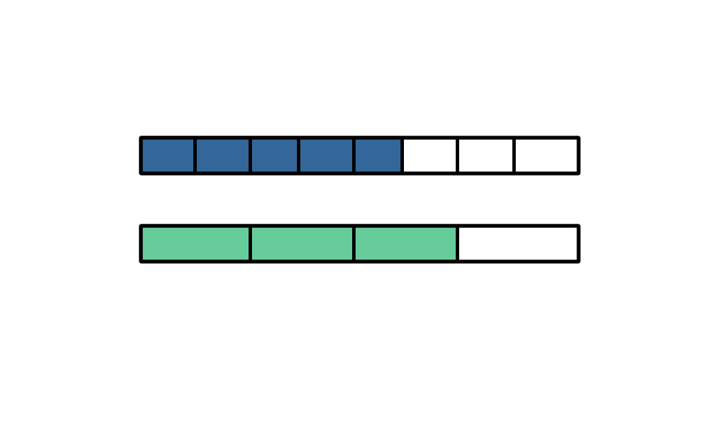
Talking time:
5 .
8_
3 .
4_
Use bar models to compare with .

Slide 5
Talking time:
5 .
8_
3 .
4_
Use bar models to compare with .
5
8
<
3
4

Slide 6
Talking time:
4 .
6_
2 .
3_
Sketch bar models to compare with .

Slide 7
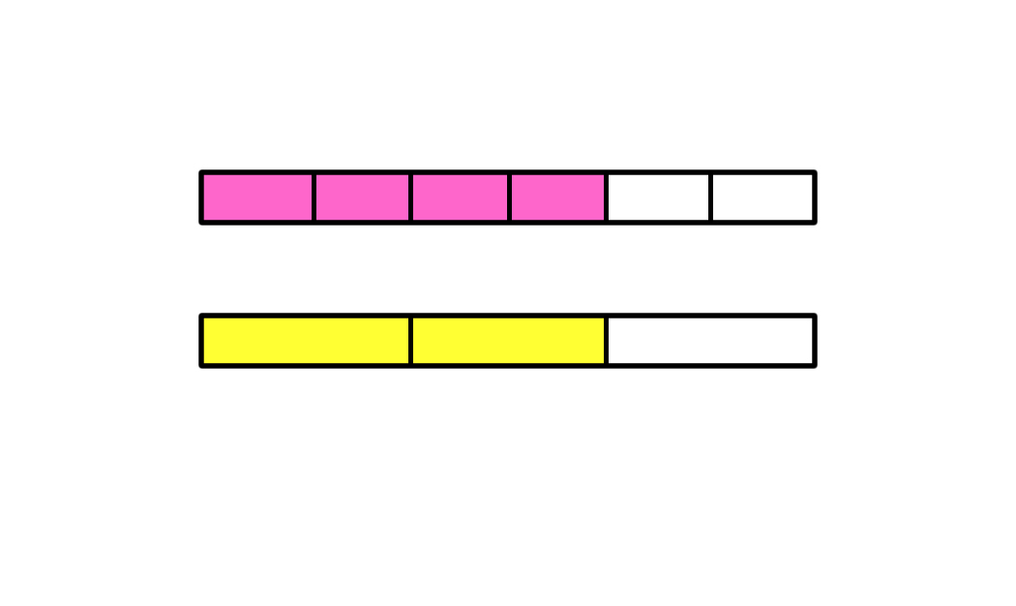
Talking time:
4 .
6_
2 .
3_
Sketch bar models to compare with .
4
6
=
2
3

Slide 8
Talking time:
10 .
12_
3 .
4_
Sketch bar models to compare with .

Slide 9
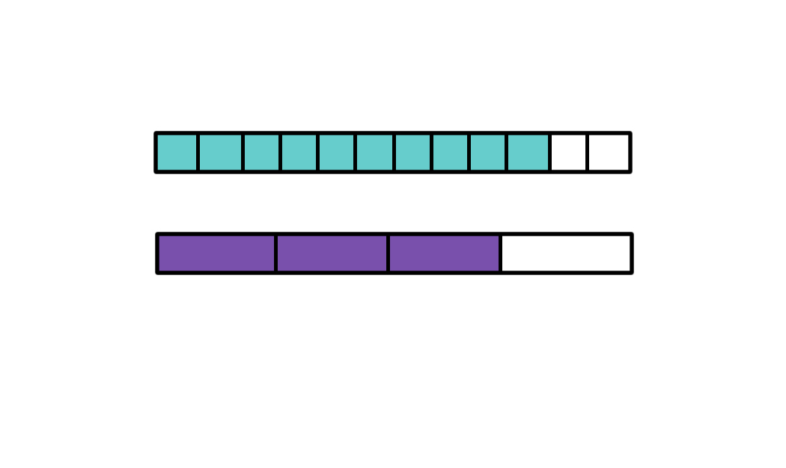
Talking time:
10 .
12_
3 .
4_
Sketch bar models to compare with .
10
12
>
3
4

Slide 10
Activity 1:
Sketch bar models to compare each pair of fractions.

Slide 11
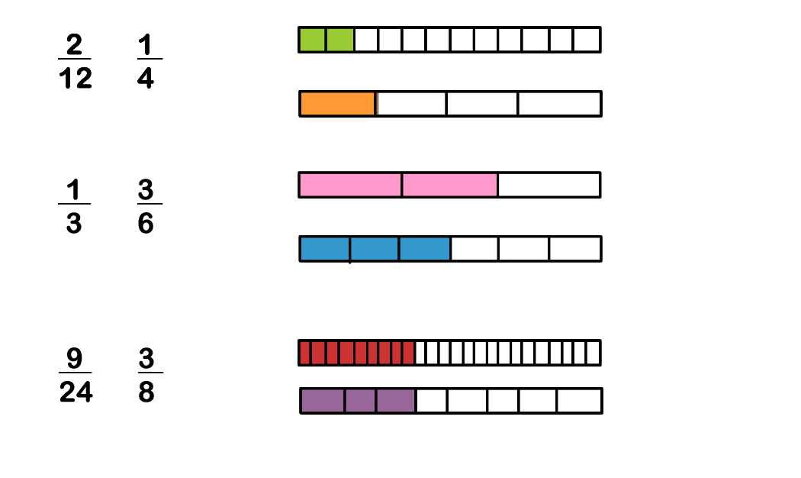
Activity 1:
Sketch bar models to compare each pair of fractions.
<
>
=

Slide 12
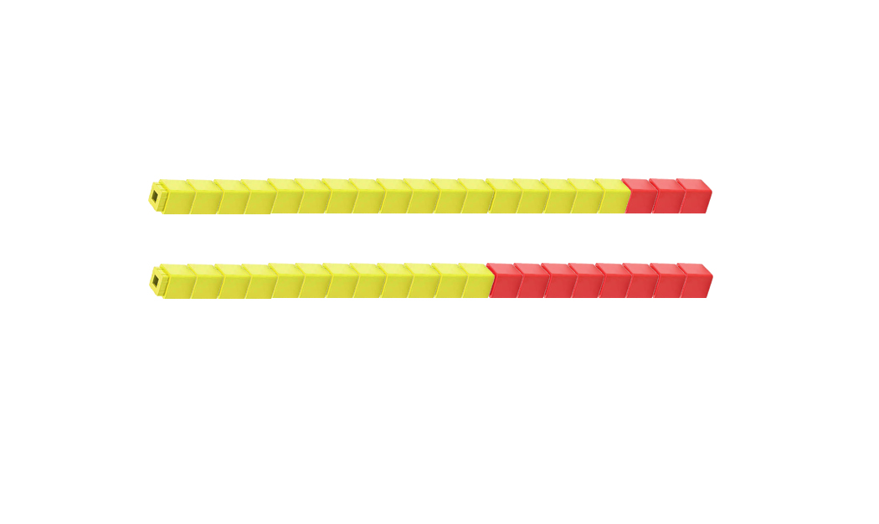
Talking time:
17
20_
3 .
5_
Use cubes to compare with .

Slide 13
Talking time:
17
20_
3 .
5_
Use cubes to compare with .
>
17
20
3
5

Slide 14
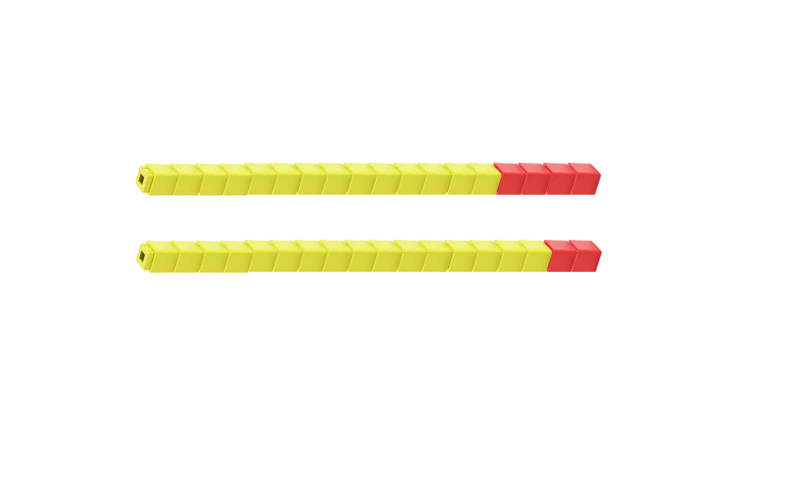
Talking time:
14 .
18_
8 .
9_
Use cubes to compare with .

Slide 15
Talking time:
14 .
18_
8 .
9_
Use cubes to compare with .
<
14
18
8
9

Slide 16
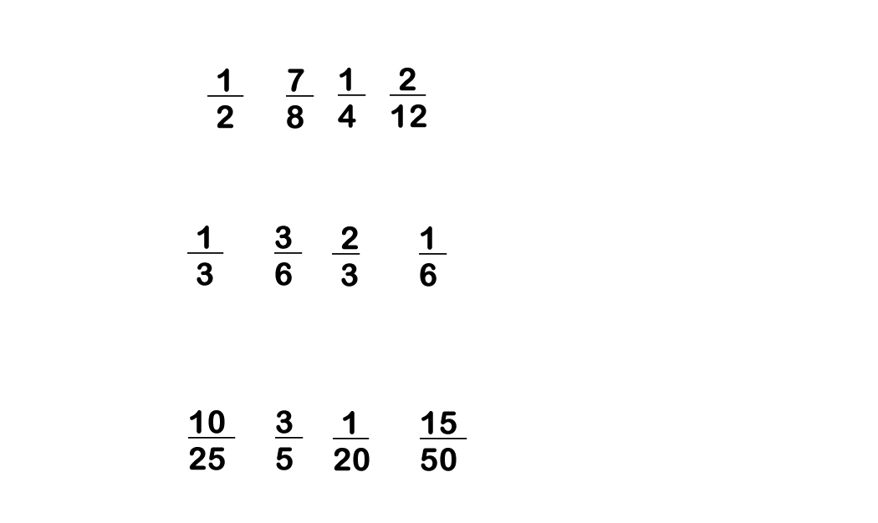
Activity 2:
Put each group of fractions in order, from smallest to largest.

Slide 17
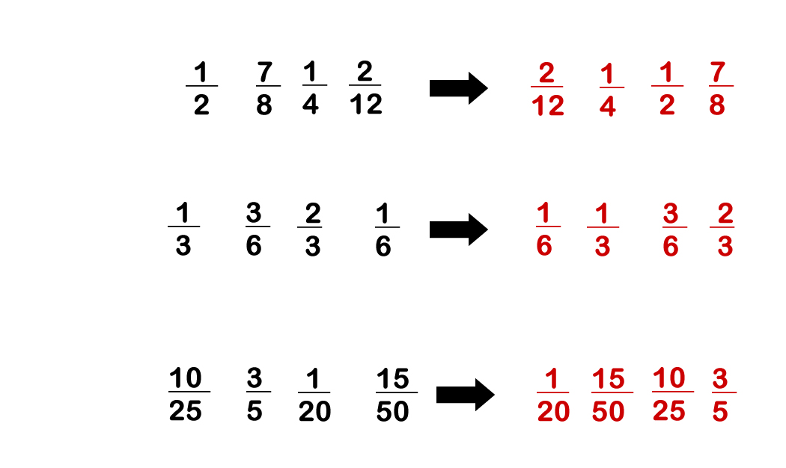
Activity 2:
Put each group of fractions in order, from smallest to largest.

Slide 18
Activity 3:
Kiera wants to compare 3/6 and 3/7.
She says,
Explain how Kiera knows this.
I don’t need to convert these fractions to compare them.
I can see which is the larger fraction already!

Slide 19
Activity 3:
Kiera wants to compare 3/6 and 3/7.
She says,
Explain how Kiera knows this.
Both fractions have the same numerator, so we know that they both have three parts selected.
But they have different denominators, so the size of the three parts are different. The fraction with the larger denominator (3/7) has smaller part because it has been split into seven, not six. So, three of those parts are less than three parts of a whole that is split into six. 3/6 is more then 3/7.
I don’t need to convert these fractions to compare them.
I can see which is the larger fraction already!

Slide 20
Success Criteria: I can compare and order fractions less than 1 I can use equivalent fractions to help me I can use bar models to show what I know
Lightbulb Challenge:
True or False?
If a fraction has a larger denominator, it must be a
larger fraction.
b) >
If two fractions have the same numerators, the one
the smallest denominator is larger.
<
If two fractions have the same denominators, the one with the smallest numerator is larger.
4
10
2
5
3
9
2
3

Slide 21
Light bulb challenge
Success Criteria: I can compare and order fractions less than 1 I can use equivalent fractions to help me I can use bar models to show what I know
True or False?
If a fraction has a larger denominator, it must be a
larger fraction. FALSE
b) > FALSE
If two fractions have the same numerators, the one
the smallest denominator is larger. TRUE
< TRUE
If two fractions have the same denominators, the one with the smallest numerator is larger. FALSE
4
10
2
5
3
9
2
3

